Slide 1
Investigating the fluency-affect relationship in judgements of (in)coherent risk
What mechanisms are involved in intuitive judgement of risk?
David Gamblin
Dr Adrian Banks

Slide 2
Processing fluency
Visual ease
Contrast
Linguistic
Semantic priming
Contour priming
Prototypicality
Embodied cognition
Retrieval ease
Coherence
Truth
Liking
Confidence
Familiarity
Frequency
Reliability
Value
Fame
Intelligence
(Alter & Oppenheimer, 2009)

Slide 3
Processing fluency
(e.g. McGlone & Tofighbakhsh , 2000)
Visual ease
Contrast
Linguistic
Semantic priming
Contour priming
Prototypicality
Embodied cognition
Retrieval ease
Coherence
Truth
Liking
Confidence
Familiarity
Frequency
Reliability
Value
Fame
Intelligence
(Alter & Oppenheimer, 2009)

Slide 4
Processing fluency
(e.g. Reber, Winkielman, & Schwarz, 1998)
Visual ease
Contrast
Linguistic
Semantic priming
Contour priming
Prototypicality
Embodied cognition
Retrieval ease
Coherence
Truth
Liking
Confidence
Familiarity
Frequency
Reliability
Value
Fame
Intelligence
(Alter & Oppenheimer, 2009)

Slide 5
Processing fluency
(e.g. Borges, Goldstein, Ortmann, & Gigerenzer, 1999)
Visual ease
Contrast
Linguistic
Semantic priming
Contour priming
Prototypicality
Embodied cognition
Retrieval ease
Coherence
Truth
Liking
Confidence
Familiarity
Frequency
Reliability
Value
Fame
Intelligence
(Alter & Oppenheimer, 2009)

Slide 6
Processing fluency
Visual ease
Contrast
Linguistic
Semantic priming
Contour priming
Prototypicality
Embodied cognition
Retrieval ease
Coherence
Truth
Liking
Confidence
Familiarity
Frequency
Reliability
Value
Fame
Intelligence
Affect
(Alter & Oppenheimer, 2009)

Slide 7
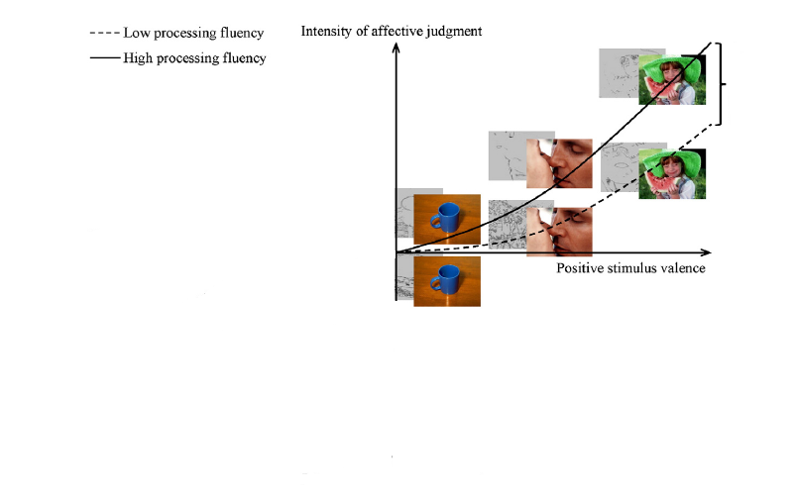
The role of affect
How is it evoked?
Affect
Valence
Hedonic marking hypothesis
Winkielman et al (2003)
Fluency is hedonically marked

Slide 8
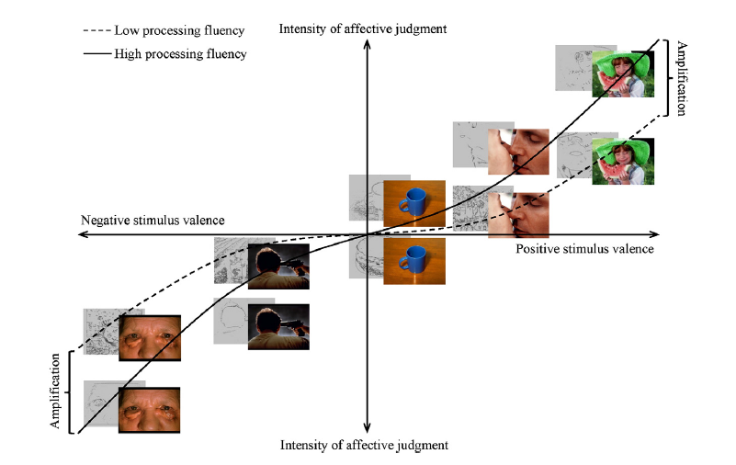
The role of affect
How is it evoked?
Affect
-ve stimulus valence
+ve stimulus valence
Fluency Amplification Model
Albrecht & Carbon (2014)
Fluency amplifies affect
Affect

Slide 9
The role of affect
Is it used in judgement?
Fluency Affect Intuition Model
Coherence
Fluency
Affect
Judgement
(Topolinski, 2011)
Reattribution studies
Fluency evoked affect reattributed to another source (e.g. music)
Participants unable to intuitively distinguish coherent and incoherent trials
(Topolinski & Strack, 2009)

Slide 10
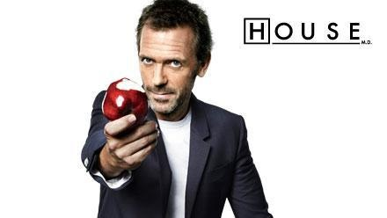
Coherence
The feeling when an item fits a pattern
Processed with increased fluency through partial activation of associates
Coherent
SALT
DEEP
Incoherent
DREAM
BOOK
FOAM
BALL
(RAT task: Mednick, 1962)

Slide 11
Current work
“A premium independent leisure centre in town offering state of the art facilities, including 25m swimming pool, fitness centre, squash courts, and individual suites for classes and courses.”
Coherent
Item 1
Item 2
Incoherent
Item 1
Item 3
Item 3
Item 2
Government promotes activities that lead to a healthy, active lifestyle
Strength
Increase in popularity of free sports such as running and cycling
Risk

Slide 12
Current work
“A premium independent leisure centre in town offering state of the art facilities, including 25m swimming pool, fitness centre, squash courts, and individual suites for classes and courses.”
Coherent
Item 2
Incoherent
Item 1
Item 3
Item 3
Item 2
Item 1
Risk judgement

Slide 13
Coherence affects reading time
Experiment 1 Experiment 2
Positive Negative
Positive Negative
Coherent trials processed significantly faster than incoherent trials
p < .001

Slide 14
Fluency affects liking - but not risk
Experiment 1
Liking ratings Risk ratings
*
**
Valence of items
Number of high risk items
Coherence amplifies affect for liking ratings
No effect on risk ratings – pattern suggests tallying
(Dawes, 1979)
* p < .001
** p < .005

Slide 15
Fluency affects liking - but not risk
Experiment 2
Liking ratings Risk ratings
Positive Negative
Positive Negative
Coherence increases liking in +ve condition* ; no effect in -ve
No effect on risk ratings
* p = .009

Slide 16
Temporal demand
Experiment 2
Response time for risk judgement task
Participants took longer to judge the risk in incoherent trials*
But what if time limits are imposed…..
* p = .040

Slide 17
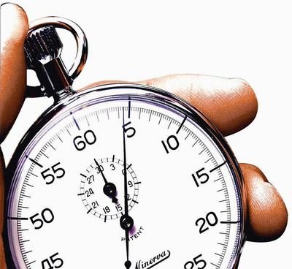
Coherence affects reading time
Experiment 3
Speeded task
Coherent trials processed faster than incoherent trials
Main effect of Coherence*
* p = .004

Slide 18
Fluency affects risk – but not liking
Experiment 3
Liking ratings Risk ratings
*
Positive Negative
Positive Negative
Coherence reduces risk ratings in +ve condition
No effect on liking ratings
* p = .013

Slide 19
The mechanisms involved in intuitive judgement
Coherence
Fluency
Affect
Risk Judgement
(Topolinski, 2011)
No time pressure
Affect
Coherence
Fluency
Risk Judgement

Slide 20
The mechanisms involved in intuitive judgement
Coherence
Fluency
Affect
Risk Judgement
(Topolinski, 2011)
No time pressure
Affect
Coherence
Fluency
Risk Judgement
Time pressure

Slide 21
Summary
How is Affect evoked?
Fluency amplifies affect
Results did not support hedonic marking
Is Affect used in judgement of risk?
Without time pressure
Risk judgements made rationally
Under time pressure
Risk judgements less rational
Fluency, and not affect, influences judgement
Valence of items

Slide 22
References
Albrecht, S., & Carbon, C-C. (2014). The Fluency Amplification Model: Fluent stimuli show more intense but not evidently more positive evaluations. Acta Psychologica, 148, 195-203.
Alter, A. L., & Oppenheimer, D. M. (2009). Uniting the tribes of fluency to form a metacognitive nation. Personality and Social Psychology Review, 13, 219-235.
Alter, A. L., Oppenheimer, D. M., Epley, N., & Eyre, R. N. (2007). Overcoming intuition: Metacognitive difficulty activates analytic reasoning. Journal of Experimental Psychology: General, 136, 569-576.
Borges, B., Goldstein, D. G., Ortmann, A., & Gigerenzer, G. (1999). Can ignorance beat the stock market? In G. Gigerenzer, P. M. Todd, & the ABC Research Group (Eds.), Simple heuristics that make us smart (pp. 59–72). New York: Oxford University Press.
Dawes, R.M. (1979). The robust beauty of improper linear models in decision making. American Psychologist, 34, 571–582.
McGlone, M. S., & Tofighbakhsh, J. (2000). Birds of a feather flock conjointly (?): Rhyme as reason in aphorisms. Psychological Science, 11, 424-428.
Reber, R., Winkielman, P., & Schwarz, N. (1998). Effects of perceptual fluency on affective judgments. Psychological Science, 9, 45-48.
Topolinski, S. (2011). A process model of intuition. European Review of Social Psychology, 22, 1, 274-315.
Topolinski, S., & Strack, F. (2009). The analysis of intuition: Processing fluency and affect in judgements of semantic coherence. Cognition and Emotion, 23, 1465–1503.
Winkielman, P., Schwarz, N., Fazendeiro, T. A., & Reber, R. (2003). The hedonic marking of processing fluency: Implications for evaluative judgment. In J. Musch & K. C. Klauer (Eds.), The psychology of evaluation: Affective processes in cognition and emotion (pp. 189-217). Mahwah, NJ: Lawrence Erlbaum.

Slide 23
Thank you
d.m.gamblin@surrey.ac.uk
David Gamblin
Dr Adrian Banks
Gamblin & Banks - SPUDM 2015

