Slide 1
Are repositories holding back OER?
Quality assurance in repositories of OER
Javiera Atenas
SOAS, University of London
&
Leo Havemann
Birkbeck, University of London

Slide 2
Ethos of the OER movement
The ethos of the OER movement was distilled in the 2012 Paris OER Declaration, which (in article I) encourages States to:
Facilitate finding, retrieving and sharing of OER. Encourage the development of user-friendly tools to locate and retrieve OER that are specific and relevant to particular needs. Adopt appropriate open standards to ensure interoperability and to facilitate the use of OER in diverse media (UNESCO, 2012).
...thereby indicating that OER repository initiatives must play a significant role in the development of Open Educational Practices (OEP).

Slide 3
How is the OER movement doing?
For Windle et al (2010)
to date the OER movement has mostly focused on the input or sharing aspect.... A relatively large amount of funding has been made available for the creation of repositories, and the movement has had some success in encouraging individuals to share their resources. Much less is known about the reusability or reuse of the resources that have been accumulated. Who is reusing the resources? How much is being reused? What is being reused? Why are they reusing? What makes it easier or more difficult?
http://jime.open.ac.uk/jime/article/viewArticle/2010-4/html

Slide 4
Supporting Open Educational Practices (OEP)
Whereas the nature and degree of openness afforded by MOOCs appears to be variable, openness is at the core of OER.
In order for the sharing and reuse of openly licensed resources to become adopted as a mainstream educational practice, it is necessary to consider how technical infrastructure underpins such activity and how it can further support and enhance Open Educational Practices (OEP).
With this in mind, we have set out consider what key features we should expect to find in Repositories of Open Educational Resources (ROER), and whether current repositories are meeting the challenges.

Slide 5
Defining concepts of this study
Drawing from our analysis of the literature, we would argue that the ethos underlying the creation of repositories of OER can be said to comprise four key themes:
Search, Share, Reuse, and Collaborate.
The purpose of OER repositories is to support educators in searching for content in a structured way, sharing their own resources, reusing existing materials and creating new resources through adapting or translating, and collaborating with others by interacting, commenting upon, reviewing and promoting resources.
According to the literature, the repositories must include certain characteristics in the development of the platforms; these must aim both at the social and technical aspects of the repositories to facilitate the access to the resources.

Slide 6
Evaluating repositories of OER
The aim of the study was to analyse the current state of the ROER developments worldwide. In order to identify a relevant sample, 450 OER initiatives and 120 institutional repositories were reviewed with the aim to obtain a sample of OER-specific repositories.
From the sample were excluded:
Repositories which contained only audio or video, as the content is homogeneous, and may or may not be open.
Proprietary platforms such as iTunesU / Youtube
Open Course Ware (OCW)
Massive Open Online Courses (MOOCs)
80 OER-specific repositories which were analysed and reviewed in this study.

Slide 7
Indicators for Quality Assurance
IQA | Description
Featured resources | Ability of featuring resources that are potentially of high interest for teachers because of it design or content.
User evaluation tools | Tools for the resources to be evaluated by users aiming to rate a resource.
Peer review | Peer review as policy to revise and analyse each resource to ensure its quality.
Authorship of the resources | Analyse if the repositories include the name of the author(s) of the resources.
Keywords of the resources | Methodically describe the resources to facilitate the retrieval of the materials within certain specific subject areas
Inclusion of Metadata (Dublin Core - IEEE LOM - OAI-PMH) | Introduce standardised formats of metadata to describe OER such as Dublin Core - IEEE LOM - OAI-PMH to comply with international standards for quality making descriptions interoperable amongst ROER
Multilingual support | Design the interface of the in a multilingual way to widen the scope of users by allowing them to perform search of content in different languages.
Inclusion of Social Media tools for sharing resources | Introduce social media tools to enable the users to share the resources within social media platforms.
Specification of Creative Commons Licence | Specify the type of Creative Commons Licence per each resource or give information about the specific type of licence for all the resources.
Source Code or Original Files Available | Allow the download of the source code or original files for resources.

Slide 8
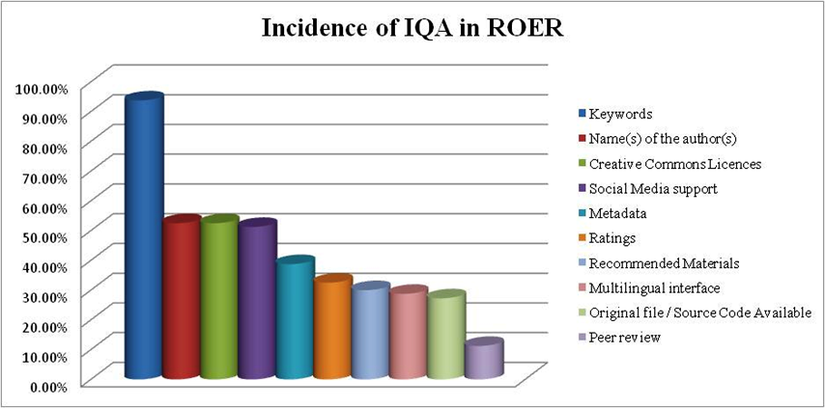
Incidence of IQA in ROER
Atenas & Havemann (2013) , http://is.jrc.ec.europa.eu/pages/EAP/documents/All_OE2030_HE_v%204_author%20revised_OK.pdf

Slide 9
We propose that repositories should include
IQA | Definition | Model
User Evaluation tools | Pedagogical value, accessibility, design | Tripadvisor, Amazon
Metadata provided by the contributors | Relevant information about the materials | Slideshare
Type of CC license provided by the author | The author must decide the type of CC licenses | Drop down menu
Multilingual interface | Allows users to navigate in different languages | Google
Social Media Sharing | Allow users to share content in social media | Online news, blogs, shopping
Download of the original file / source code | Allow users to download the original file | Slideshare

