Slide 1
Doing it to Ourselves
Pandemic-Proofing Humanities Scholarship
Prof. Martin Paul Eve

Slide 2
Academic Publishing
Why do we publish?
How do we publish?
What do we want from publishing?

Slide 3
Academic publishers & freedom from the market
University presses
For-profit publishers
Prestige economy

Slide 4
Open Access (OA)
Peer-reviewed scholarship
Free to read
Free to re-use
Green vs. gold
Articles vs. monographs

Slide 5
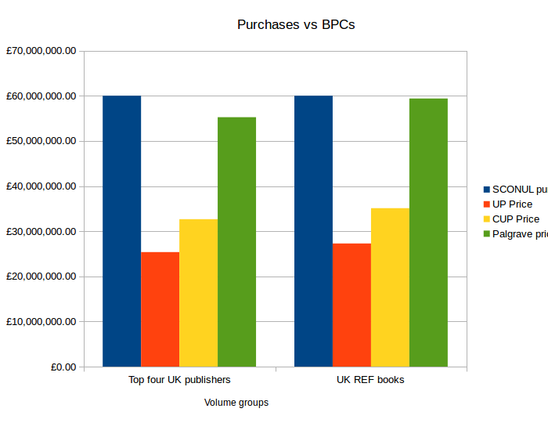
Monographs
Mellon Ithaka study (2016): $15,140 - $129,909 [cost]
100 people in a room
5,023 monographs in UK in 2013 by largest 4 publishers: £55m for OA

Slide 6
Mandates ( & neoliberalism )
REF
Funding Councils
Plan S

Slide 7
If you are frustrated by access...
Try
Try to publish OA
Always ask a publisher
Do
Do what you wish others would
Ask

