Slide 1
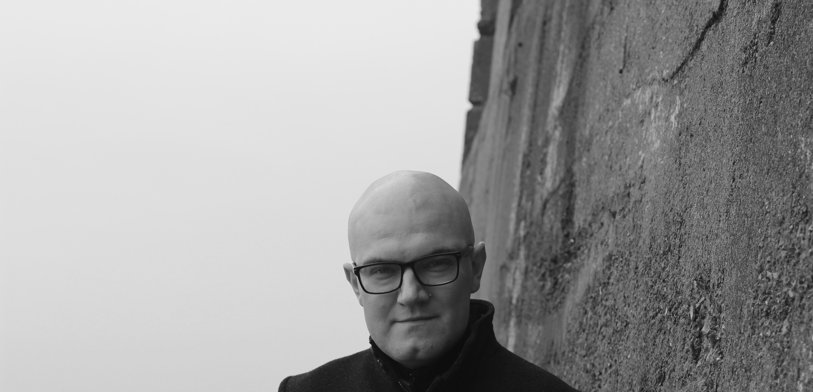

Publication
& the Pandemic
Prof Martin Paul Eve
martin.eve@bbk.ac.uk

Slide 2
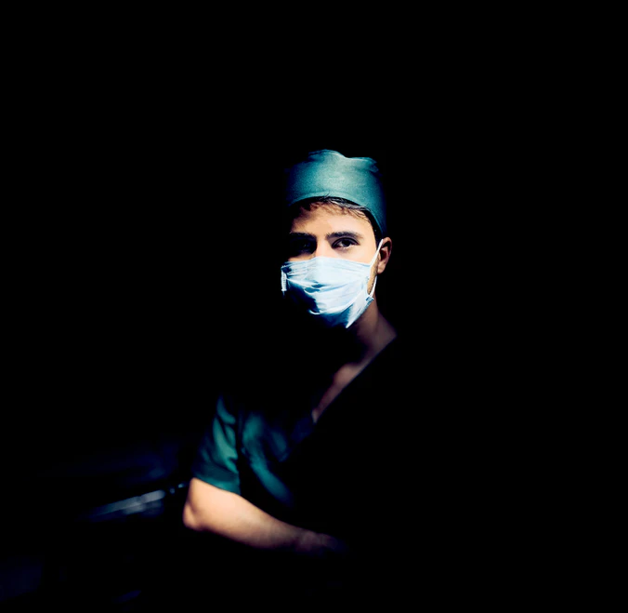
Covid: a humanities infrastructure failure
Temporary "open access" was given as a solution
Print books remain out of reach and affordability to most academics
Paid-for e-books are more expensive and less usable than print
Science did not have such a huge problem

Slide 3

Exceptional for some
Conditions of isolation are normal for many disabled academics
Libraries are not safe spaces for those vulnerable to infection
The inconvenience of Covid is an everyday reality for many, all the time

Slide 4

What I am Doing to Fix This (1)

Slide 5

What I am Doing to Fix This (2)

