Slide 1


Publishing, Power, and Praxis
Prof Martin Paul Eve
martin.eve@bbk.ac.uk

Slide 2

What is Research and Why Do We Write it?

Slide 3

Dissemination
Readership of work
Preservation of record
Footnotes and scholarly genealogy
Labour of reading: reading-avoidance techniques

Slide 4
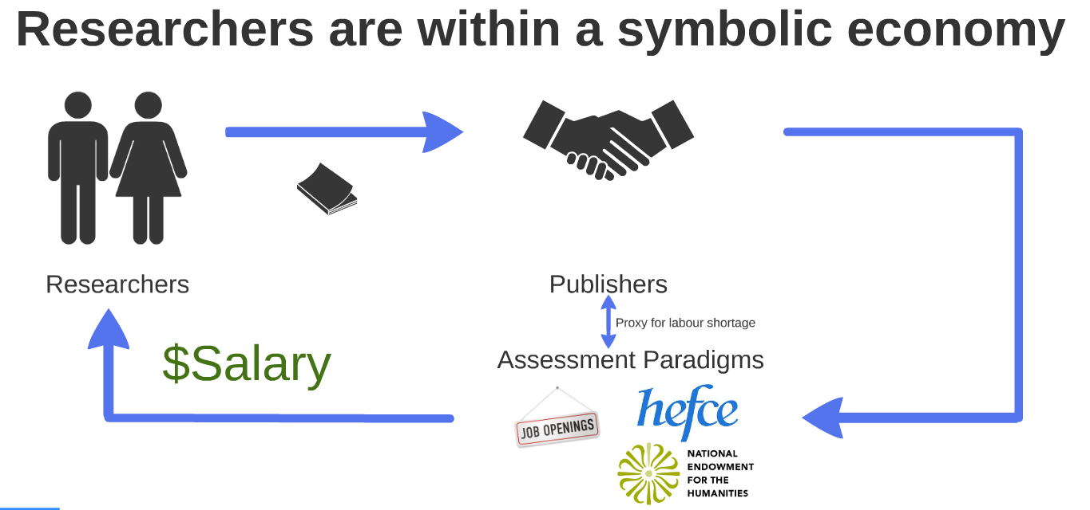
Assessment

Slide 5
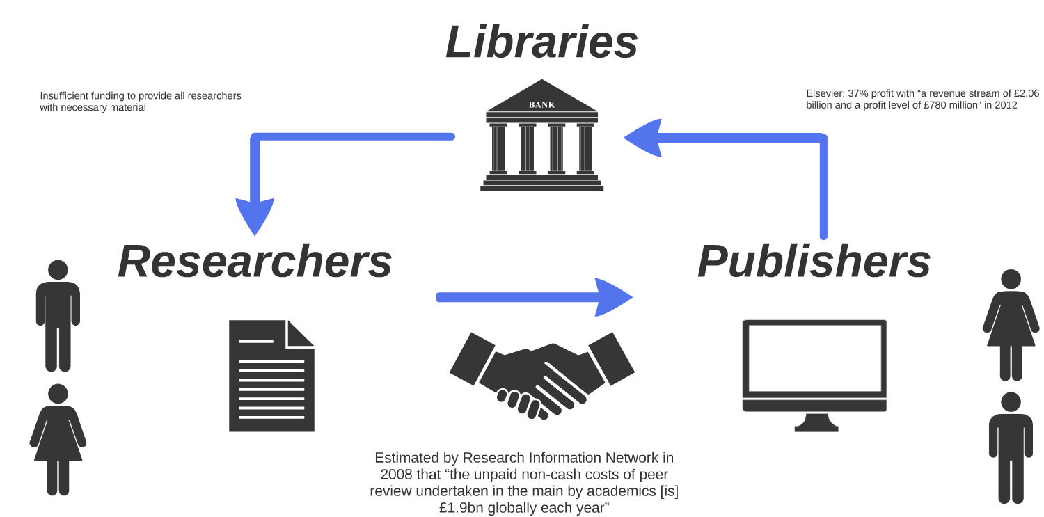
Symbolic Economics and Material Finance

Slide 6
Open Access
Peer-reviewed research
Free to read online
Permission to re-use
Gold: at publisher/source
Green: institutional/subject repository
Gratis: free to read
Libre: free to re-use

Slide 7
Mandates &
Political Economics
Centre-right wing governments
"Taxpayer" benefit
… or left-wing open access?

Slide 8

Finance & Distributive Logic
100 people in a room...

Slide 9
OA Books
Mellon Ithaka study (2016): $15,140 - $129,909
Palgrave: $95 x 200 copies = $19,000
Palgrave: Book Processing Charge: $17,000
CUP: Book Processing Charge: $10,000
Ubiquity Press: Book Processing Charge: £6,020 [~$7k USD]

Slide 10
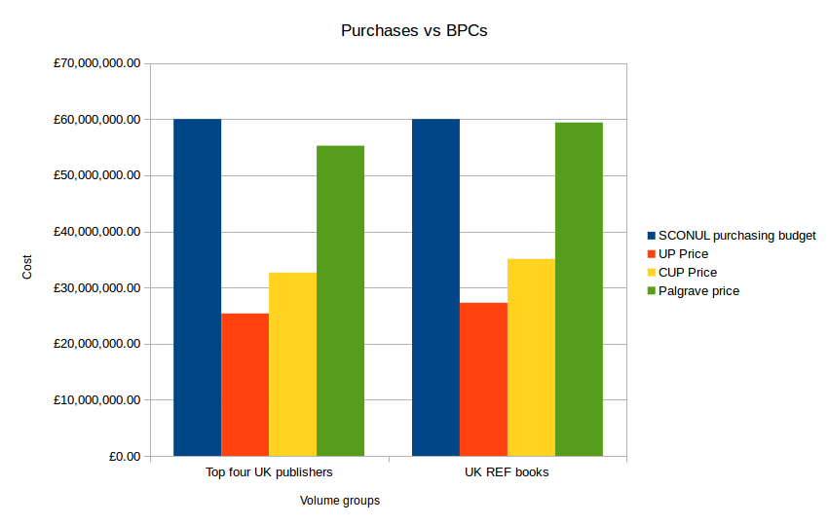
Book Processing Charges will not work

Slide 11

New Models for OA Books

Slide 12



New Models for OA Books

Slide 13

Where do we sit with OA?
Open access can be politically progressive
OA can also be implemented for conservative reasons
The economics of OA remain implausible under strict market neoliberalism and APCs/BPCs
Open licensing continues to pose challenges

