Slide 1
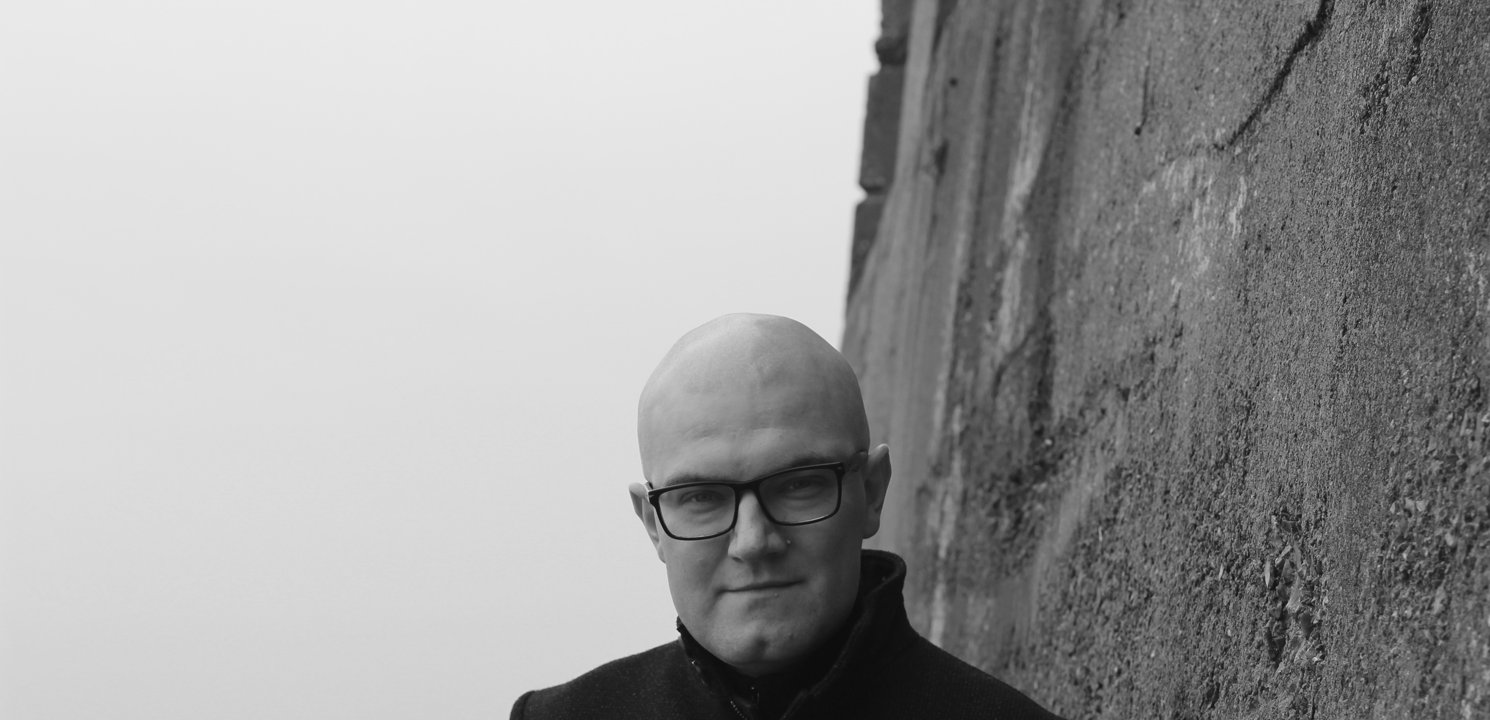

Rights Retention: an OA publishing perspective
Prof Martin Paul Eve
martin.eve@bbk.ac.uk

Slide 2

What permissions does a publisher need?
The right to make the work public in a variety of formats
The right to attribution?
The right to sell the work?
The right to defend the author?

Slide 3

Business models for open access change the need to sell
Article Processing Charges
Collective subsidy funding models
The need to sell
A range of general purpose licenses can replace

Slide 4
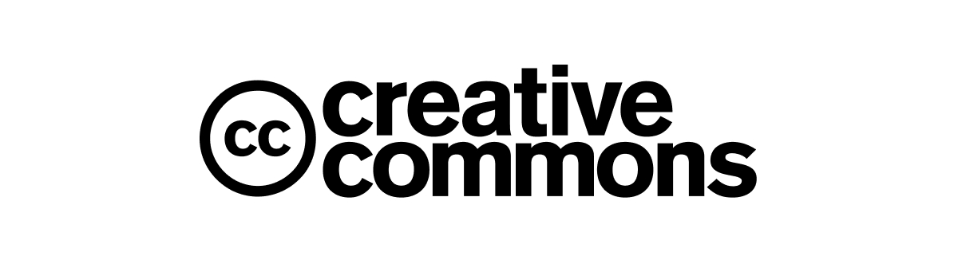

Opportunities and Challenges
I have published 7 books under Creative Commons licenses at a range of presses (from Stanford UP, to Cambridge UP, to Open Book Publishers); 2 more forthcoming
There are unauthorised reprints and resales of some of these
I have also had work transcribed into Wikisource for easy citation
I have had volunteer translators come forward to shift my work

Slide 5

Existing publishing agreements are not fit for purpose
Academics don’t read the contract
Publishers “clarify” contracts in emails with advice that contradicts the formal legal wording
Frequently contain uneforceable or unrealistic clauses
“You warrant that you shall not ... permit the Licensed Material to be linked to either directly or indirectly from any external or third party website”

Slide 6

It would be good for authors to retain their rights, but...
… even if academics should care about this, they usually do not
… most academics do not really want to exercise their rights, most of the time
… lots of academics are fearful at the stage when discussing contracts and do not wish to assert themselves
… if an author violates either a funding agreement or a publishing agreement, who is going to penalise the academic?

Slide 7

Sensitive re-use contexts
The Disability Studies Reader
“Pickens, who studies and writes about disability, clicked through to the website for Routledge, the reader’s publisher, to see which other works were included in the most recent edition. There, in the table of contents, she saw that not only was her work cited, her book Black Madness :: Mad Blackness was to be partially republished there. She was surprised. And then she got angry.
Had she been consulted, Pickens would have objected to having a portion of her book be included, she said, because she believes the book works best as a coherent whole.”
Gluckman, ‘Why Disability Studies Scholars Are Protesting a Prominent Textbook’, Chronicle of Higher Education, 2021 <https://www.chronicle.com/article/why-disability-studies-scholars-are-protesting-a-prominent-textbook> [accessed 19 April 2021]

Slide 8

Rights Retention
The fact that rights retention is accompanied by need to deposit openly with Creative Commons license will not fix re-use in sensitive contexts
Authors often perceive rights retention as a worse rights surrender than a traditional publishing agreement
Many academics are very wedded to traditional notions of intellectual property

Slide 9

In all...
Rights retention makes sense in an OA world
But only, really, so that most of those rights can be given away
Authors are nervous about this (most believe a publisher would defend them in a legal case)
Authors still frequently wish to block re-uses of which they do not approve
Disciplinary concerns remain about Creative Commons

