Slide 1

& Sharla Lair

Slide 2
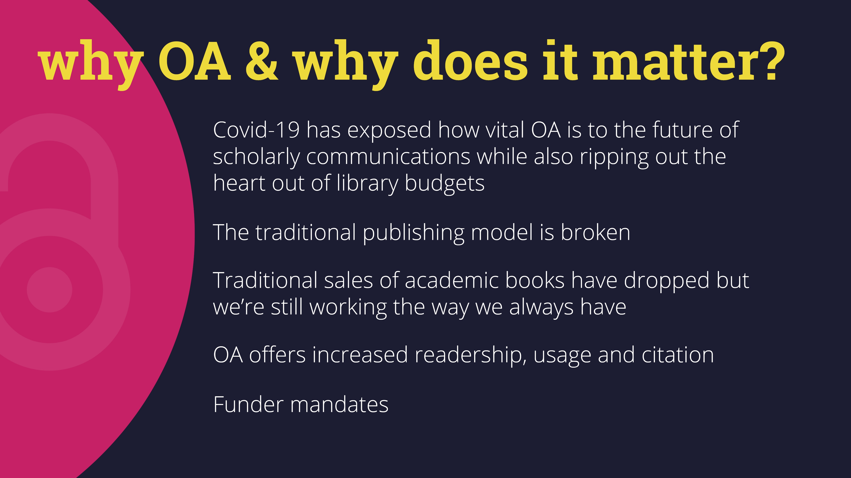

Slide 3
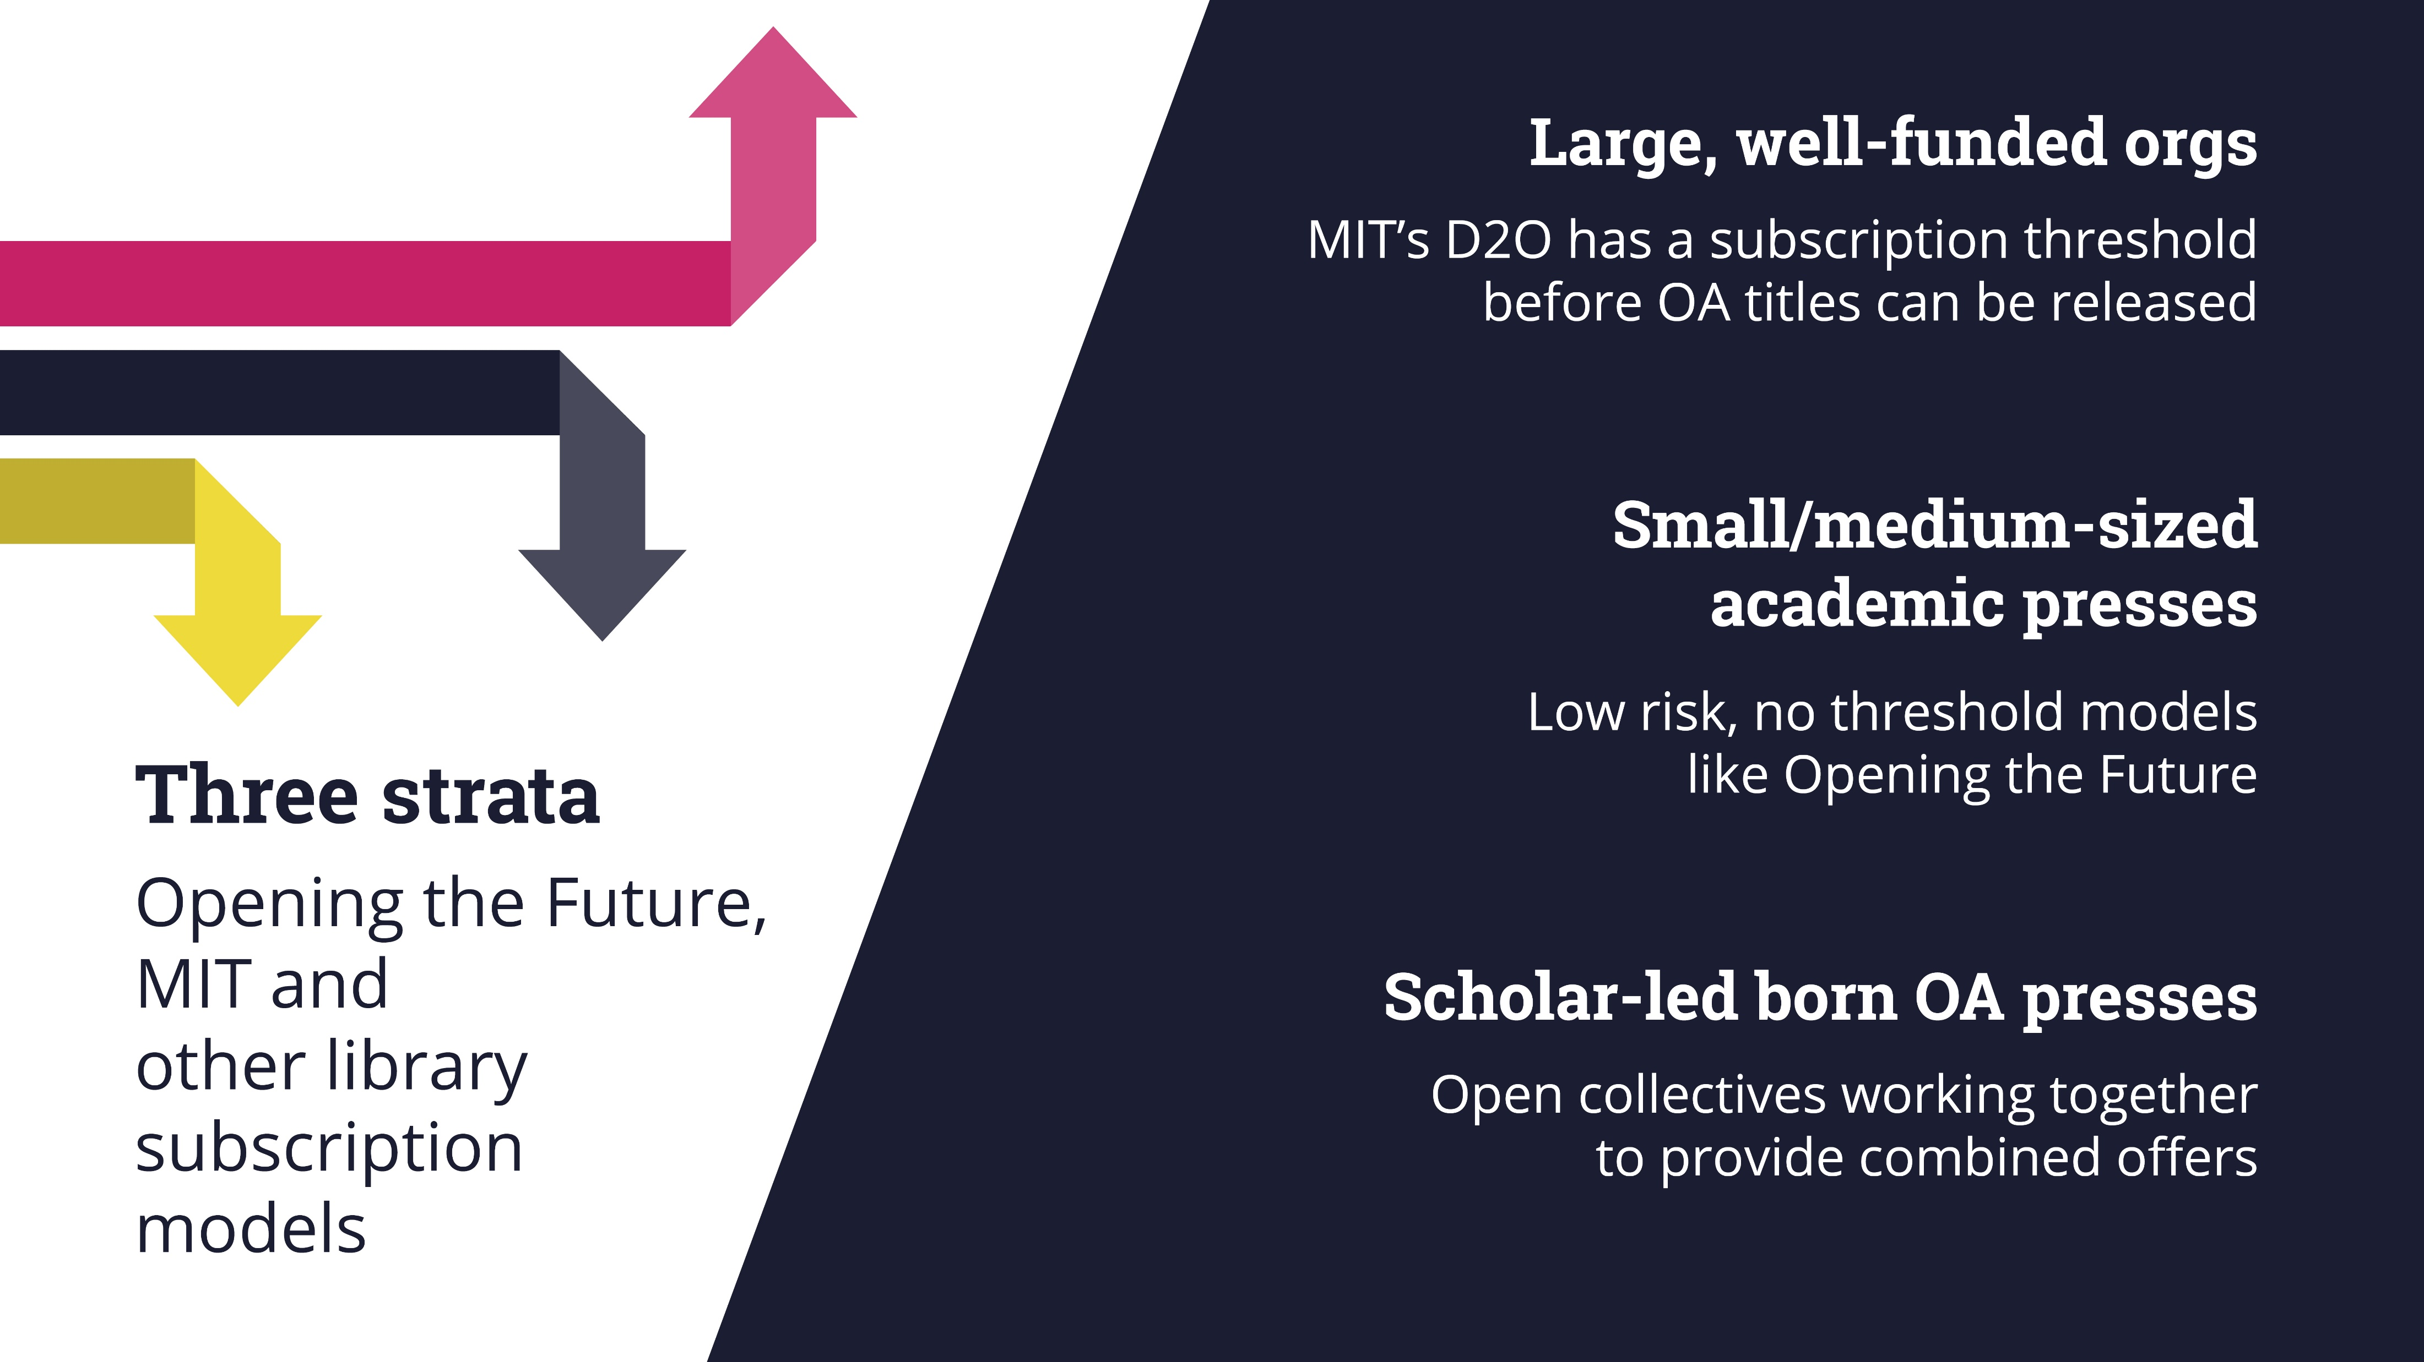
Large, well-funded academic presses
Small/medium-sized academic presses
Scholar-led born OA presses
Notes:
(Change the word ‘org’ to ‘academic presses’. Needs to be consistent with the small-medium sized type of publisher. ‘Org’ is too broad.
Run through this to identify the emerging models for the main types of presses. Hint at Hub here, but no slide for that just now.

Slide 4
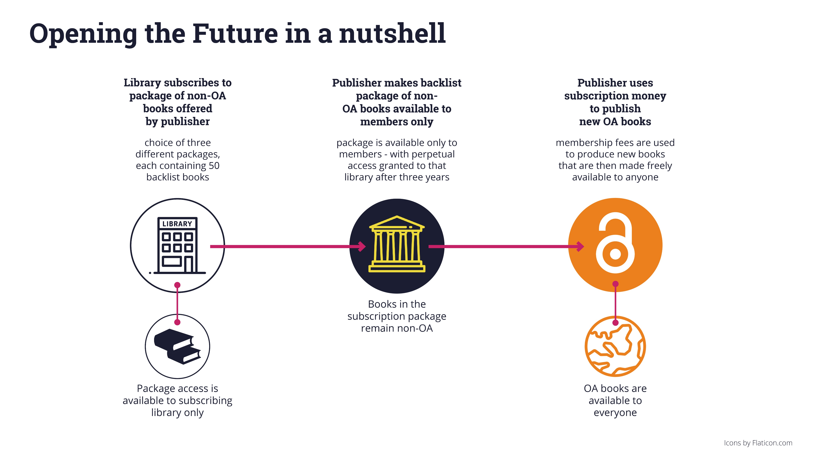

Slide 5
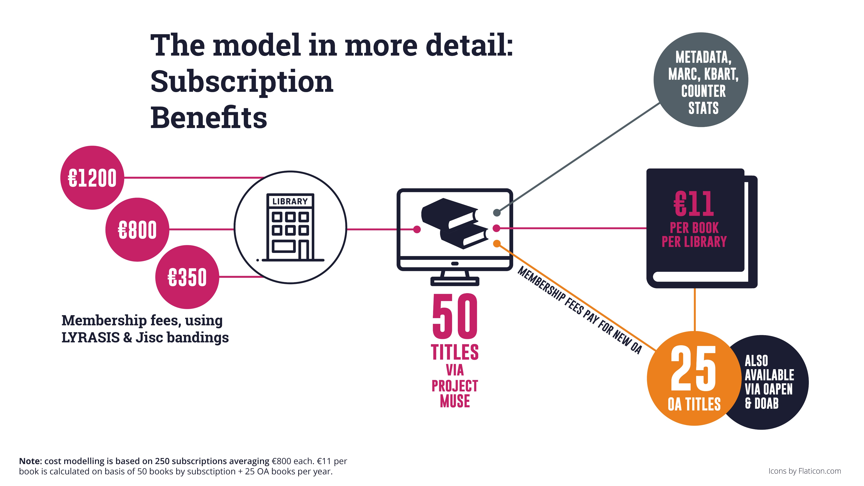

Slide 6
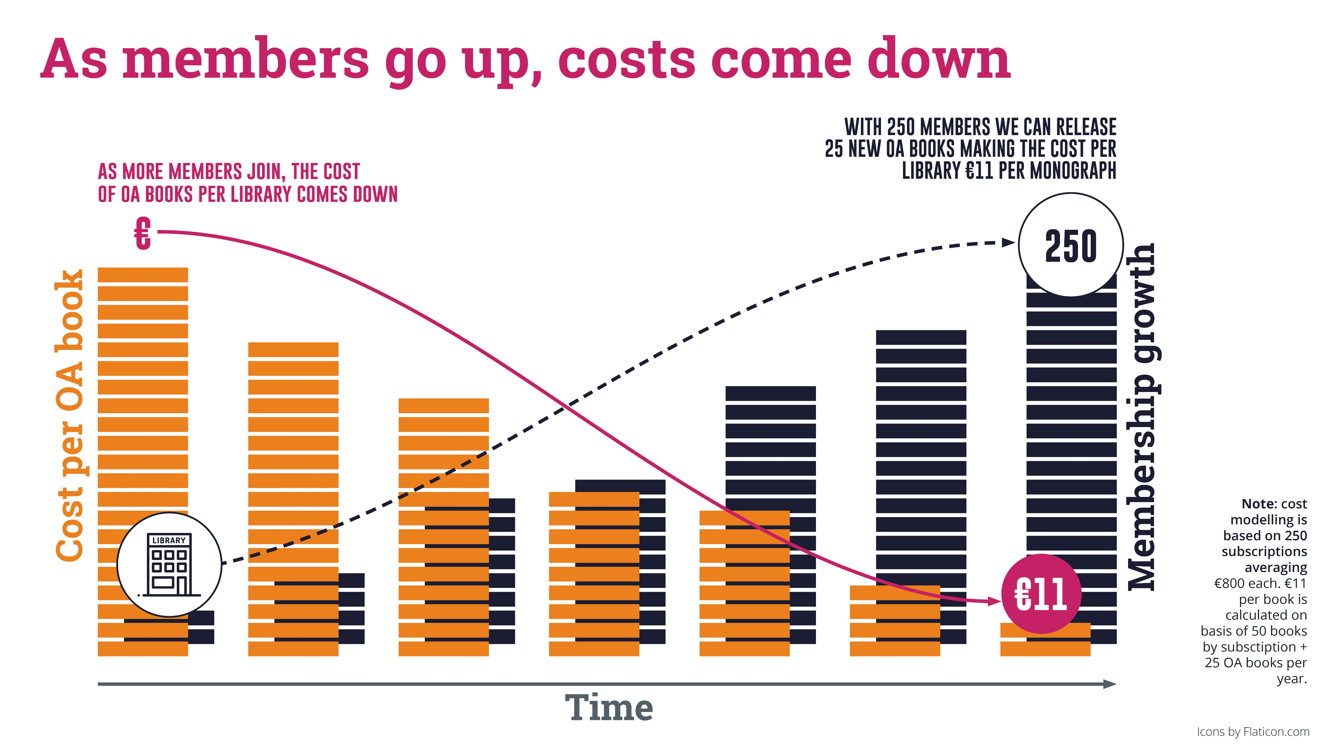

Slide 7
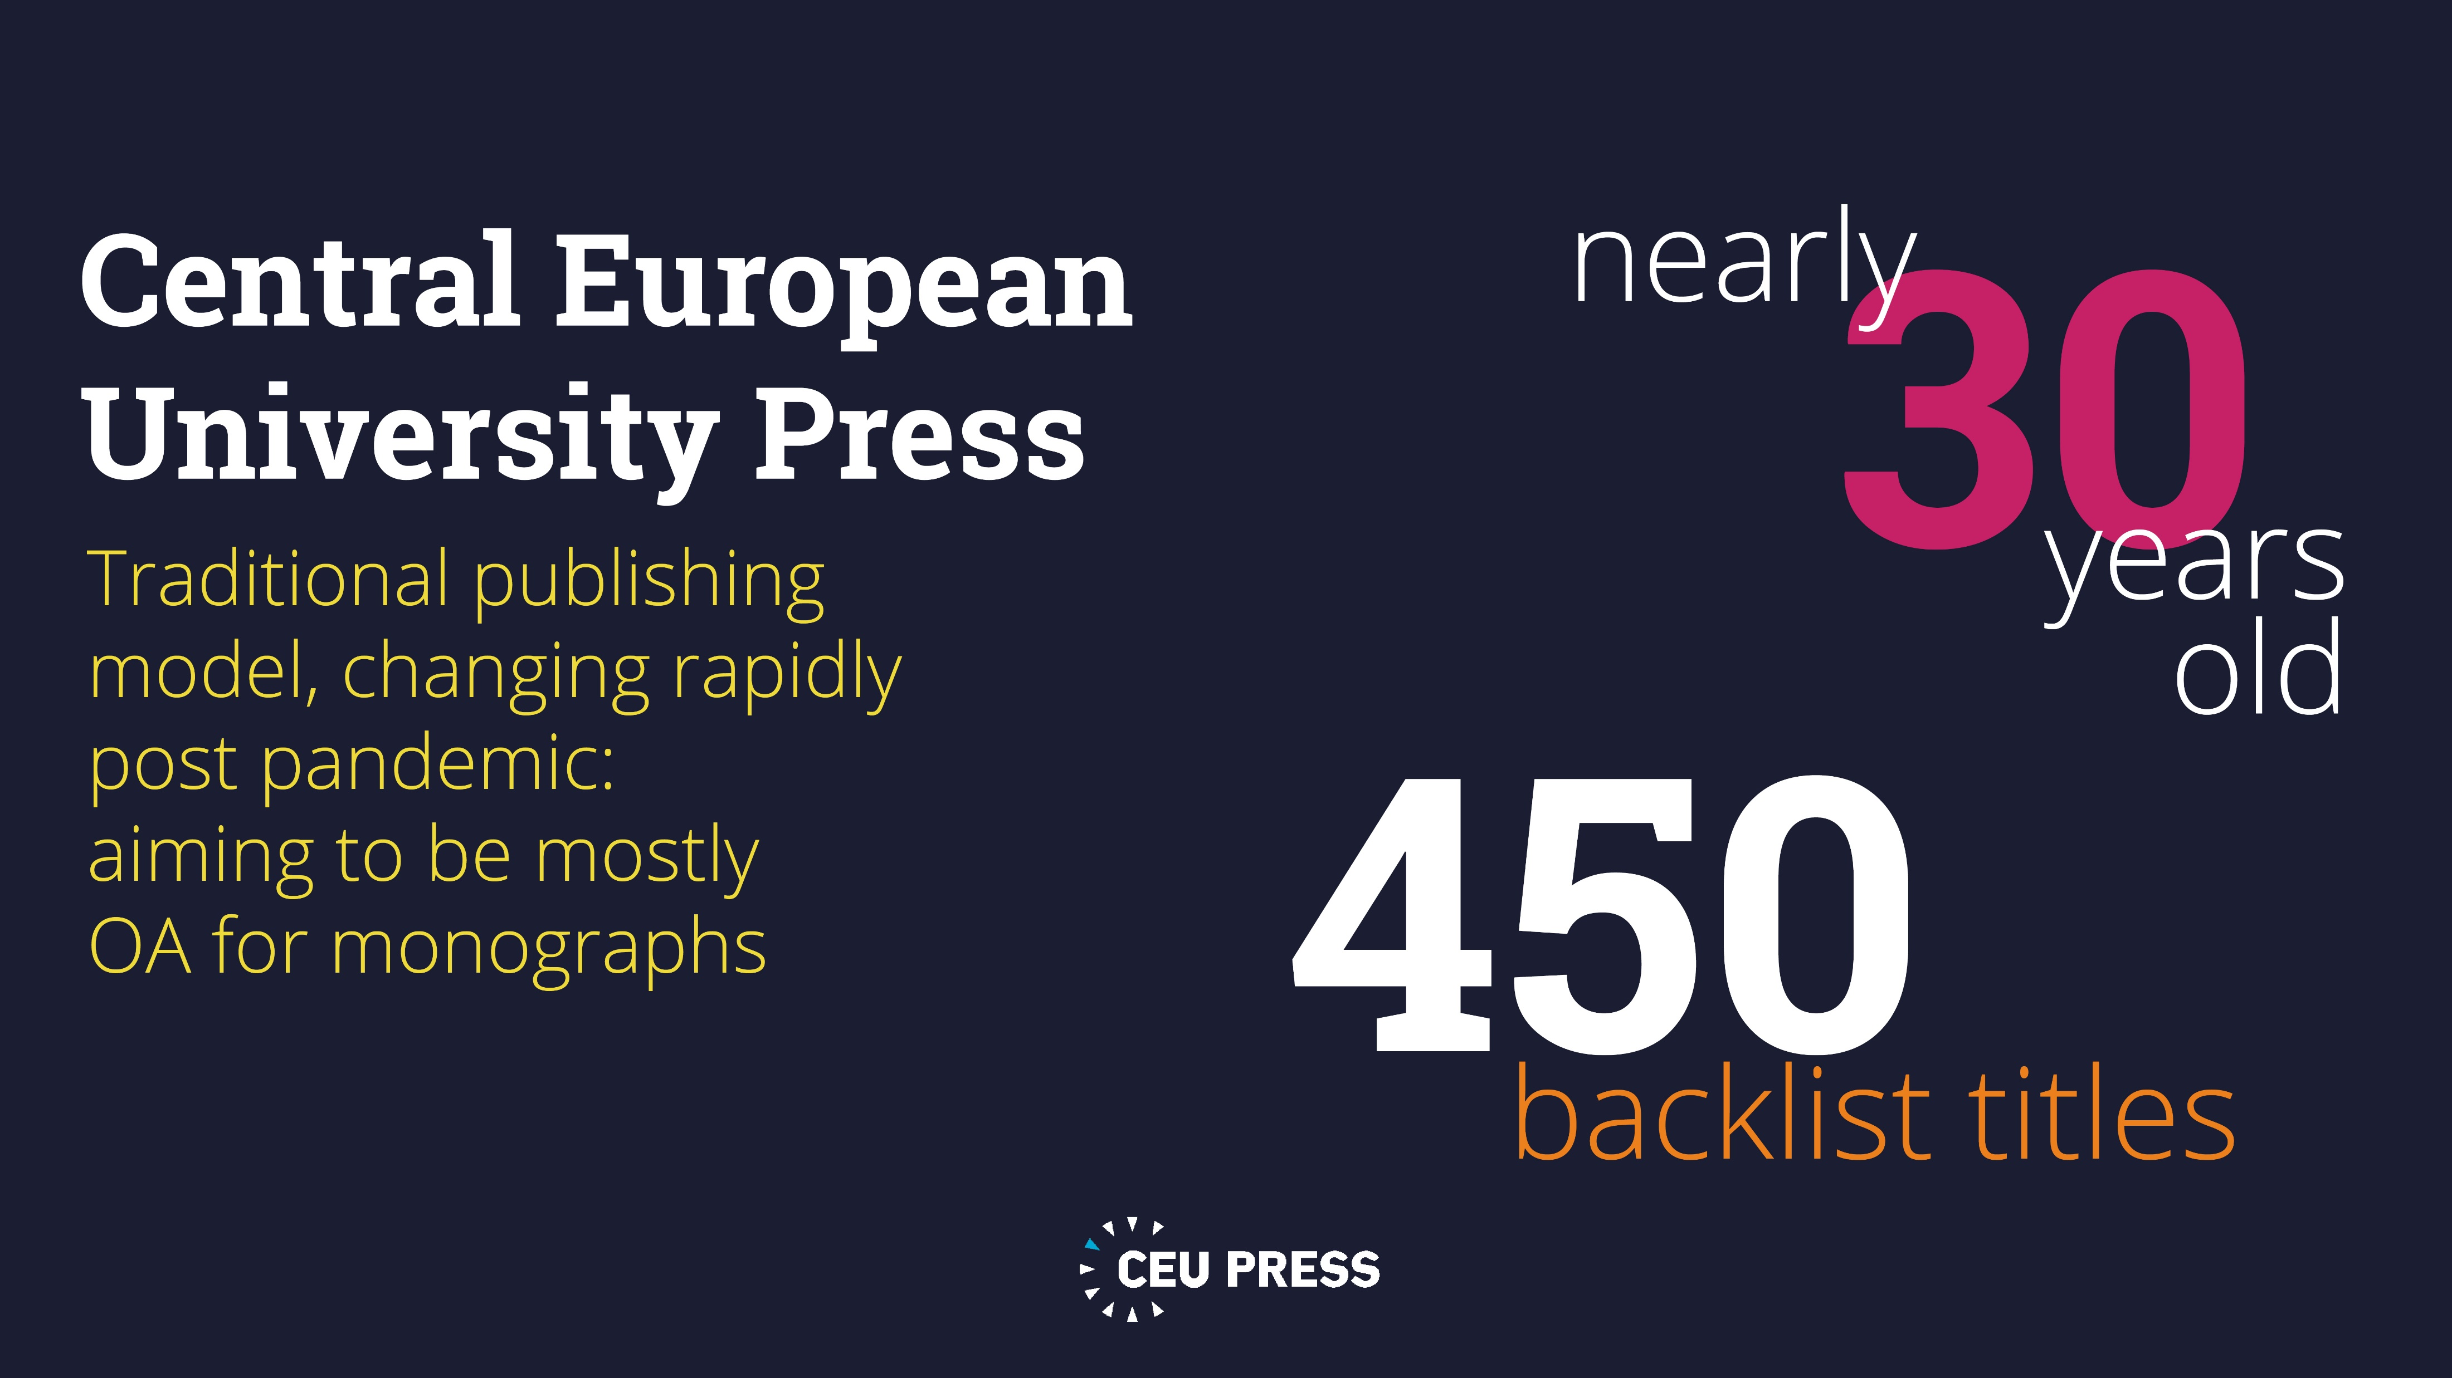

Slide 8
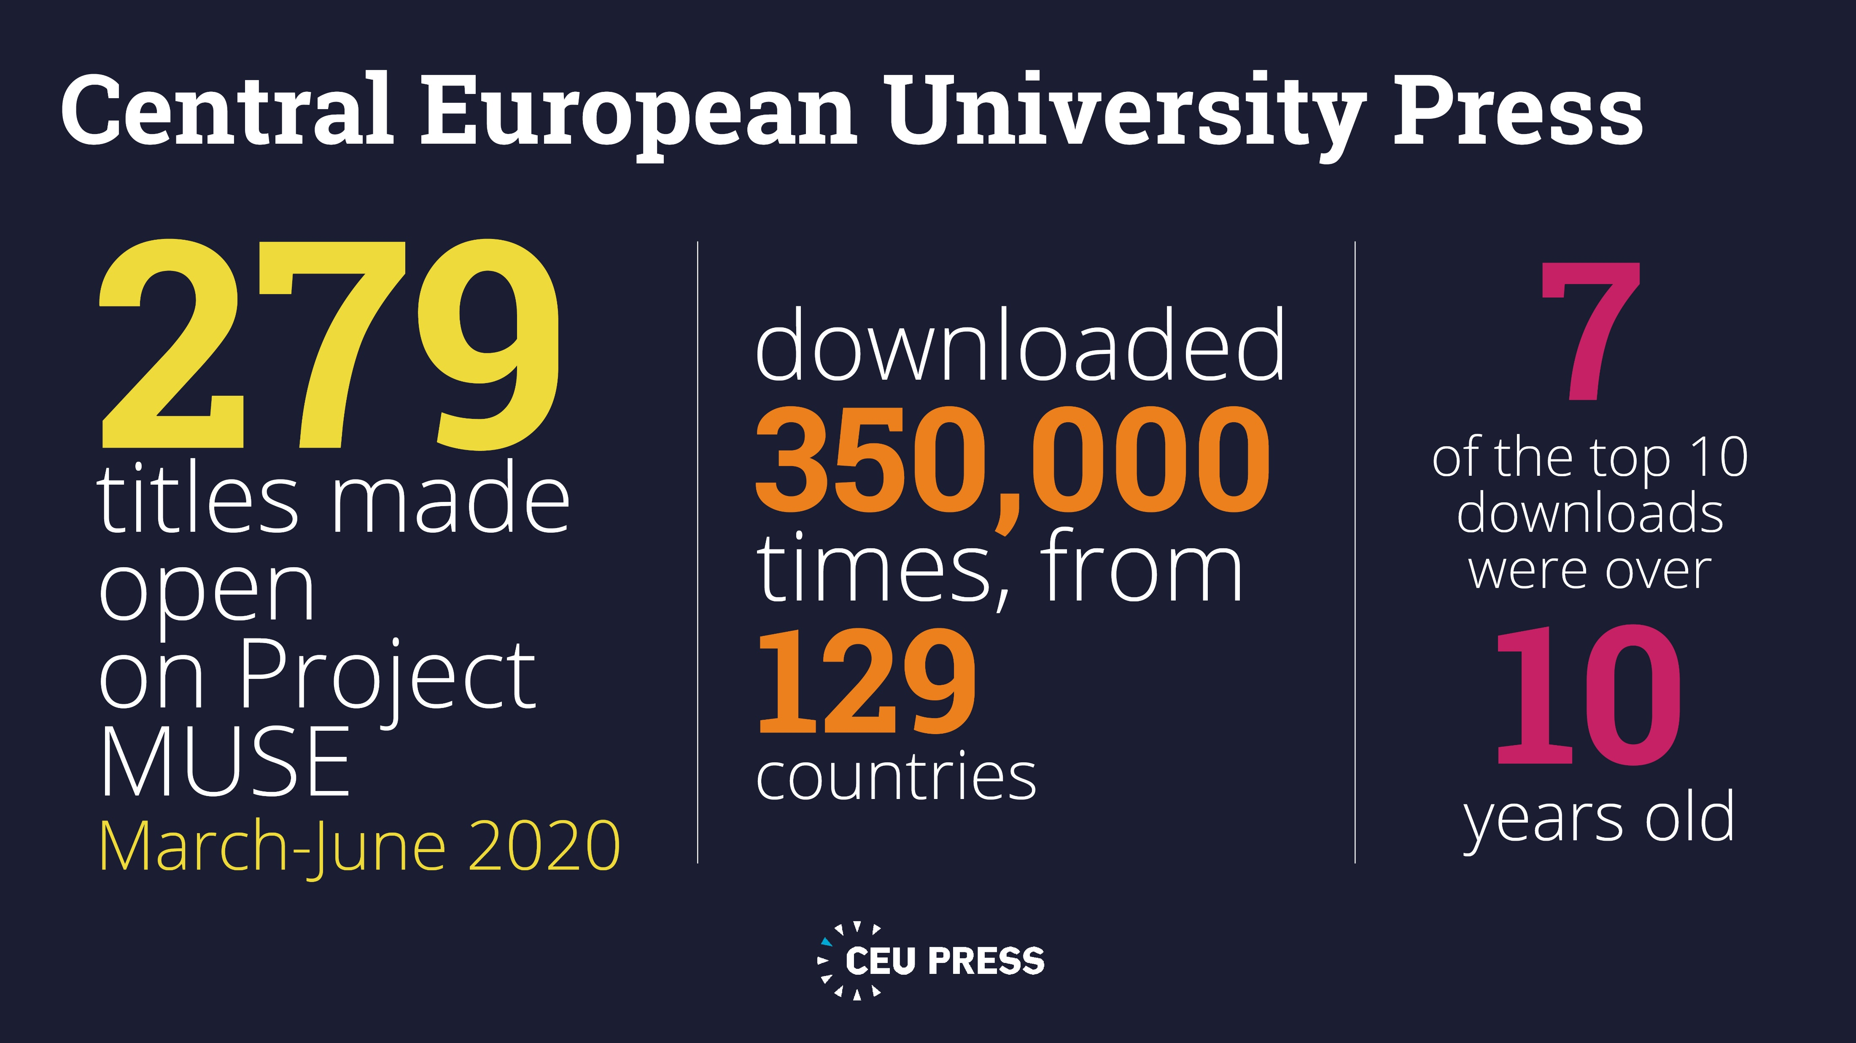

Slide 9
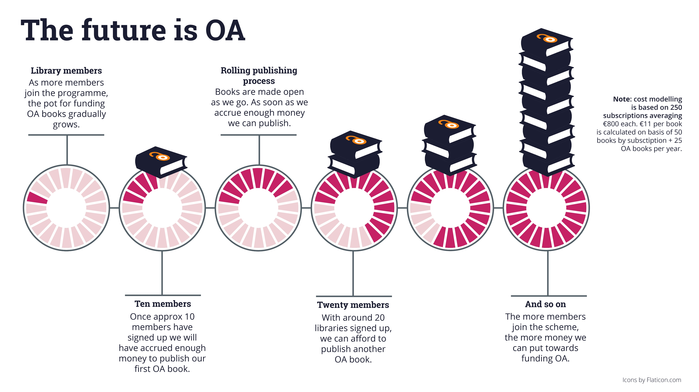

Slide 10
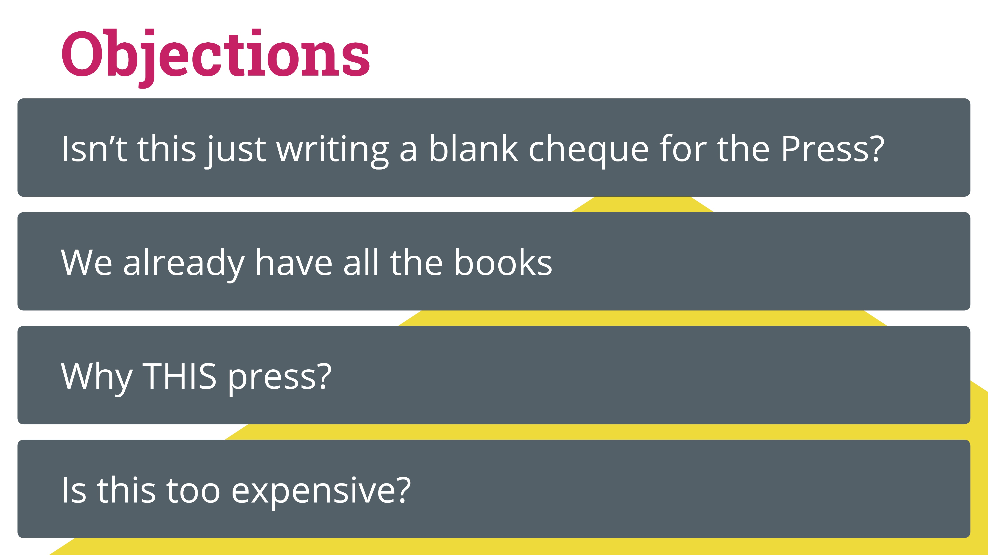

Slide 11



Snapshot of OA book world
602 publishers
36,947 books
100 publishers
16,172 journals,
5,890,831 articles
OA books market has many smaller players with publications in multiple languages, across a broad spectrum of subject areas

Slide 12
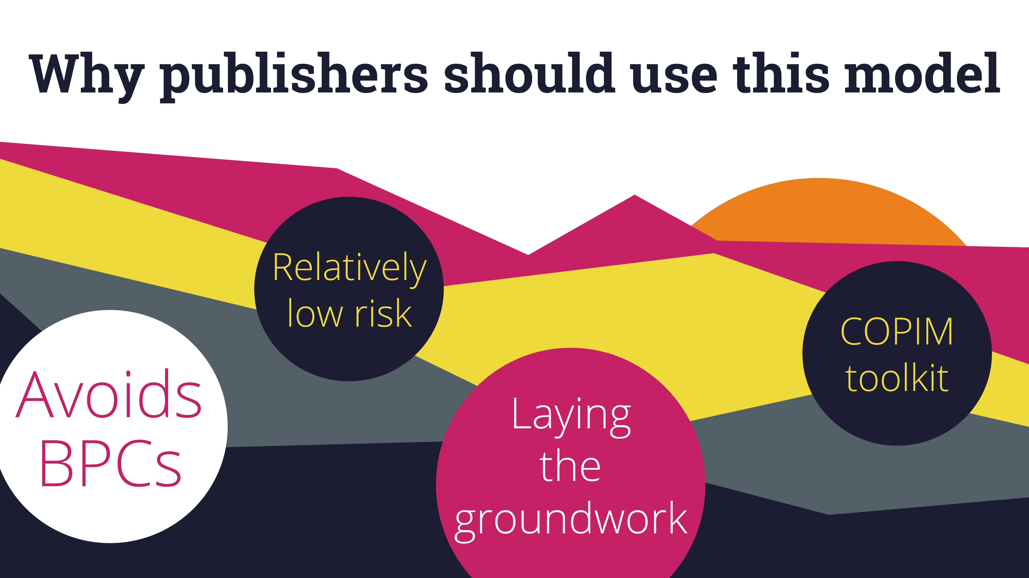

Slide 13


