Slide 1
The emerging landscape in collective library funding for OA monographs
Professor Martin Paul Eve

Slide 2
Community-led Open Publication Infrastructures for Monographs
An international partnership of libraries, publishers, scholars, and infrastructure providers
Seven connected work packages, working on:
mutually supportive governance models;
re-use of and experimentation with OA books;
effective archiving of OA content;
cost reductions achieved by economies of scale;
and a pilot OA consortial funding model called Opening the Future.

Slide 3

Why OA and why does it matter?
COVID 19 has exposed how vital OA is to the future of scholarly communications while also ripping out the heart of library budgets
The traditional publishing model is broken
Traditional sales of academic books have dropped but we’re still working the way we always have
OA offers increased readership, usage and citation
Funder mandates

Slide 4

Three strata
Large, well-funded academic presses
MIT’s D20 has a subscription threshold before OA titles can be released
Small to medium-sized academic presses
Low risk, no threshold models like Opening the Future
Opening the Future,
MIT’s D20, and other
library subscription models
Scholar-led born-OA presses
Open collectives working together to provide combined offers

Slide 5

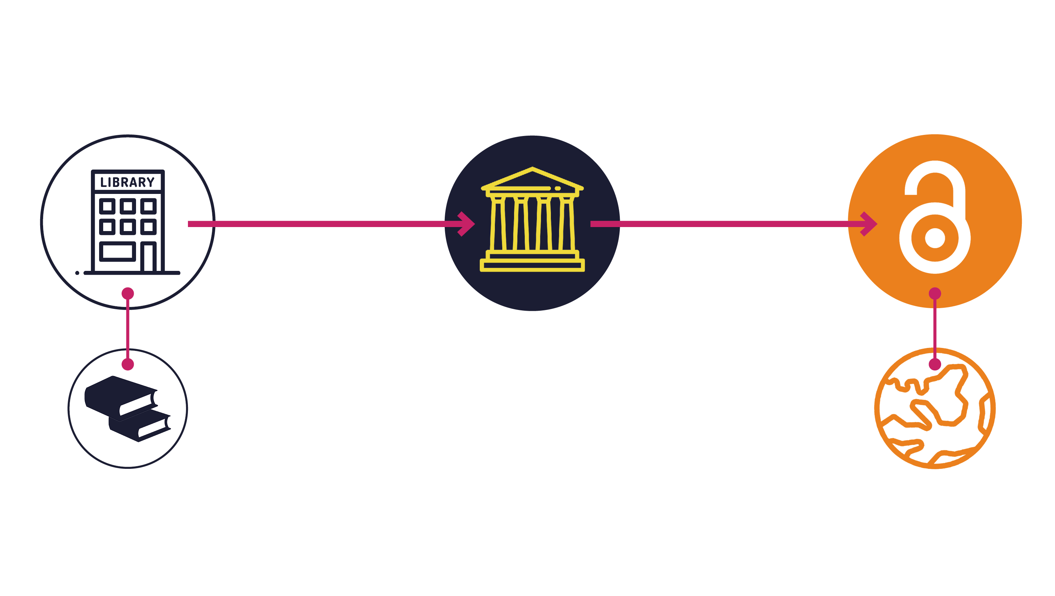

Opening the Future, in a nutshell
Alt text long description: Infographic showing libraries subscribing to backlist packages of non-OA books and publishers using the library membership fees to fund new OA books.

Slide 6
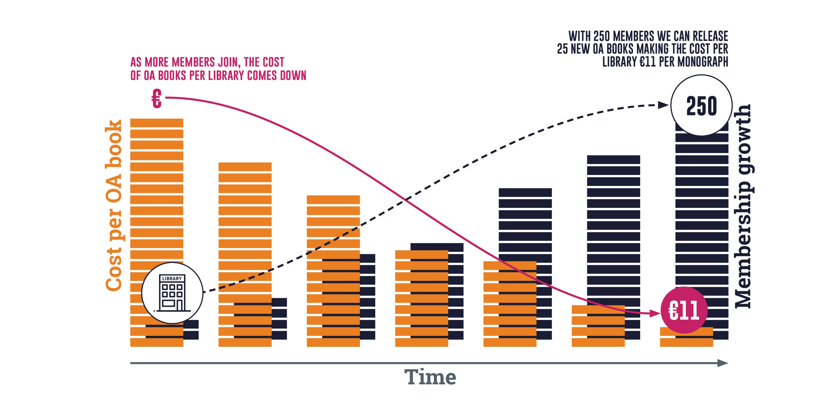
As members go up, costs come down
Note: cost modelling is based on 250 subscriptions averaging €800 each. €11 per book is calculated on basis of 50 books by subscription + 25 books OA per year.
Alt text long description: Infographic showing library members increasing and the cost of OA books per library going down, over time.

Slide 7
Central European University Press
279
7
they were downloaded
350,000
of the top 10 downloads were over
titles were made open on Project MUSE during
times, from
10
129
March to June 2020
countries
years old

Slide 8
Liverpool University Press
Established in 1899, they are the UK’s third oldest university press and an award-winning academic publisher.
publishing OA for more than
10
publishing approximately
and
150
39
years
books a year
journals & a number of digital collections

Slide 9
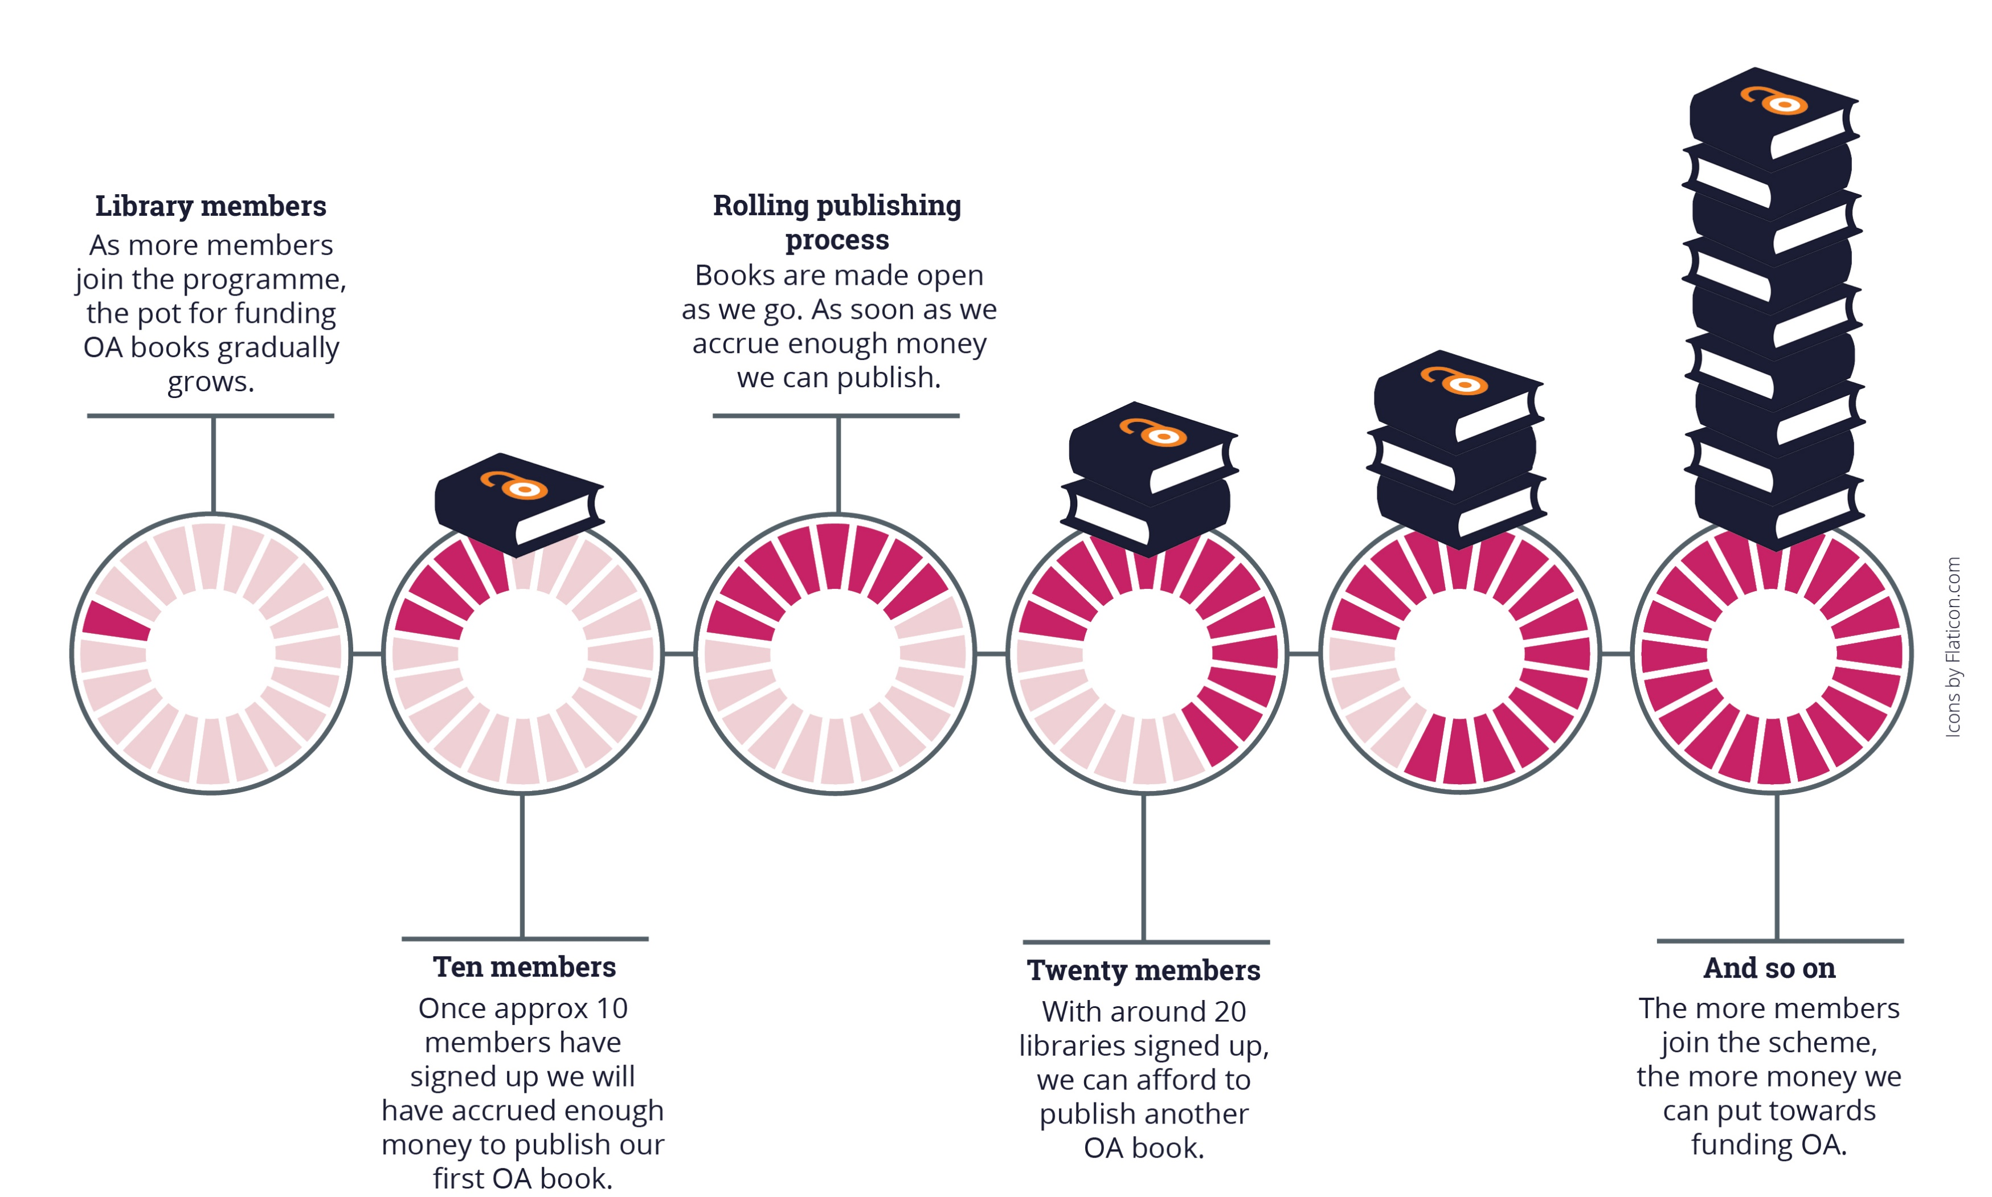
The Future is OA
Note: cost modelling is based on 250 subscriptions averaging €800 each. €11 per book is calculated on basis of 50 books by subscription + 25 books OA per year.
Alt text long description: Infographic showing library membership funds gradually accruing over time. It shows that with approximately 10 members the initiative can publish one OA book.

Slide 10

Objections
Isn’t this just writing a blank cheque for the publishers?
We already have all the books
Why these publishers – CEU Press and LUP?
Is this too expensive?

Slide 11

Why publishers should use this model
Relatively low risk
COPIM toolkit
Avoids BPCs
Laying
the groundwork

Slide 12


More information
Use the email address below to contact Martin Eve for more information:
martin.eve@bbk.ac.uk
Follow the hyperlink below for more information on Opening the Future:
https://openingthefuture.net
Follow the hyperlink below for more information on the COPIM project: https://www.copim.ac.uk/

