Slide 1
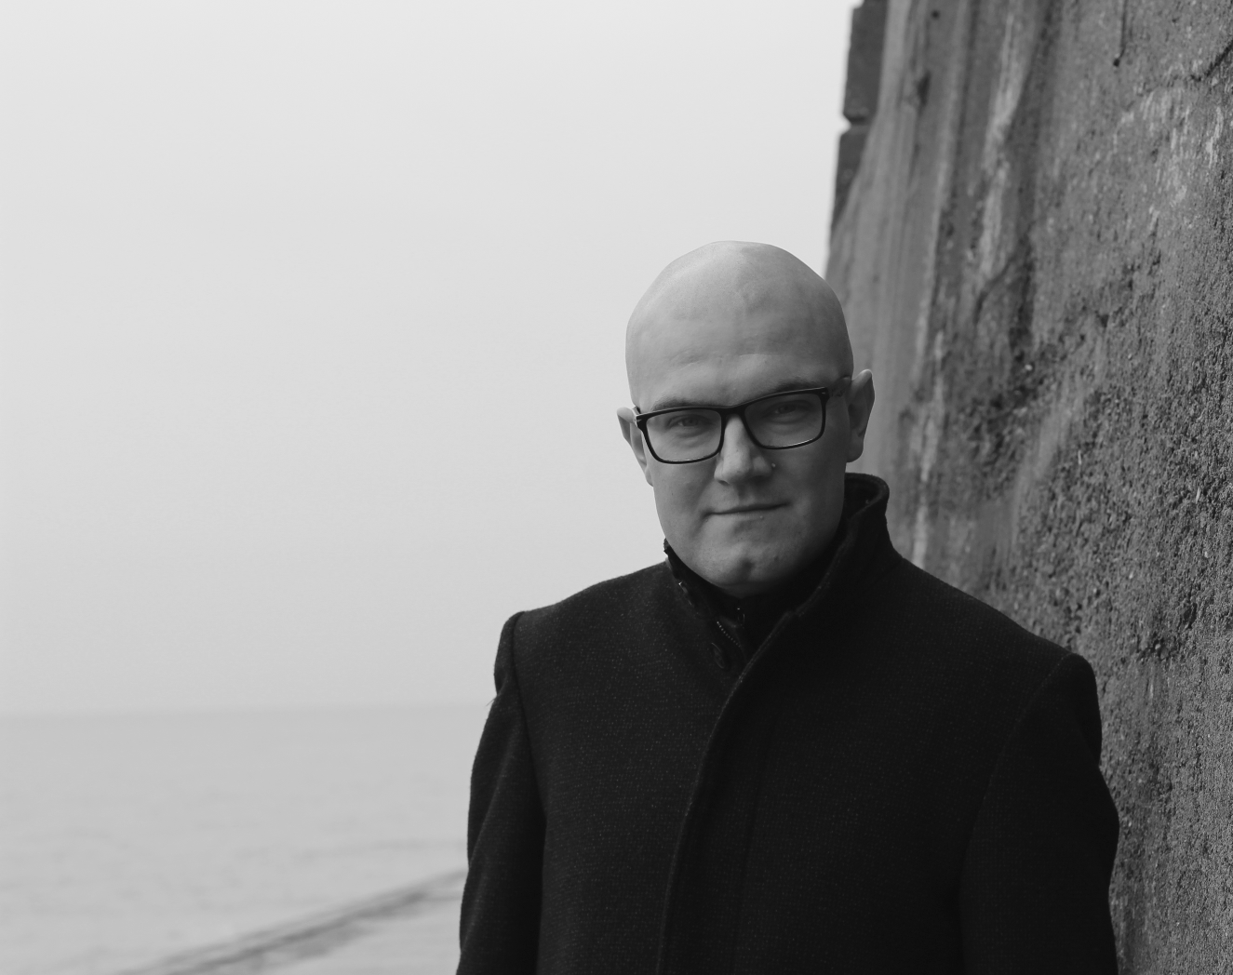

OA in the Humanities
Martin Paul Eve
martin.eve@bbk.ac.uk
Birkbeck, University of London

Slide 2

Why open access?
We will soon have a world where all natural scientific publications are free to read, while humanities scholarship will be paywalled.
Significant proportion of population with humanities degrees. Public benefit.
Access to scholarship is currently very unevenly distributed between institutions.

Slide 3

OA Policies in the UK
"The truth is that we must all go further" - Amanda Solloway, Minister for Science, Research and Innovation, August 2021
UKRI review published August 2021 (only for project funding):
  Zero-embargo green requirement
  OA extended to monographs from 2024
REF review will be next
  Ministerial steer is clear on direction of travel
  But not yet set in stone
  Unclear what funding would be provided for OA monographs
    See Eve, Martin Paul, Kitty Inglis, David Prosser, Lara Speicher, and Graham Stone. 2017. ‘Cost Estimates of an Open Access Mandate for Monographs in the UK’s Third Research Excellence Framework’. Insights: The UKSG Journal 30 (3). https://doi.org/10.1629/uksg.392.

Slide 4
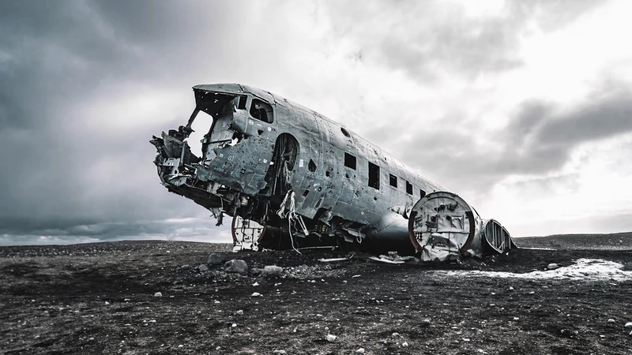
Challenges
Article and Book Processing Charges do not scale
Open licensing is difficult in some disciplines
Trade crossover books
Creative writing
Persistent misunderstandings (peer review, prestige, green open access)

Slide 5



New Models

Slide 6

Thank you
Martin Paul Eve
martin.eve@bbk.ac.uk
https://eve.gd

