Slide 1



Funding Open Access Books
Opening the Future
Professor Martin Paul Eve
Birkbeck, University of London

Slide 2

Why OA and why does it matter?
COVID 19 has exposed how vital OA is to the future of scholarly communications while also ripping out the heart of library budgets
The traditional publishing model is broken
Traditional sales of academic books have dropped but we’re still working the way we always have
OA offers increased readership, usage and citation
Funder mandates

Slide 3

Scholar-led born-OA presses
Open collectives working together to provide combined offers
Small to medium-sized academic presses
Low risk, no threshold models like Opening the Future
Three strata
Opening the Future,
MIT’s D20, and other
library subscription models
Large, well-funded academic presses
MIT’s D20 has a subscription threshold before OA titles can be released

Slide 4

£3.6m
COPIM is funded by the Research England Development Fund (REDFund) as a major development project in the Higher Education sector with significant public benefits, and by Arcadia, a charitable fund of Lisbet Rausing and Peter Baldwin.
International partnership
Libraries, Universities, OA book publishers, Researchers, Infrastructure providers
Infrastructure Developments to support OA books
Work Package 2 – Open Book Collective
Work Package 3 – Opening the Future, piloting with CEU Press & Liverpool University Press
Work Package 5 – Metadata & dissemination = THOTH

Slide 5
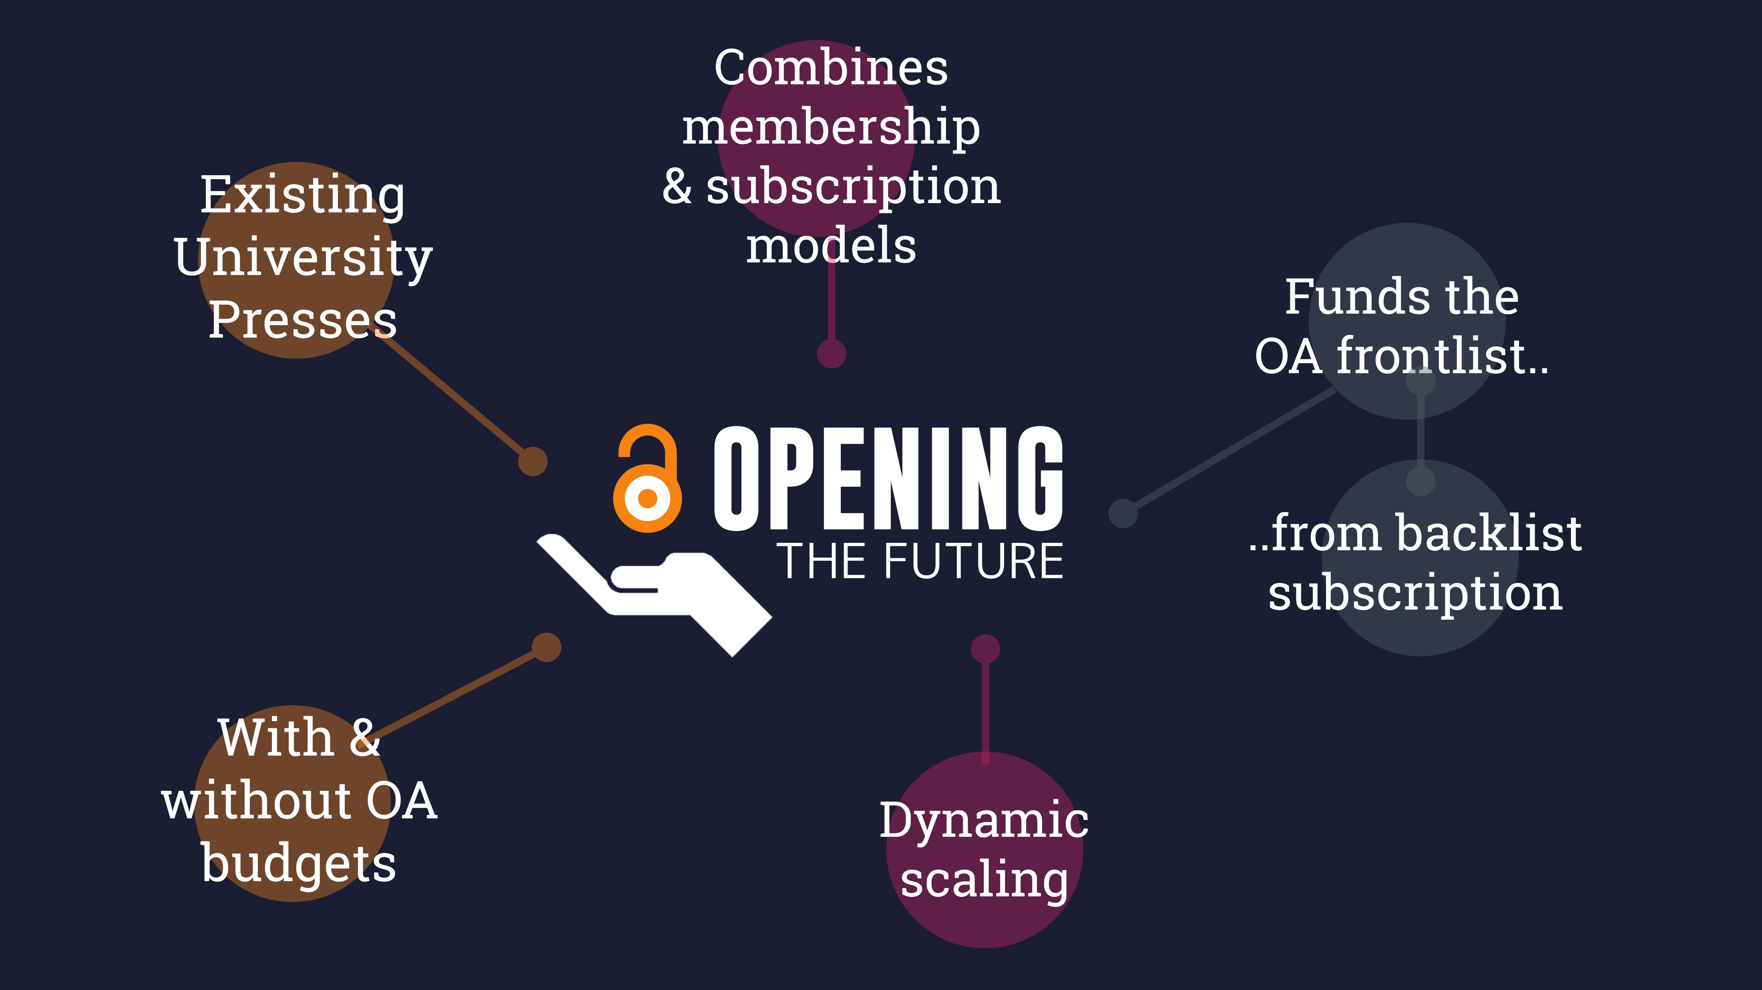

Slide 6
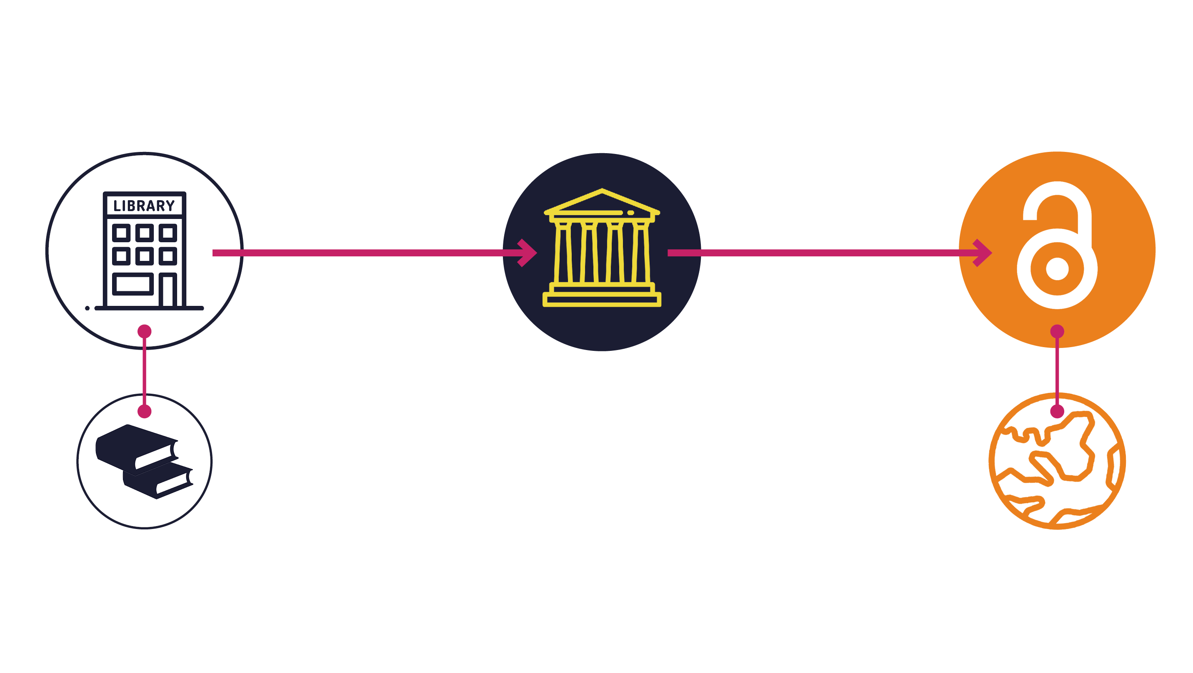
Opening the Future in a nutshell

Slide 7
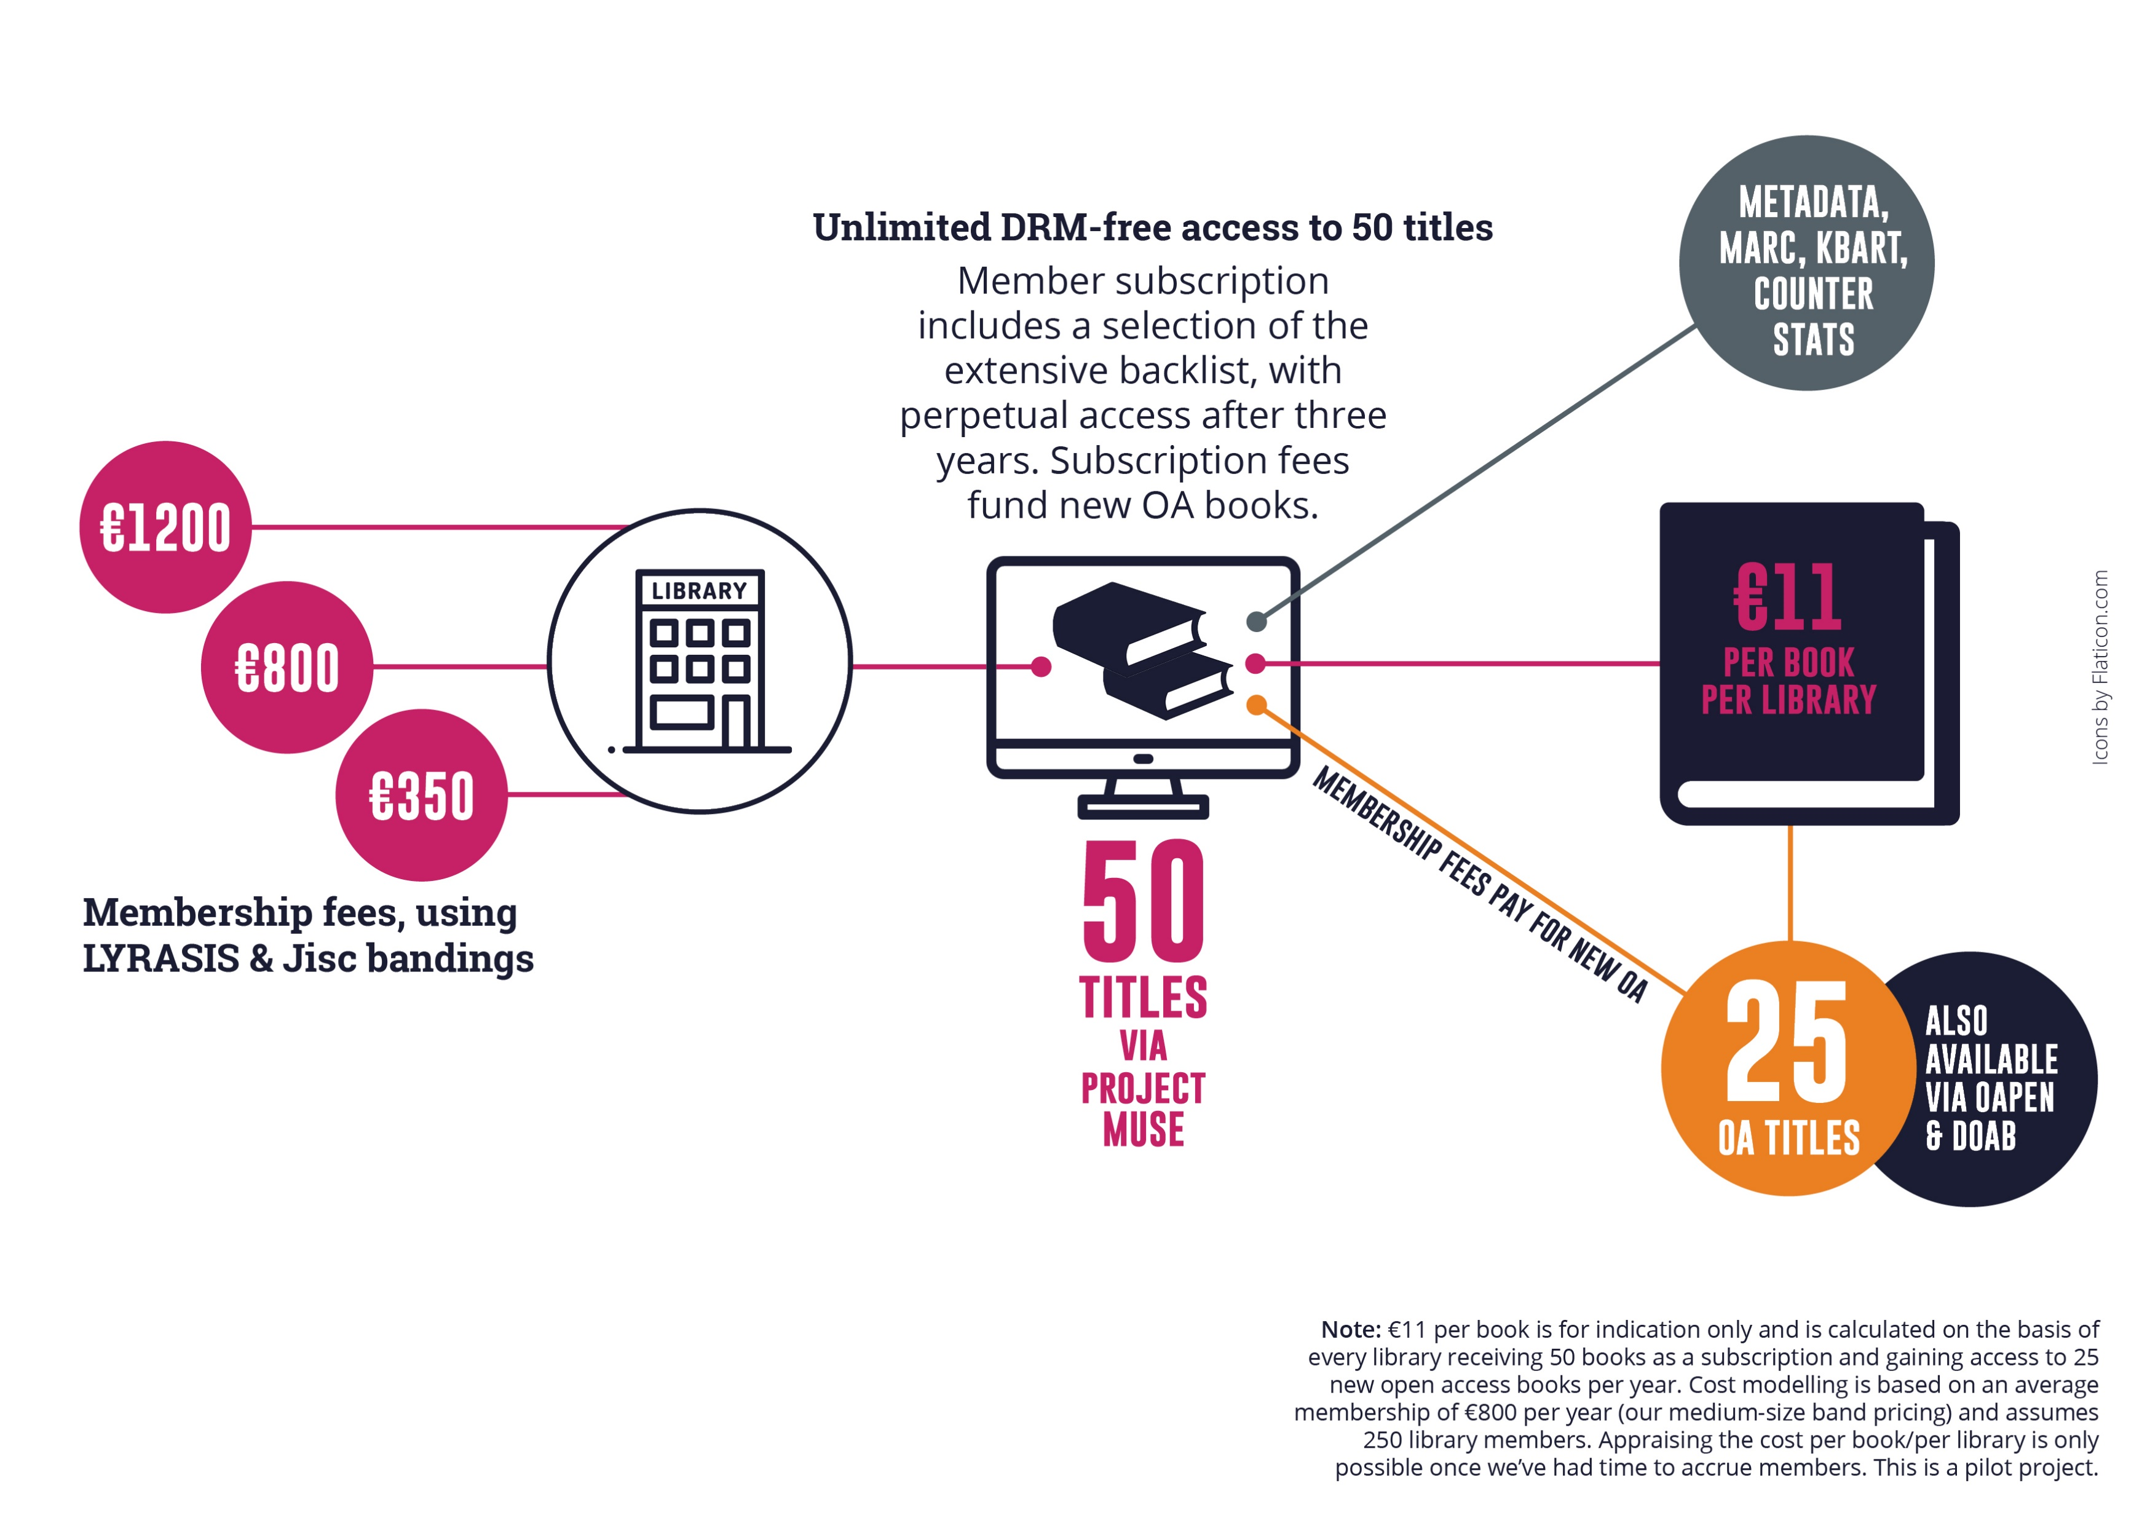

Slide 8
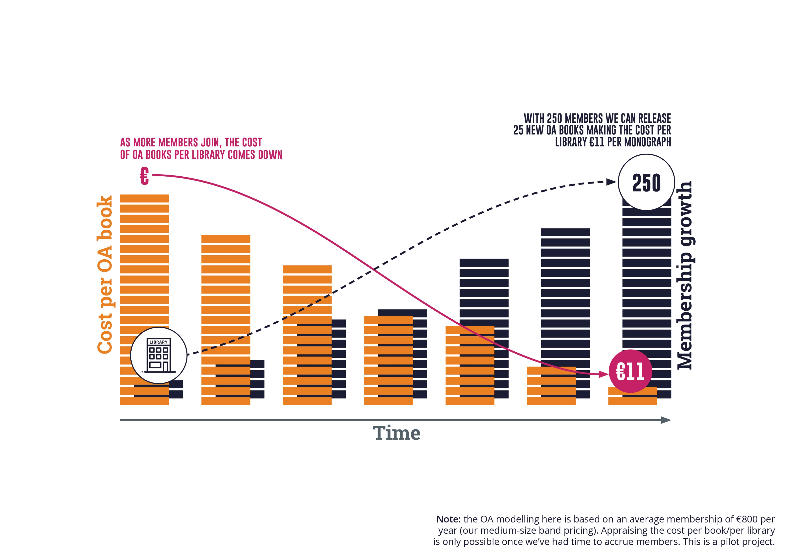

Slide 9

279
7
they were downloaded
350,000
of the top 10 downloads were over
titles were made open on Project MUSE during
times, from
10
129
March to June 2020
countries
years old

Slide 10
Liverpool University Press
Established in 1899, they are the UK’s third oldest university press and an award-winning academic publisher.
publishing OA for more than
10
publishing approximately
and
150
39
years
books a year
journals & a number of digital collections

Slide 11
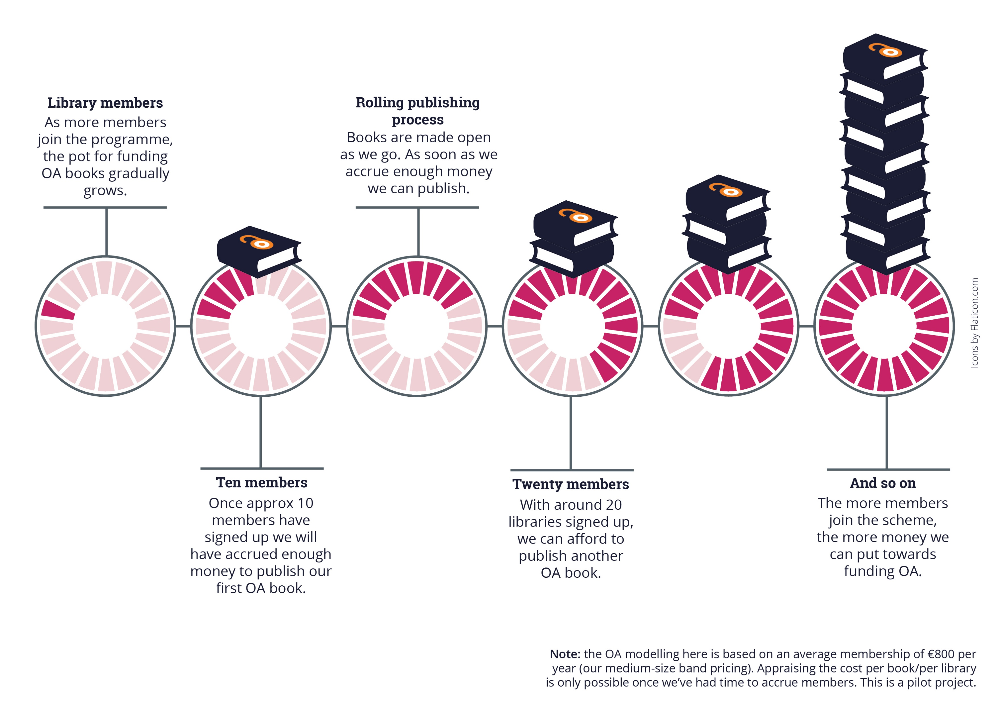

Slide 12
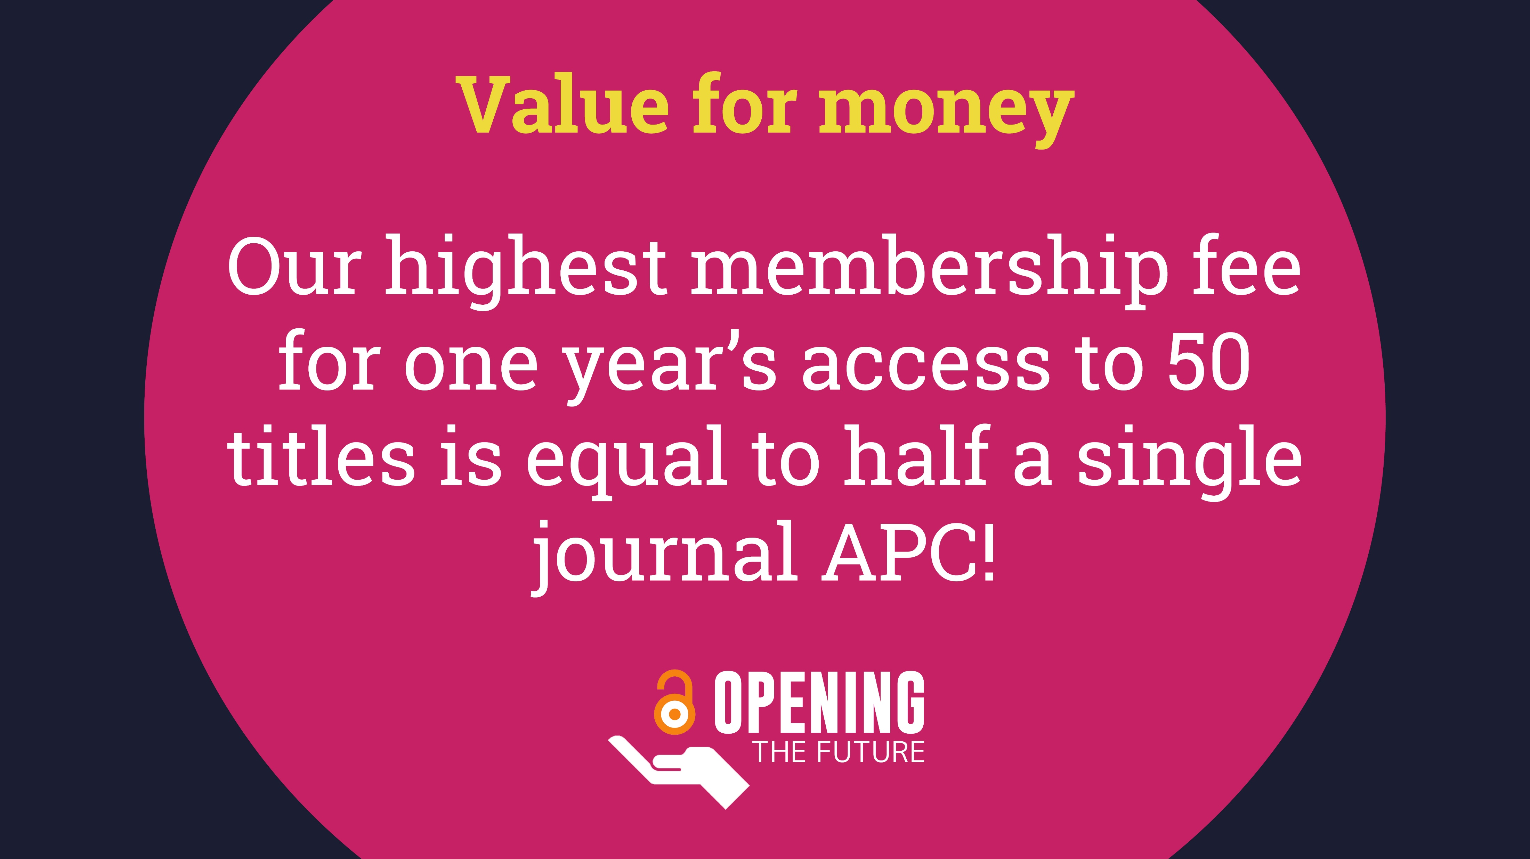

Slide 13





More information
martin.eve@bbk.ac.uk
https://openingthefuture.net
for FAQs, downloadable brochure, lists of available titles & ISBNs

