Slide 1


New Models for Open Access Monographs
Funding Open Access Books
Opening the Future
Opening the Future
Professor Martin Paul Eve
COPIM & Birkbeck, University of London
Prof. Martin Paul Eve
Birkbeck, University of London & COPIM

Slide 2

Why OA and why does it matter?
COVID 19 has exposed how vital OA is to the future of scholarly communications while also ripping out the heart of library budgets
The traditional publishing model is broken
Traditional sales of academic books have dropped but we’re still working the way we always have
OA offers increased readership, usage and citation
Funder mandates

Slide 3
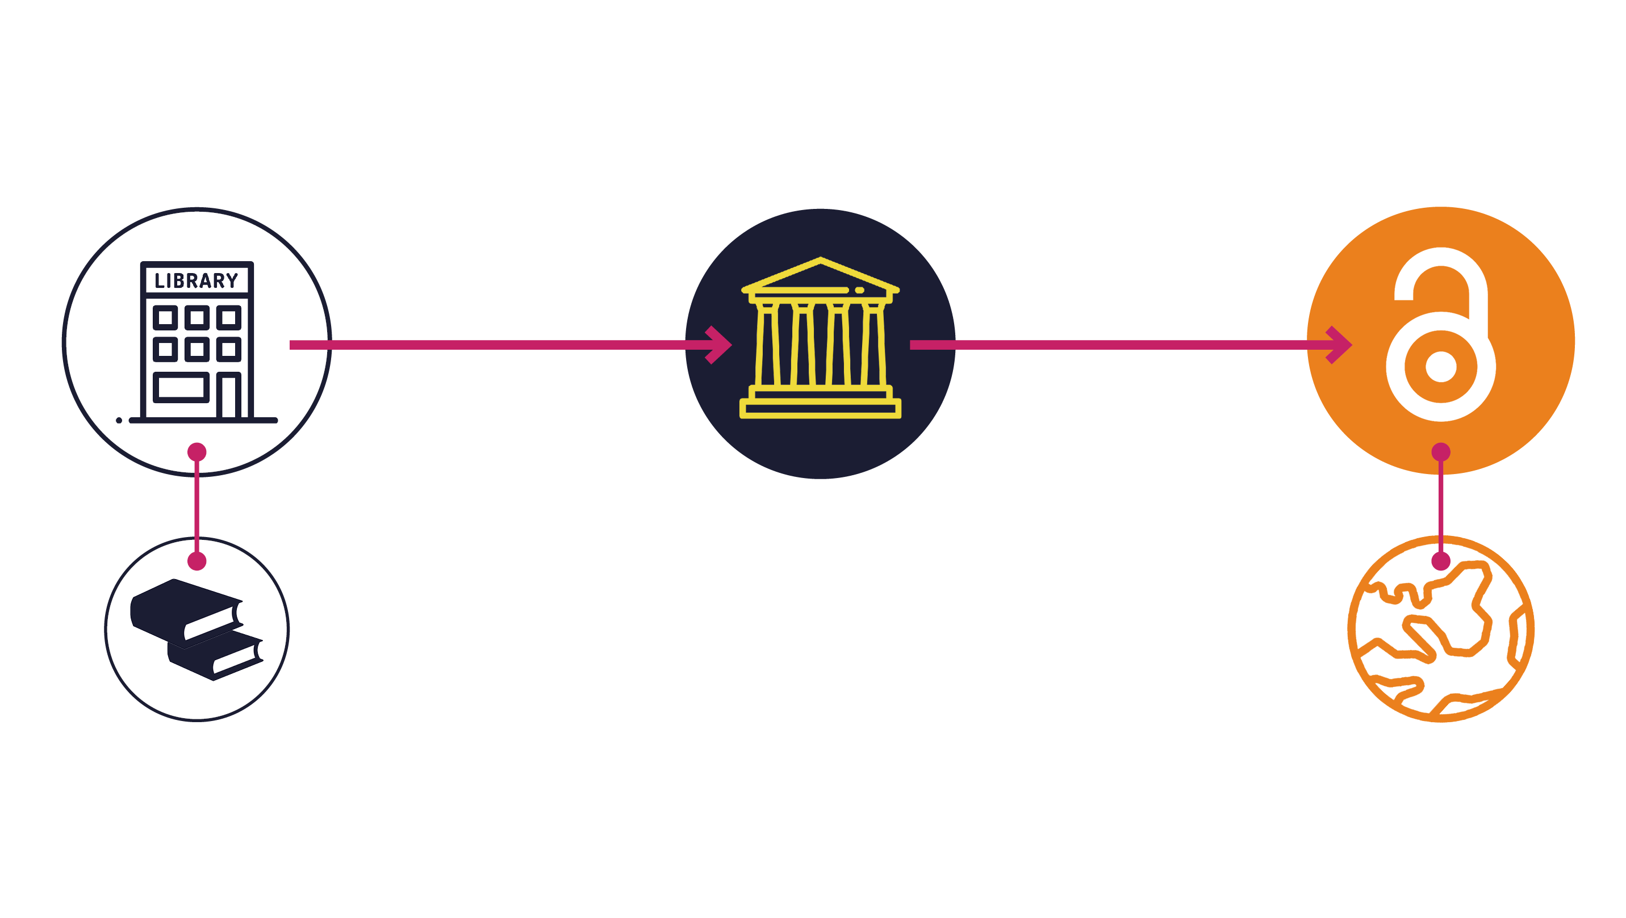
Opening the Future in a nutshell

Slide 4
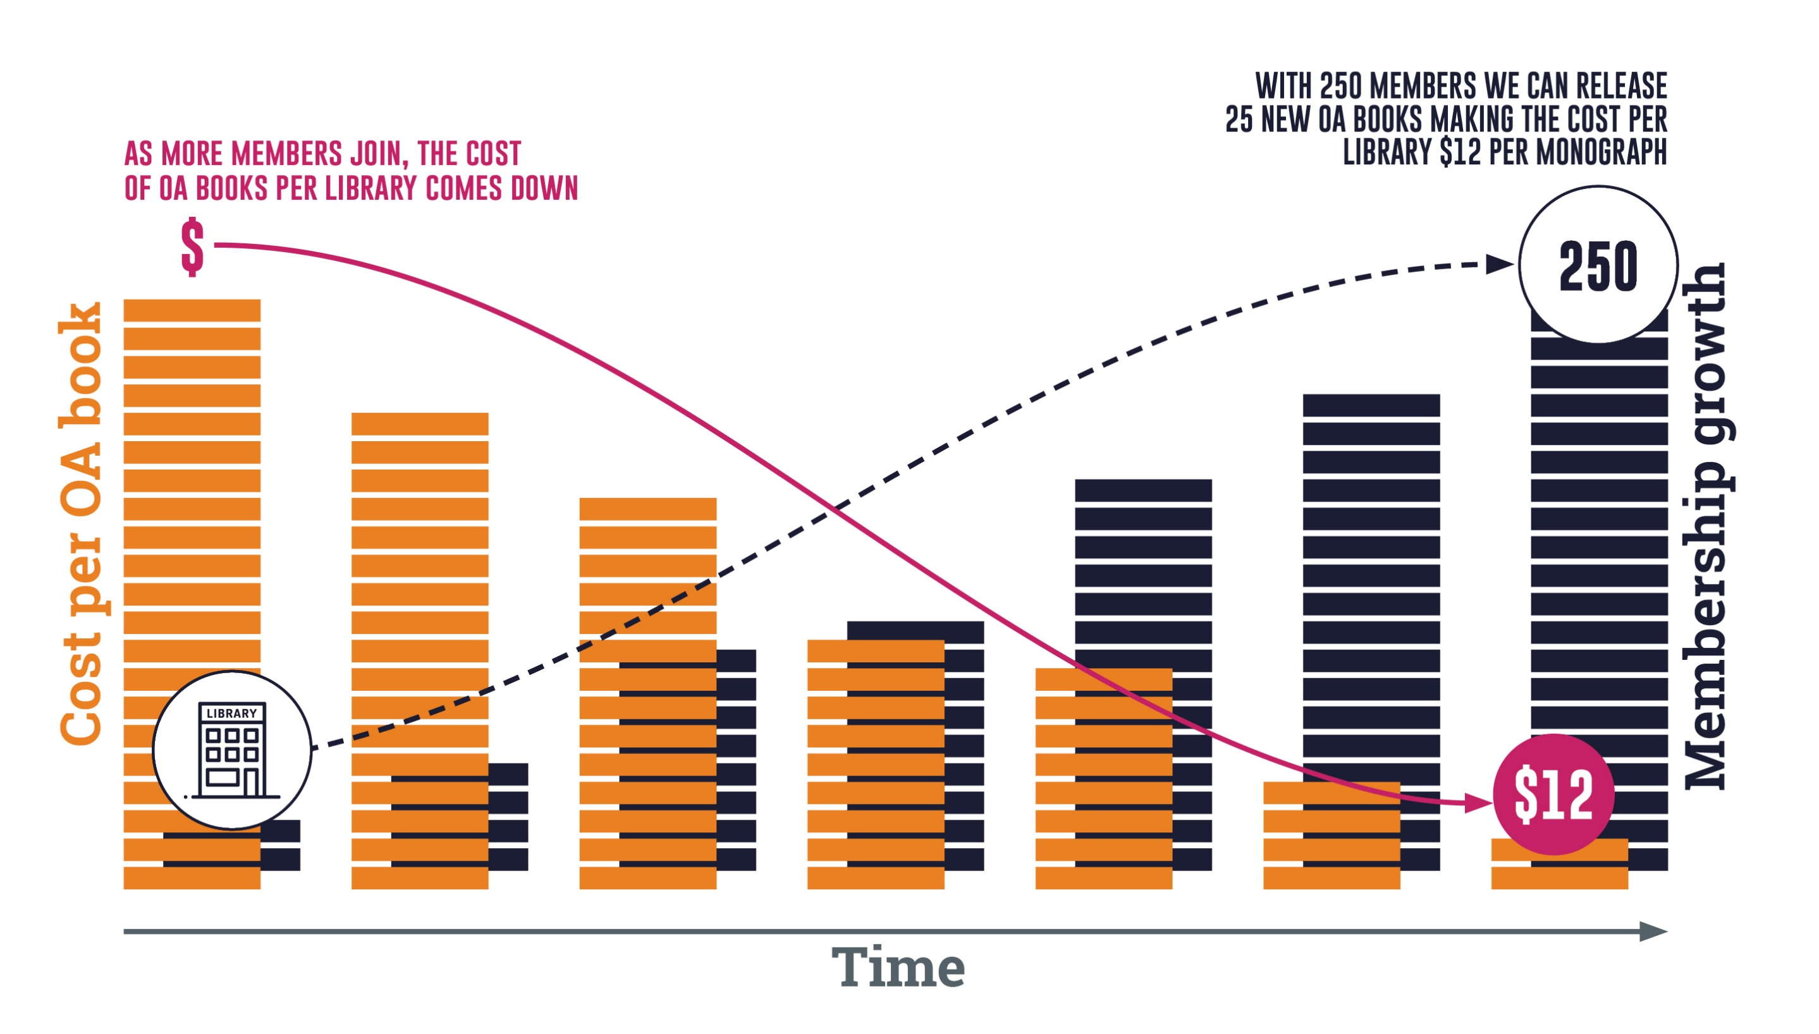
Note: the OA modelling here is based on an average membership of $800 per year (our medium-size band pricing). Appraising the cost per book/per library is only possible once we’ve had time to accrue members. This is a pilot project. Icons by Flaticon.com

Slide 5
What this model is not
This isn’t a ‘read and publish’ deal
This isn't a backlist-to-OA model
We're trying to avoid APCs
This model won't work for everyone

Slide 6
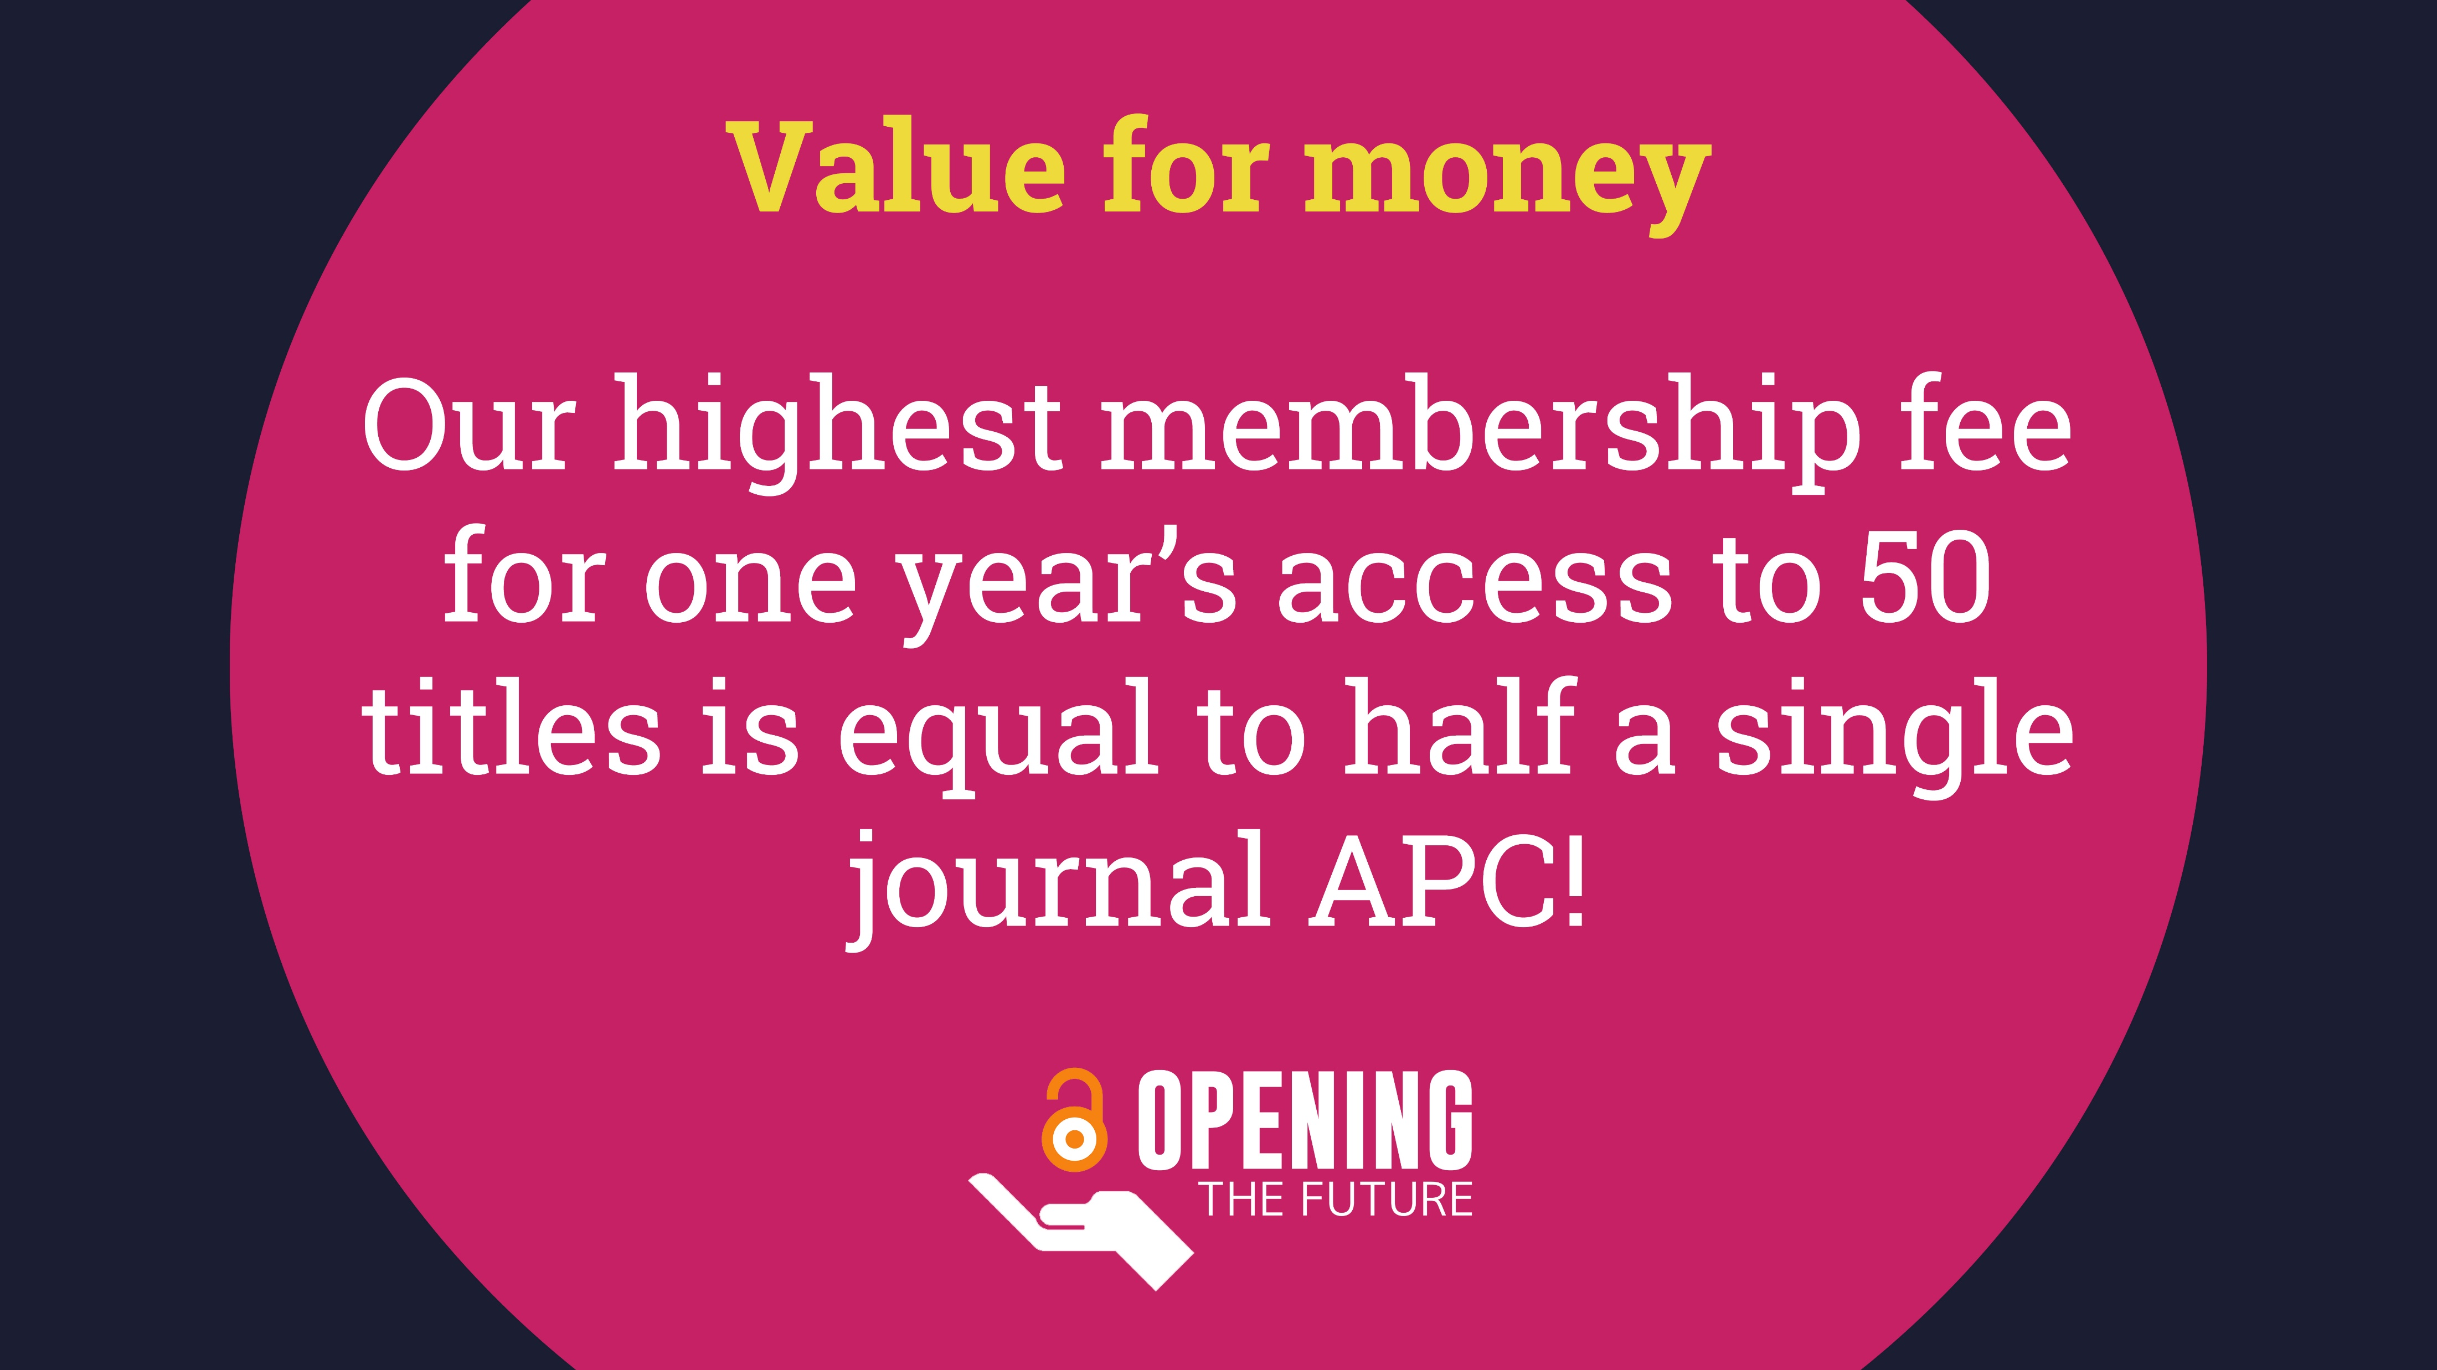

Slide 7







For more information
martin.eve@bbk.ac.uk
ceup.openingthefuture.net
lup.openingthefuture.net

