Slide 1


The Open Library of Humanities:
A Sustainable Scholar-led Model for OA without Publication Fees
Martin Paul Eve
martin.eve@bbk.ac.uk
Notes:
The goal of this presentation is to give you a sense of the complexities involved in scholarly publishing, the growth of Article Processing Charges (APCs) in open access, and the alternatives to this model. It then continues to discuss one solution to the potential problem in the form of the Open Library of humanities

Slide 2
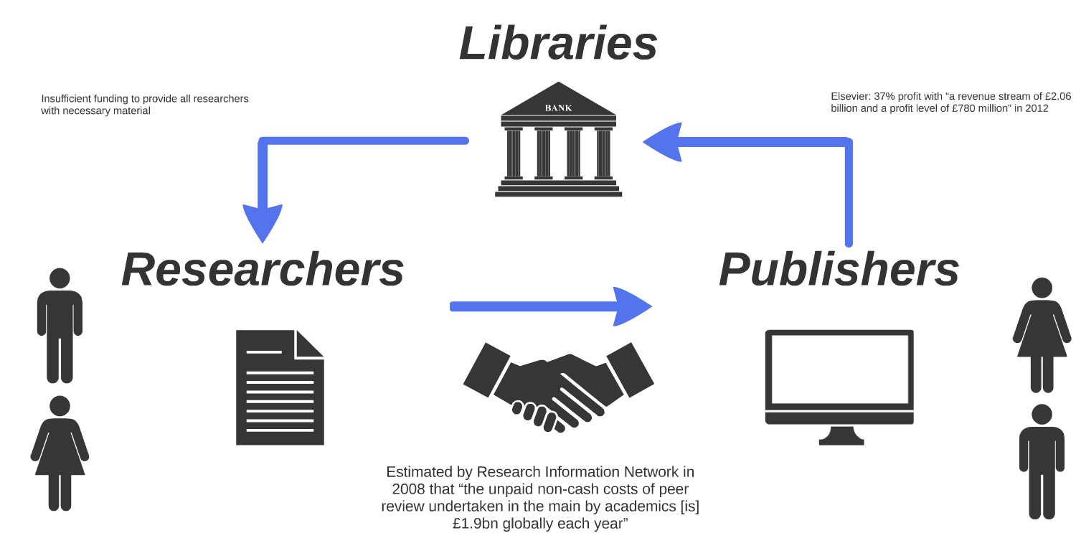

Slide 3

Peer-reviewed research
Free to read online
Permission to re-use
Gold: at publisher/source
Green: institutional/subject repository
Bronze: Available on a publisher website,
but not licensed
Gratis: free to read
Libre: free to re-use

Slide 4

Megajournal / Multijournal / Scholar-led / Not-for-profit / Collectively Funded
Notes:
The OLH is a mega-journal (the OLHJ) which publishes stand-alone and collection-based articles gathered into issues, as well as a collection of independent supported journals. The OLH is not-for-profit (and cannot be bought), and is collectively funded by a consortium of libraries paying a small subsidy fee. A lot of partners pay a little to get big results.

Slide 5

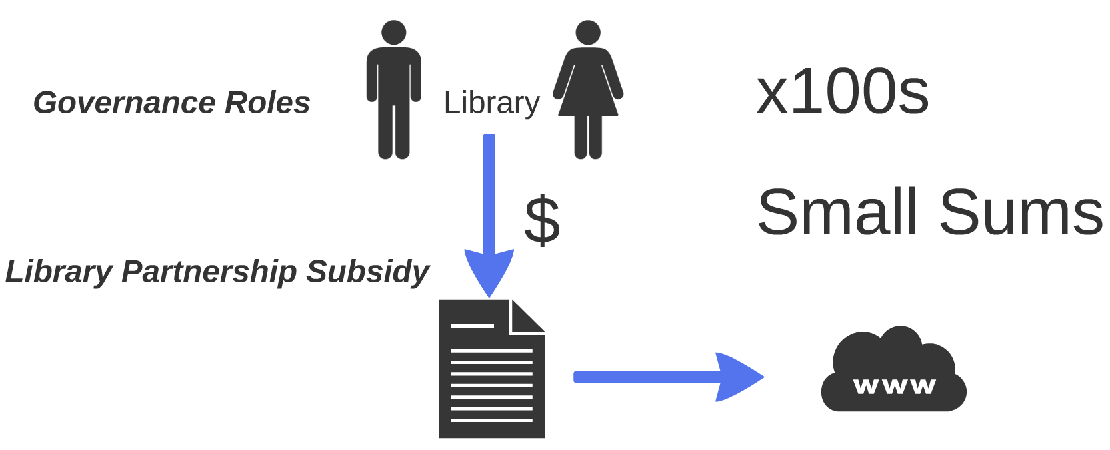
A consortial business model for OA
Notes:
The OLH library partnership subsidy model. Everyone pays small sums which go towards the production costs (direct and indirect) of articles without any profit. The system is very efficient and good value for money. Librarians vote on the admission of each new journal.

Slide 6

300+ Libraries Financially Supporting the OLH

Slide 7
Open Access: Challenges and opportunities
The opportunity of having research published openly is that it will always improve the speed, efficiency and efficacy of research, its reproducibility and the potential for collaboration. Open access also increases the visibility, usage and impact of research, allowing everyone to benefit from it.
In the OLH in 2019:
  We published 532 articles.
  These articles were viewed 870,324 times.
  These articles were uniquely downloaded 120,435
  Average time between submission and publication: 238 days
The challenges of open access have much to do with business models.
  One of the main goals of the Open Library of Humanities has been to ‘flip’ subscription journals to open access using a business model that does not require authors to pay.

Slide 8
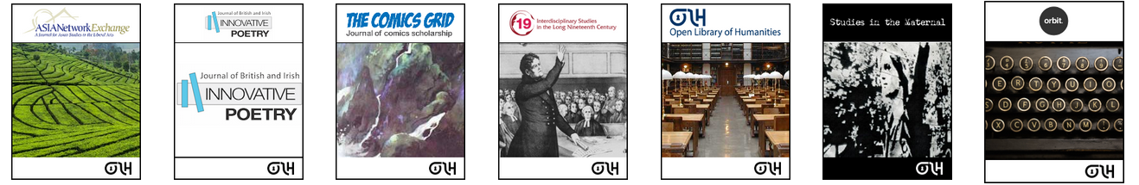



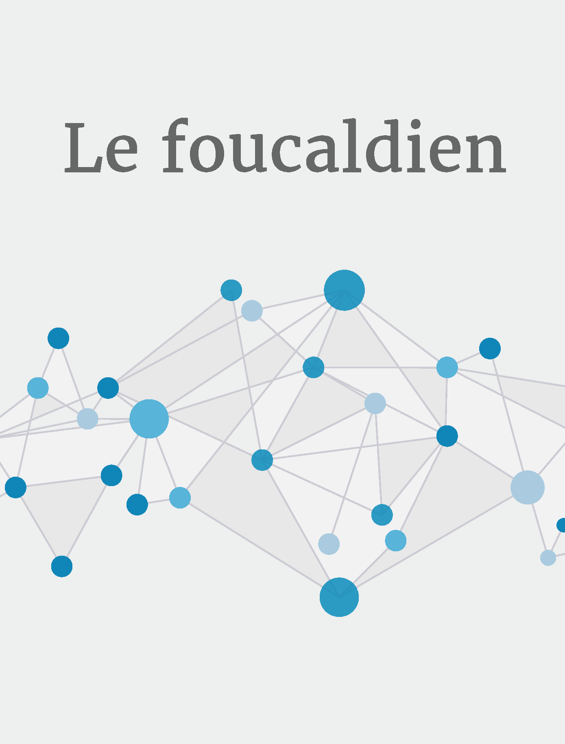

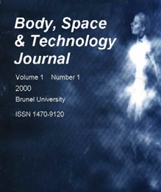

28 Journals on or Supported by the Platform ( 532 articles published in 2019)

Slide 9

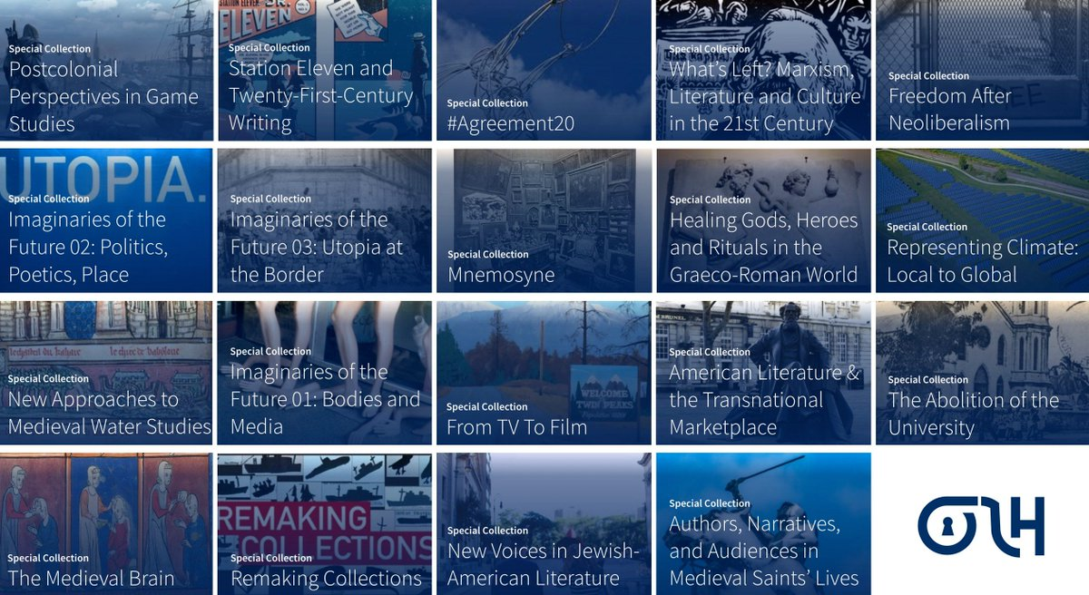



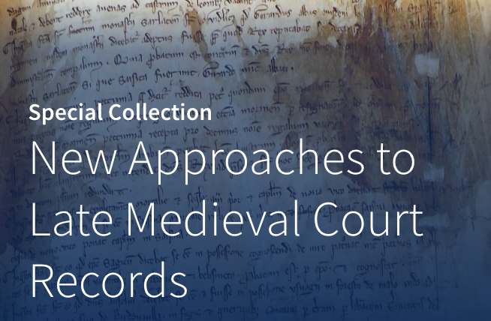



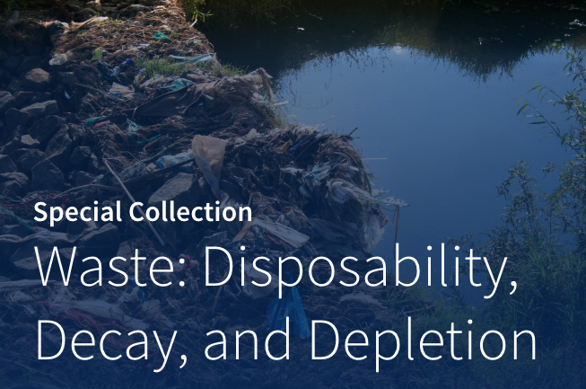



Slide 10
Thank you!
Presentation licensed under a CC BY 4.0 license. All institutional images excluded from CC license.​

