Slide 1



Making Open Access Book Funding Work Fairly
Professor Martin Paul Eve
COPIM & Birkbeck, University of London

Slide 2

Why OA and why does it matter?
COVID 19 has exposed how vital OA is to the future of scholarly communications while also ripping out the heart of library budgets
The traditional publishing model is broken
Traditional sales of academic books have dropped but we’re still working the way we always have
OA offers increased readership, usage and citation
Funder mandates

Slide 3

Large, well-funded academic presses
MIT’s D20 has a subscription threshold before OA titles can be released
Small to medium-sized academic presses
Low risk, no threshold models like Opening the Future
Three strata
Opening the Future,
MIT’s D20, and other
library subscription models
Scholar-led born-OA presses
Open collectives working together to provide combined offers

Slide 4
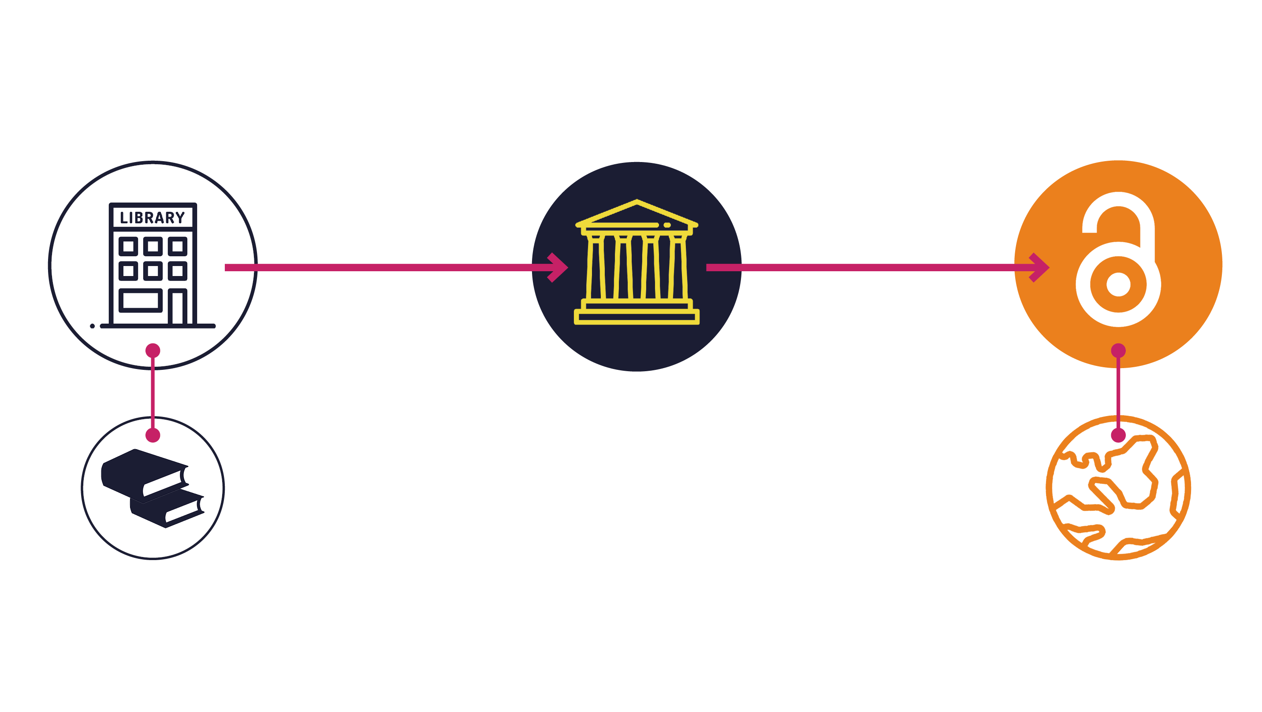
Opening the Future in a nutshell

Slide 5
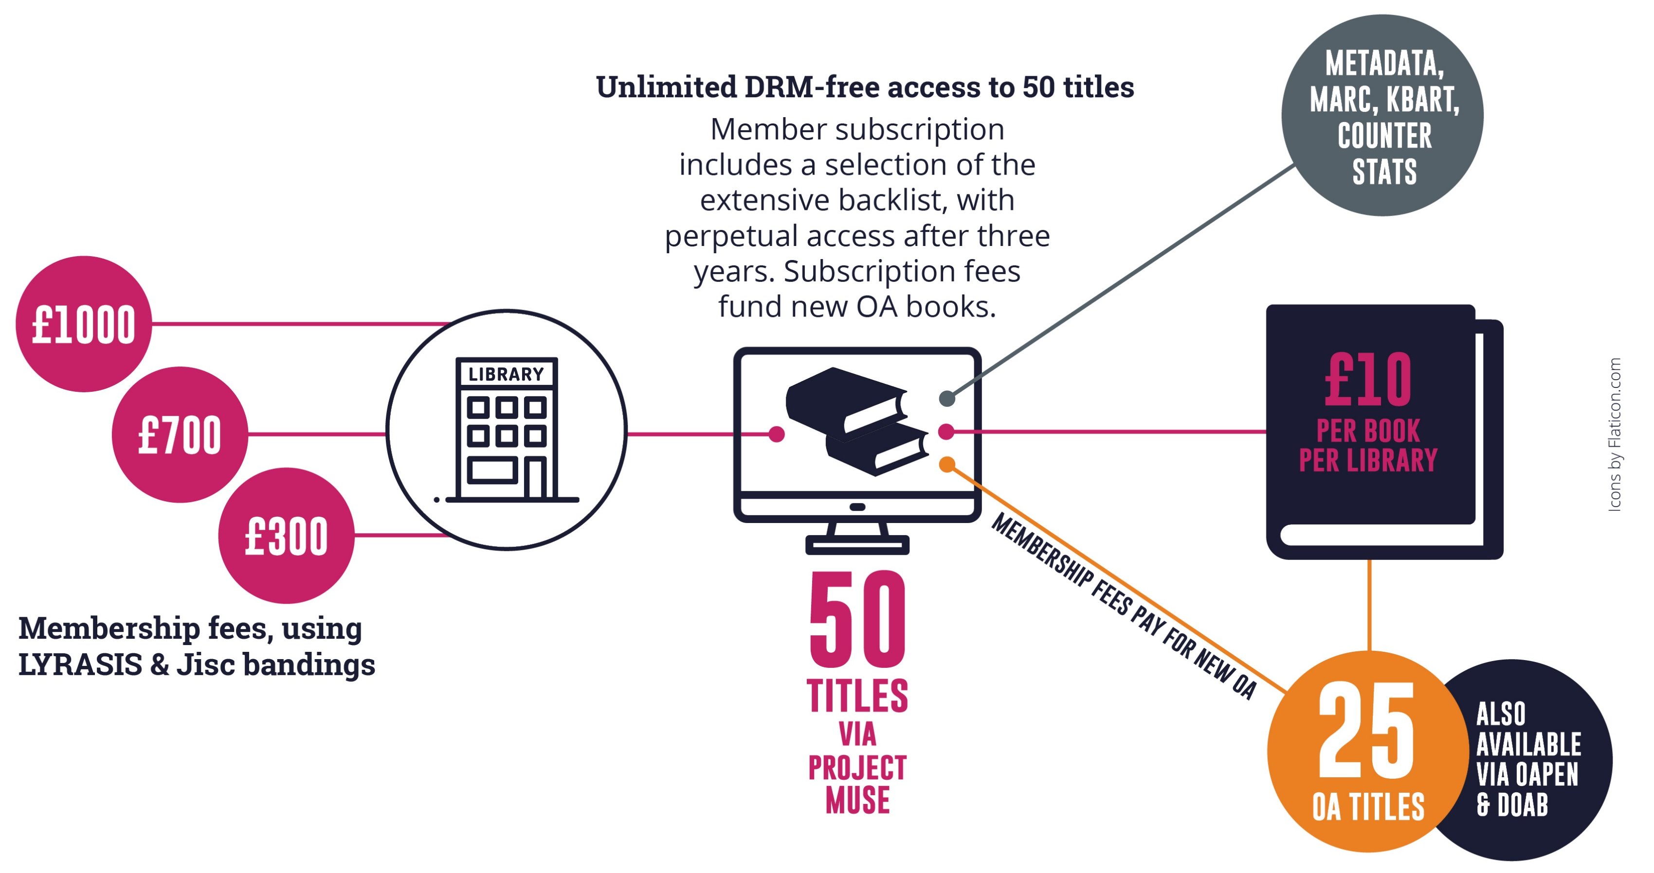
Note: £10 per book is for indication only and is calculated on the basis of every library receiving 50 books as a subscription and gaining access to 25 new open access books per year. Cost modelling is based on an average membership of £700 per year (our medium-size band pricing) and assumes 250 library members.
Appraising the cost per book/per library is only possible once we’ve had time to accrue members. This is a pilot project.

Slide 6
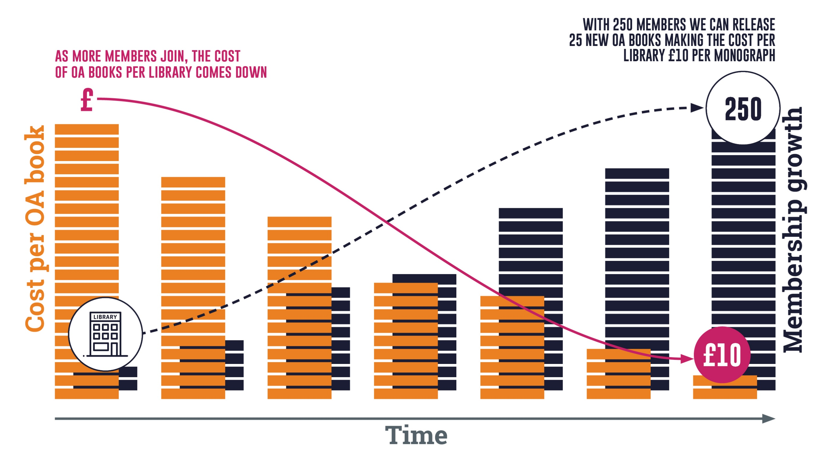
Note: the OA modelling here is based on an average membership of £700 per year (our medium-size band pricing). Appraising the cost per book/per library is only possible once we’ve had time to accrue members. This is a pilot project. Icons by Flaticon.com

Slide 7




Piloting Opening the Future
Liverpool University Press & Central European University Press

Slide 8
Central European University Press
279
7
they were downloaded
350,000
of the top 10 downloads were over
titles were made open on Project MUSE during
times, from
10
129
March to June 2020
countries
years old

Slide 9
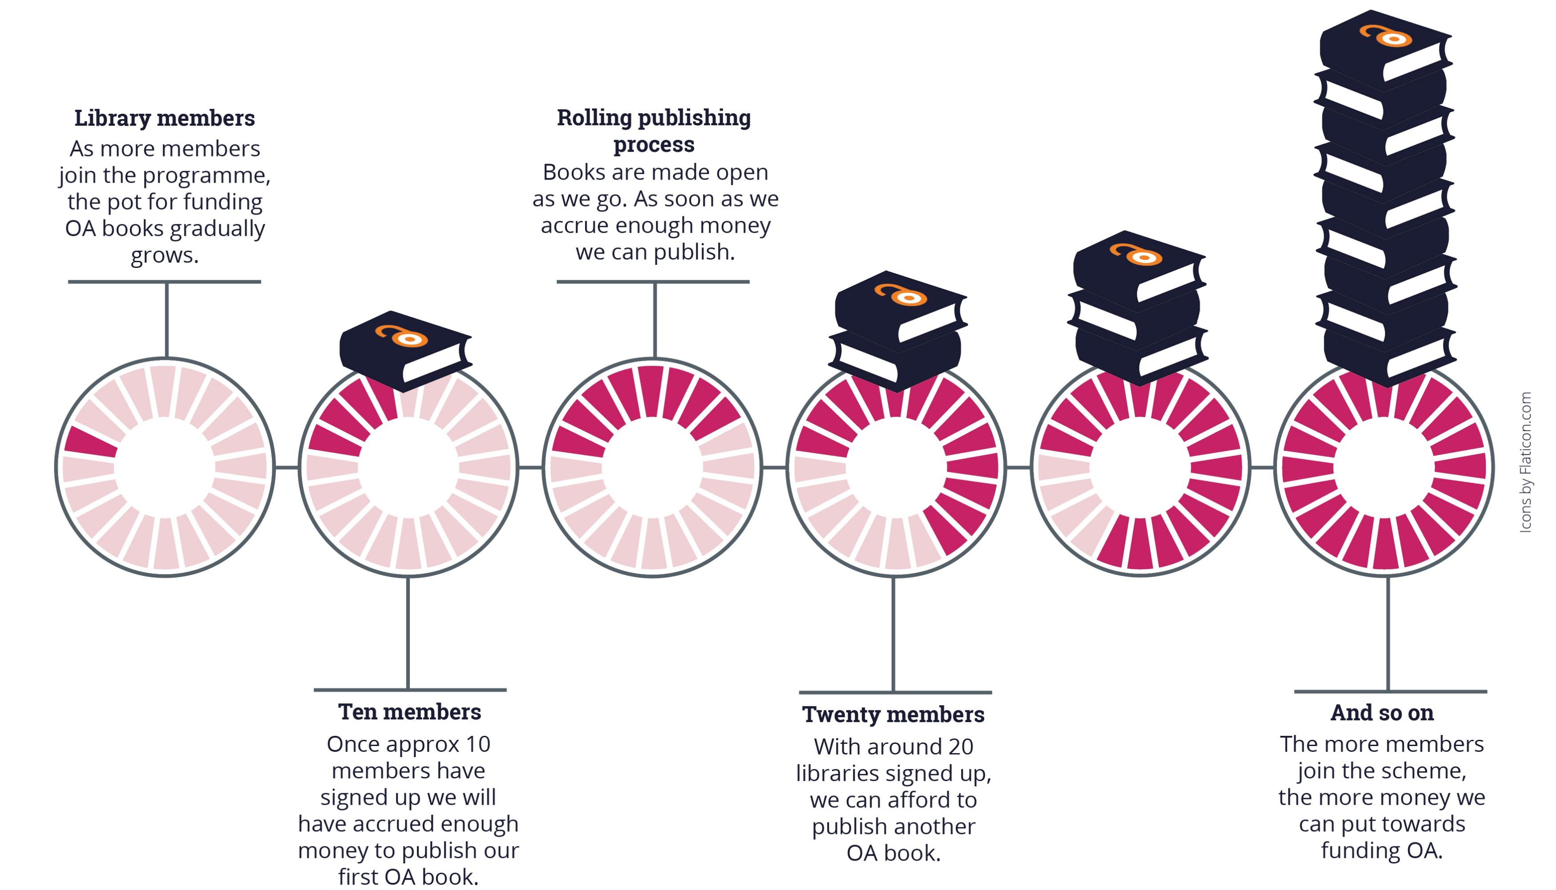
Note: the OA modelling here is based on an average membership of £700 per year (our medium-size band pricing). Appraising the cost per book/per library is only possible once we’ve had time to accrue members. This is a pilot project.

Slide 10
What this model is not
Opening the Future is not a ‘read and publish’ deal

Slide 11




SCALING infrastructure development at COPIM
Opening the Future
Open Book Collective - a single platform where libraries can find, assess, and sign up to support OA book programmes.
THOTH – Open metadata & dissemination
And collaborating with initiatives around the world

Slide 12



For more information
martin.eve@bbk.ac.uk
openingthefuture.net
for FAQs, downloadable brochure, lists of available titles & ISBNs

