Slide 1


Open Access and Digital Mutations in Academic Publishing
Martin Paul Eve
martin.eve@bbk.ac.uk
Notes:
The goal of this presentation is to give you a sense of the complexities involved in scholarly publishing, the growth of Article Processing Charges (APCs) in open access, and the alternatives to this model. It then continues to discuss one solution to the potential problem in the form of the Open Library of humanities

Slide 2

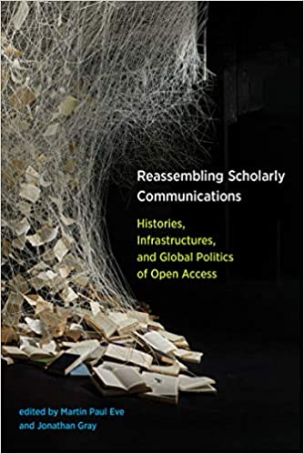
Background

Slide 3
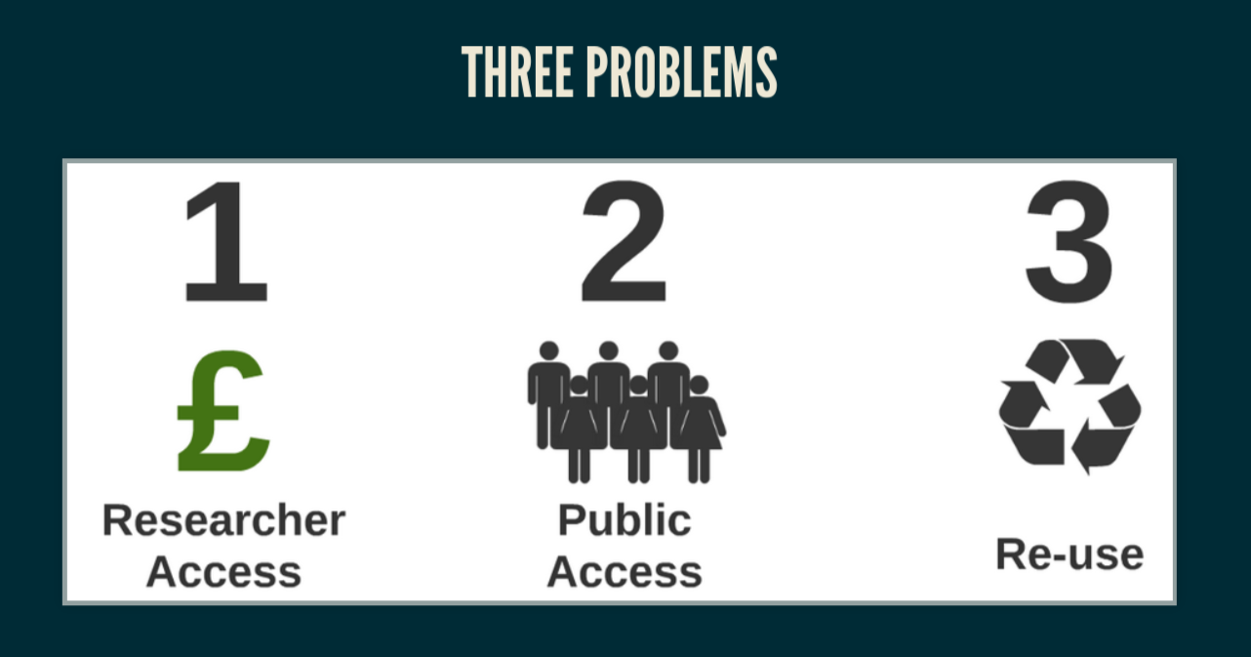
Scholarly Communications

Slide 4
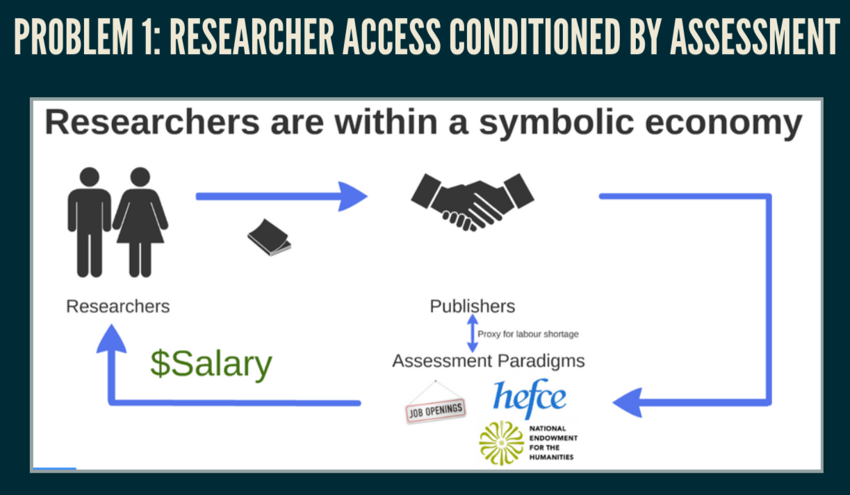

Slide 5
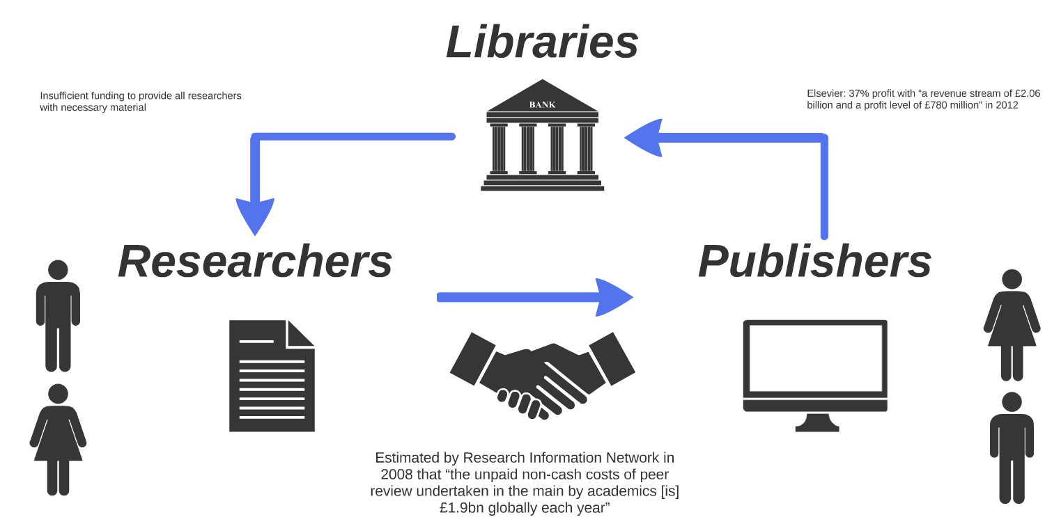

Slide 6
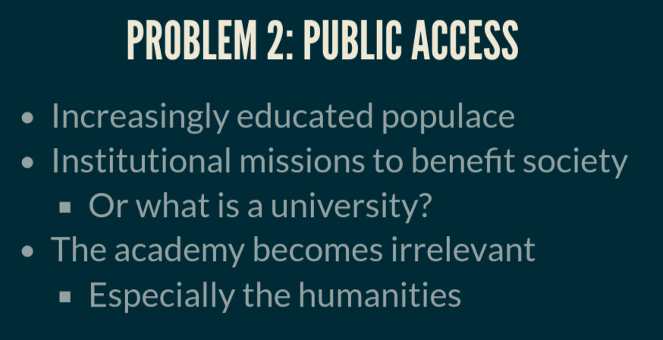

Slide 7
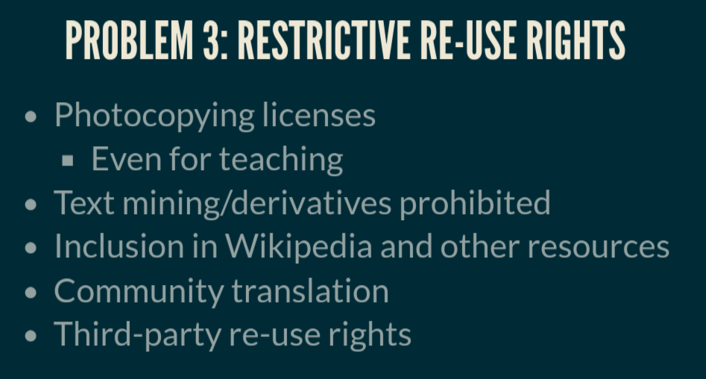

Slide 8

Peer-reviewed research
Free to read online
Permission to re-use
Gold: at publisher/source
Green: institutional/subject repository
Bronze: Available on a publisher website, but not licensed
Gratis: free to read
Libre: free to re-use

Slide 9

Why OA and why does it matter?
COVID 19 has exposed how vital OA is to the future of scholarly communications while also ripping out the heart of library budgets
The traditional publishing model is broken
Traditional sales of academic books have dropped but we’re still working the way we always have
OA offers increased readership, usage and citation
Funder mandates

Slide 10

OA Policies
"The truth is that we must all go further" - Amanda Solloway, Minister for Science, Research and Innovation, August 2021
UKRI review published August 2021 (only for project funding):
  Zero-embargo green requirement
  OA extended to monographs from 2024
REF review will be next
  Ministerial steer is clear on direction of travel
  But not yet set in stone
  Unclear what funding would be provided for OA monographs
    See Eve, Martin Paul, Kitty Inglis, David Prosser, Lara Speicher, and Graham Stone. 2017. ‘Cost Estimates of an Open Access Mandate for Monographs in the UK’s Third Research Excellence Framework’. Insights: The UKSG Journal 30 (3). https://doi.org/10.1629/uksg.392.

Slide 11
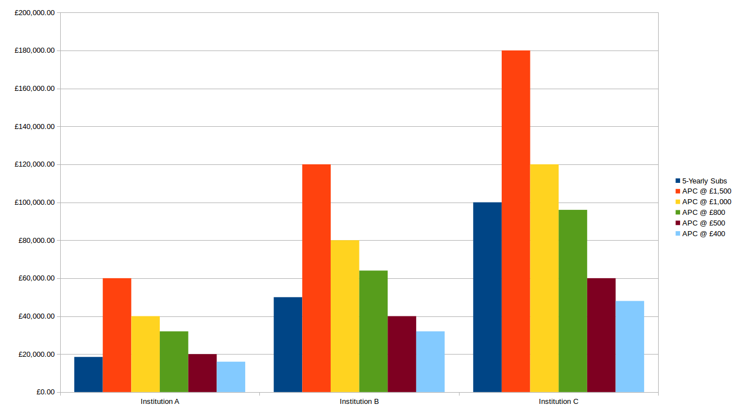
APCs are Problematic
(BPCs even more so)

Slide 12

Large, well-funded academic presses
MIT’s D20 has a subscription threshold before OA titles can be released
Small to medium-sized academic presses
Low risk, no threshold models like Opening the Future
Three strata
Scholar-led born-OA presses
Opening the Future,
MIT’s D20, and other
library subscription models
Open collectives working together to provide combined offers

Slide 13


Megajournal / Multijournal / Scholar-led / Not-for-profit / Collectively Funded
Notes:
The OLH is a mega-journal (the OLHJ) which publishes stand-alone and collection-based articles gathered into issues, as well as a collection of independent supported journals. The OLH is not-for-profit (and cannot be bought), and is collectively funded by a consortium of libraries paying a small subsidy fee. A lot of partners pay a little to get big results.

Slide 14

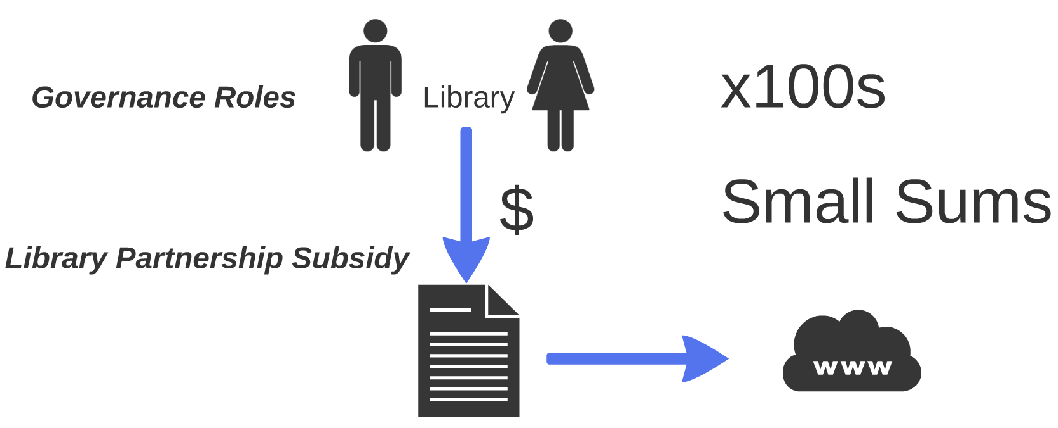
A consortial business model for OA
Notes:
The OLH library partnership subsidy model. Everyone pays small sums which go towards the production costs (direct and indirect) of articles without any profit. The system is very efficient and good value for money. Librarians vote on the admission of each new journal.

Slide 15

300+ Libraries Financially Supporting the OLH

Slide 16
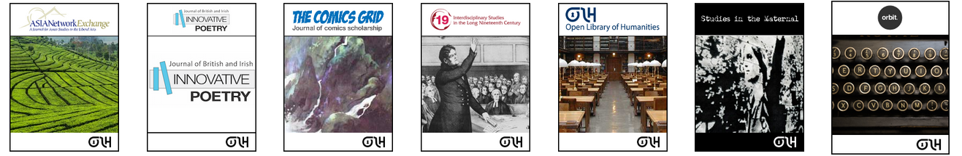

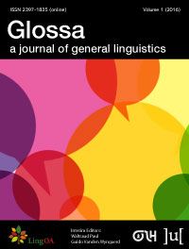
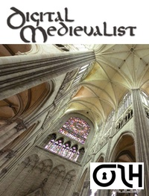
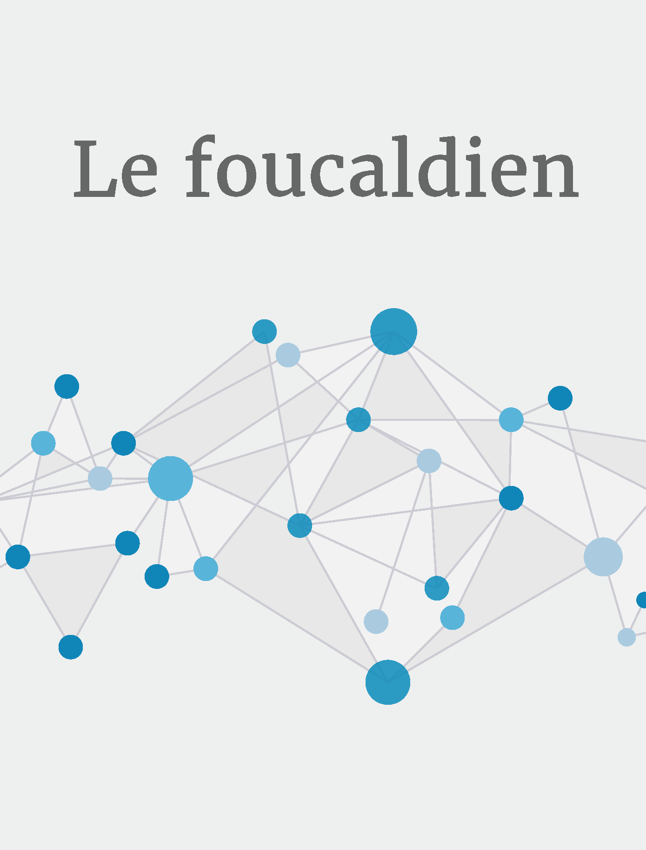
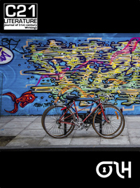


28 Journals on or Supported by the Platform ( 532 articles published in 2019)

Slide 17
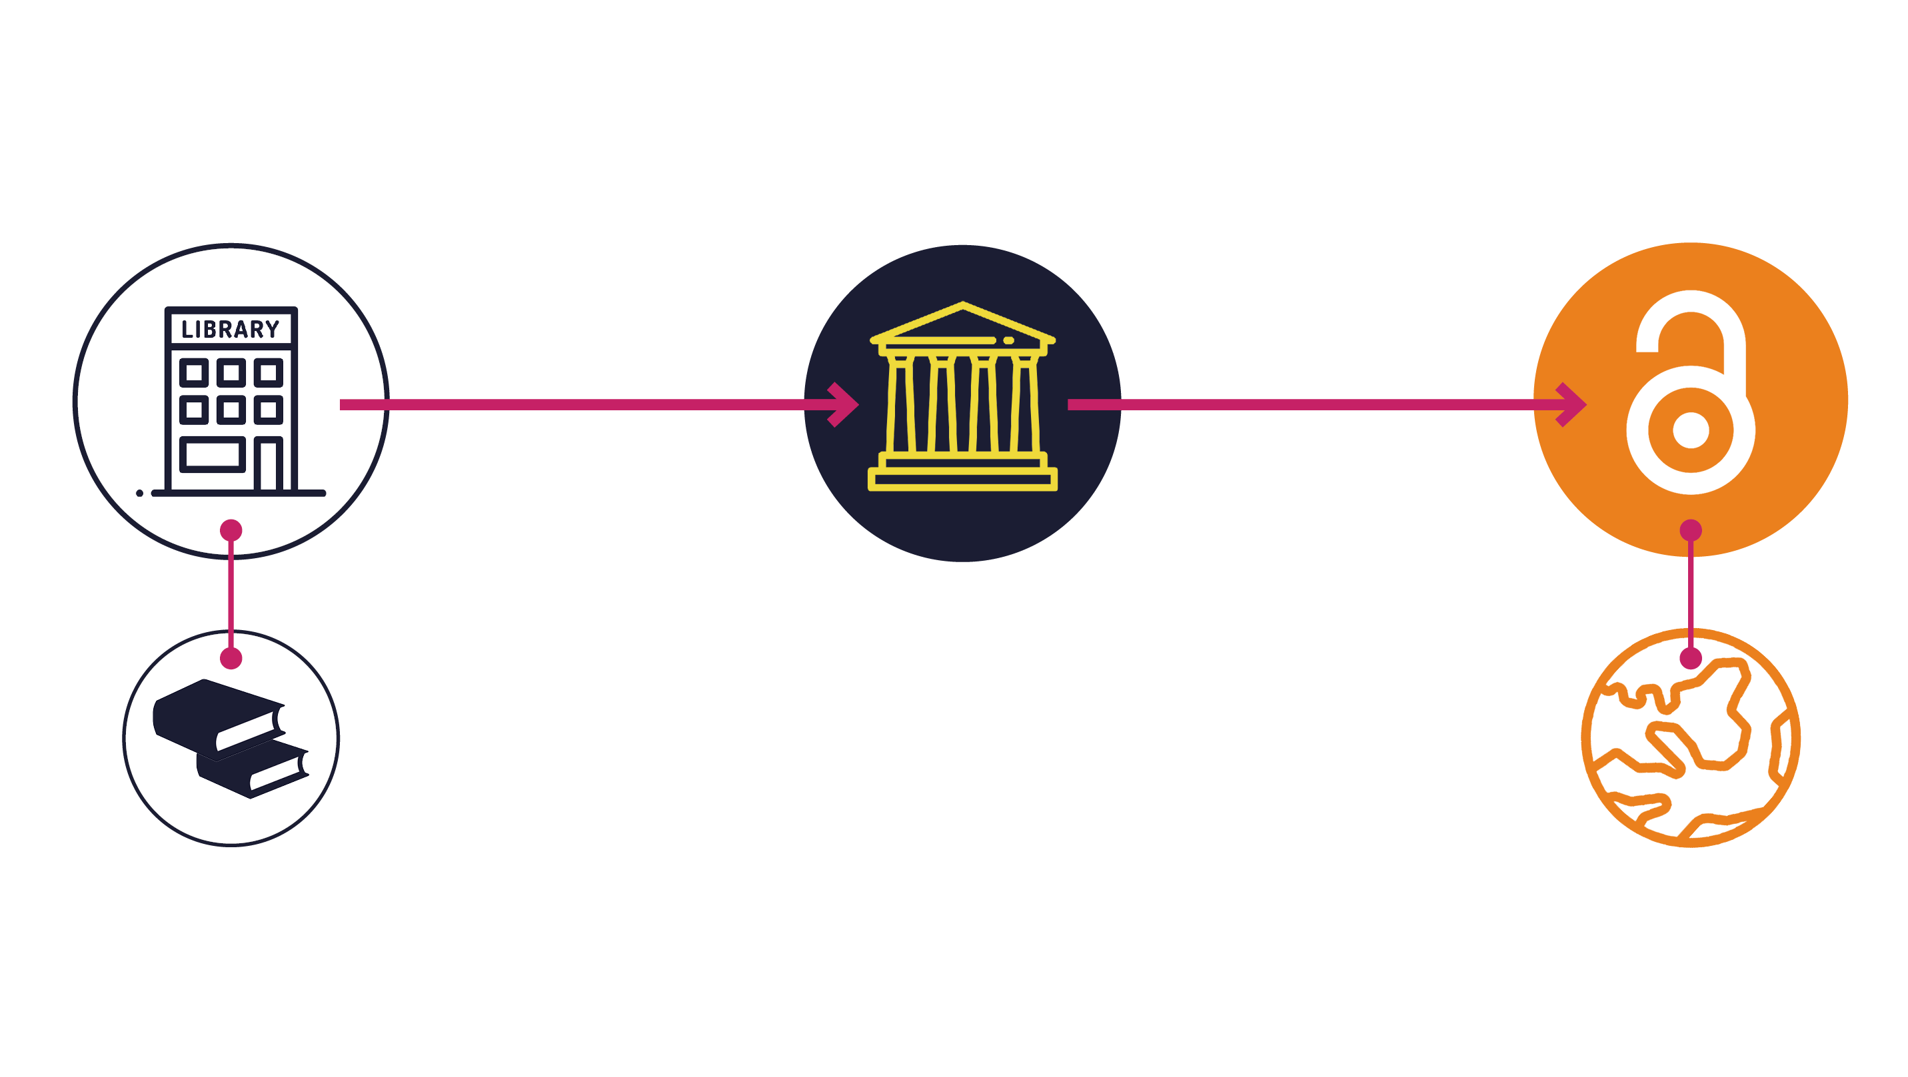
Opening the Future in a nutshell

Slide 18

New Models
Preprints and subject repositories
Open and post-publication peer review (peer review can be pretty terrible)
Rolling publication
Software platforms: Janeway
Remix, re-use, and versioning
Articles as coherent stylistic units (non-unified citation styles)
Variable-length work

Slide 19
Thank you!
Presentation licensed under a CC BY 4.0 license. All institutional images excluded from CC license.​

