Slide 1

Basic Instinct
Simple
Computation for Close Readings
Martin Paul Eve
martin@eve.gd

Slide 2
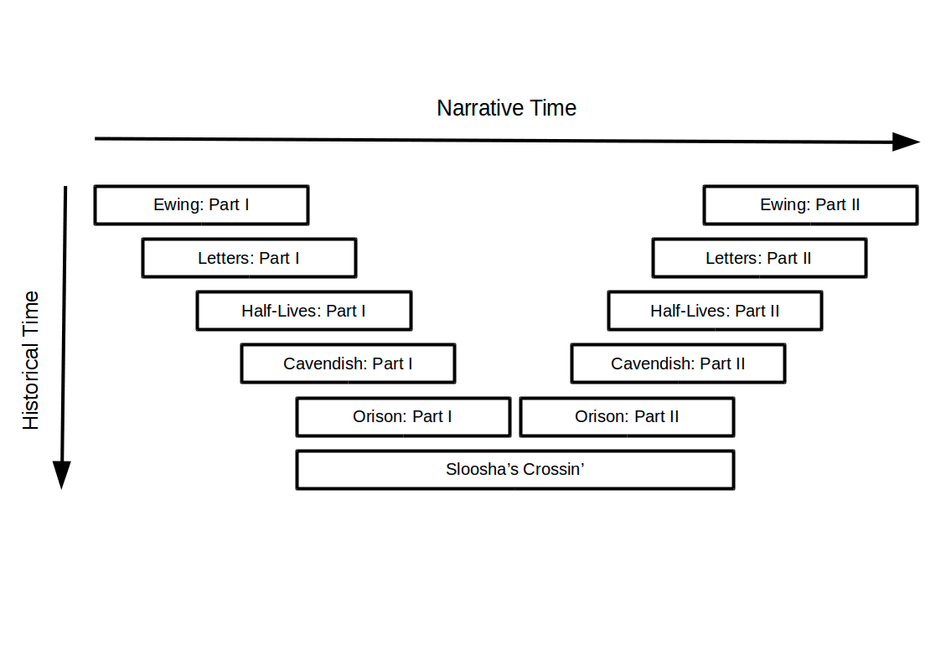
David Mitchell’s Cloud Atlas (2004)

Slide 3

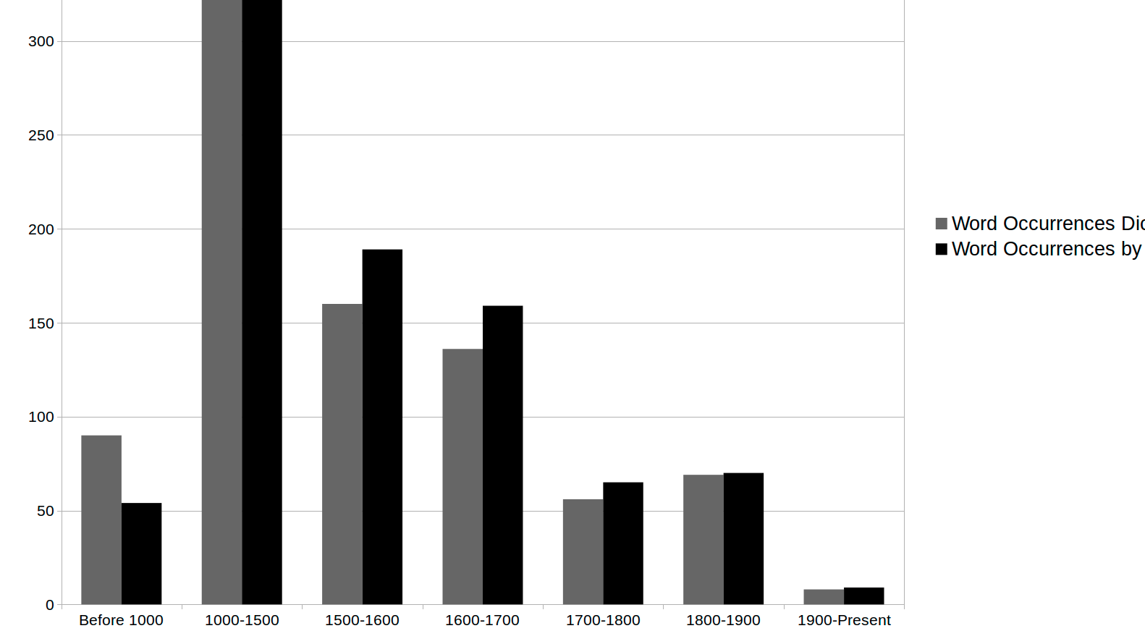
Detecting Anachronism

Slide 4
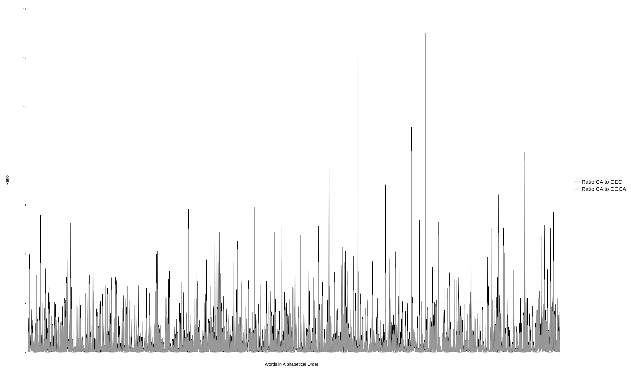

Slide 5
Questions, Comments, Discussion
Martin Paul Eve
martin@eve.gd

