Slide 1
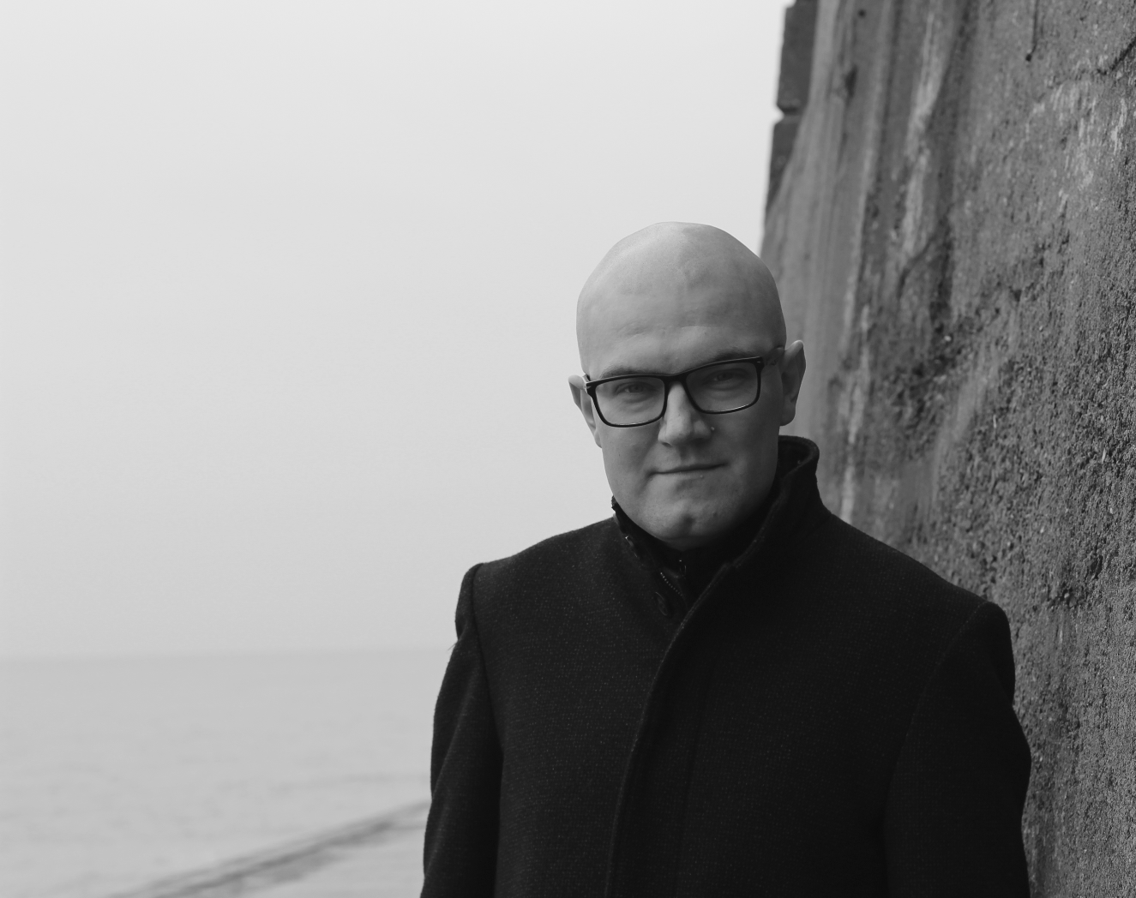
Warez
The Infrastructures and Aesthetics of Piracy
Martin Paul Eve
martin@eve.gd

Slide 2

Wherez and What?
Eve, Martin Paul, Warez: The Infrastructure and Aesthetics of Piracy (Earth, Milky Way: punctum books, 2021)

Slide 3
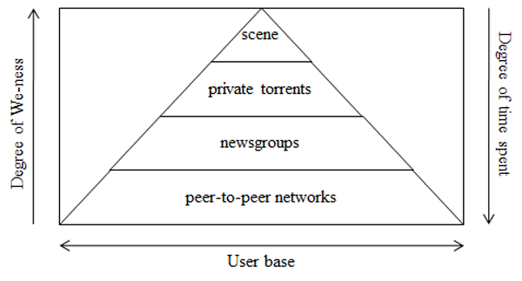
What is “The Scene”? What is it not?
A space where piracy groups race to release material
An alternative reality game
Not peer-to-peer file sharing
Huizing and van der Wal’s pyramid. Reproduced under a Creative Commons License. Ard Huizing and Jan A. van der Wal, ‘Explaining the Rise and Fall of the Warez MP3 Scene: An Empirical Account from the Inside’, First Monday, 19.10 (2014)

Slide 4
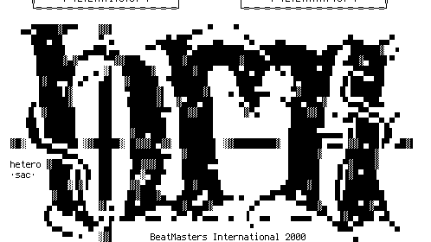
“Releases”
Naming conventions e.g. Aeon_Zen-Inveritas-WEB-2019-ENTiTLED
NFO: iNFOrmation
SFV: checksums
It's a race

Slide 5

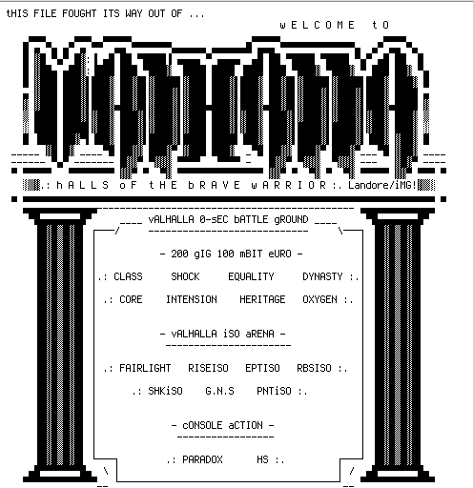
Topsites
Affiliates
High bandwidth
High security (bouncers)
Custom FTPDs
IRC channels

Slide 6

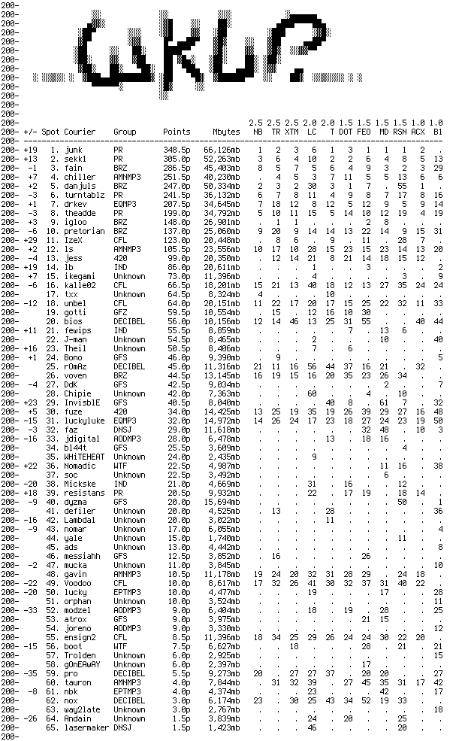
Racing and Nuking
Release groups (crack and supply speed)
Couriers (wkup)
Autotrading
Nuking

Slide 7

Artworks and Skills

Slide 8
Questions, Comments, Discussion
Martin Paul Eve
martin@eve.gd

