Slide 1

Shadow Libraries
Education and Other Forms of Piracy
Martin Paul Eve
martin@eve.gd

Slide 2

Is Education Different?
the ‘initiative fulfils United Nations/UNESCO world development goals that mandate the removal of restrictions on access to science’ and that ‘[l]imiting and delaying humanity’s access to science isn’t a business, it’s a crime, one with an untold number of victims and preventable deaths’.
- u/shrine 2020

Slide 3

Disciplinary Hierarchy?
‘Limiting and delaying humanity’s access to science isn’t a business, it’s a crime, one with an untold number of victims and preventable deaths’
What about disciplines that don’t ‘save lives’?

Slide 4
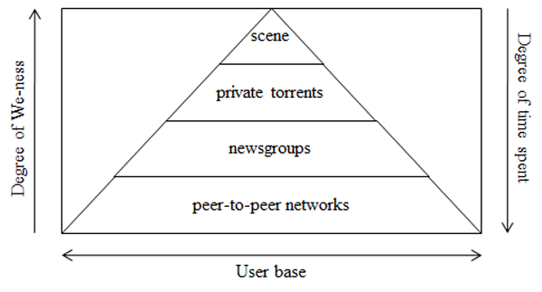
What is “The Scene”? What level of professional organization are we talking about?
A space where piracy groups race to release material
An alternative reality game
Not peer-to-peer file sharing
Huizing and van der Wal’s pyramid. Reproduced under a Creative Commons License. Ard Huizing and Jan A. van der Wal, ‘Explaining the Rise and Fall of the Warez MP3 Scene: An Empirical Account from the Inside’, First Monday, 19.10 (2014)

Slide 5

Information Security and Shadow Libraries
Sources of data?
Credential data and library information systems
Geopolitical contentions
The politics of accusation
Size: the British Library is approximately 170 million items total and 13.5 million books
  9,000 missing items!

