Slide 1



COPIM & Open Access Monographs
Opportunities for supporting Open Access books
Professor Martin Paul Eve
COPIM & Birkbeck, University of London
Open Access Australasia Webinar, Tues 24 May 2022

Slide 2

Why OA and why does it matter?
COVID 19 has exposed how vital OA is to the future of scholarly communications while also ripping out the heart of library budgets
The traditional publishing model is broken
Traditional sales of academic books have dropped but we’re still working the way we always have
OA offers increased readership, usage and citation
Funder mandates

Slide 3

OA Policies in the UK
"The truth is that we must all go further" - Amanda Solloway, Minister for Science, Research and Innovation, August 2021
UKRI review published August 2021 (only for project funding):
  Zero-embargo green requirement
  OA extended to monographs from 2024
REF review will be next
  Ministerial steer is clear on direction of travel
  But not yet set in stone
  Unclear what funding would be provided for OA monographs
    See Eve, Martin Paul, Kitty Inglis, David Prosser, Lara Speicher, and Graham Stone. 2017. ‘Cost Estimates of an Open Access Mandate for Monographs in the UK’s Third Research Excellence Framework’. Insights: The UKSG Journal 30 (3). https://doi.org/10.1629/uksg.392.

Slide 4

£3.6m
COPIM is funded by the Research England Development Fund (REDFund) as a major development project in the Higher Education sector with significant public benefits, and by Arcadia, a charitable fund of Lisbet Rausing and Peter Baldwin.
International partnership
Libraries,
Universities,
OA book publishers, Researchers,
Infrastructure providers.
Notes:
Explain here that COPIM is working with a number of presses, and that this model has been adopted by CEUP and LUP, but here the case study will be CEUP

Slide 5

Large, well-funded academic presses
MIT’s D20 has a subscription threshold before OA titles can be released
Small to medium-sized academic presses
Low risk, no threshold models like Opening the Future
Three strata
Opening the Future,
MIT’s D20, and other
library subscription models
Scholar-led born-OA presses
Open collectives working together to provide combined offers

Slide 6
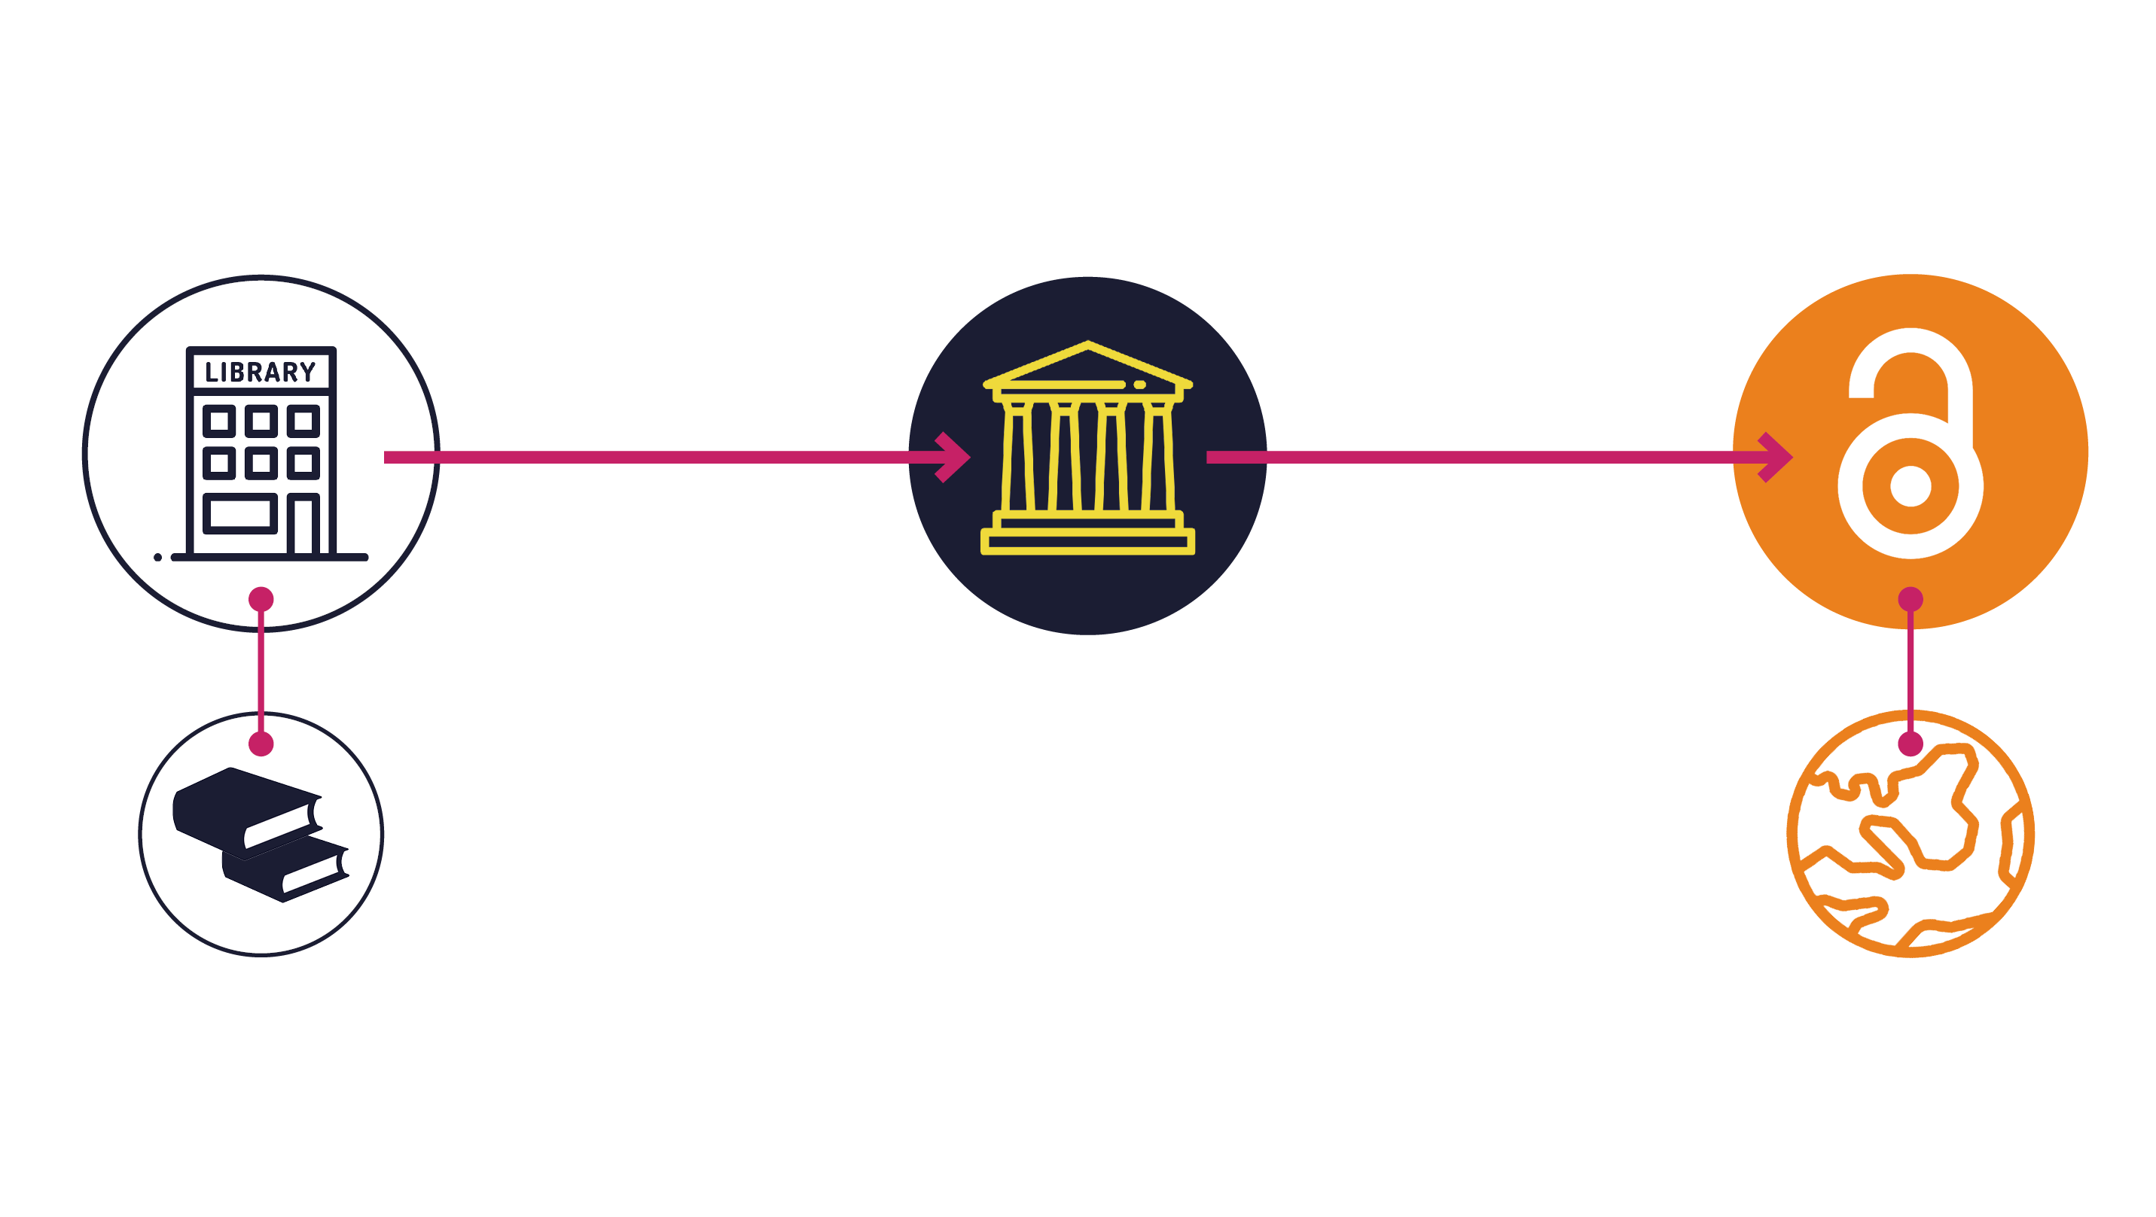
Opening the Future in a nutshell

Slide 7



Piloting Opening the Future
Liverpool University Press & Central European University Press

Slide 8
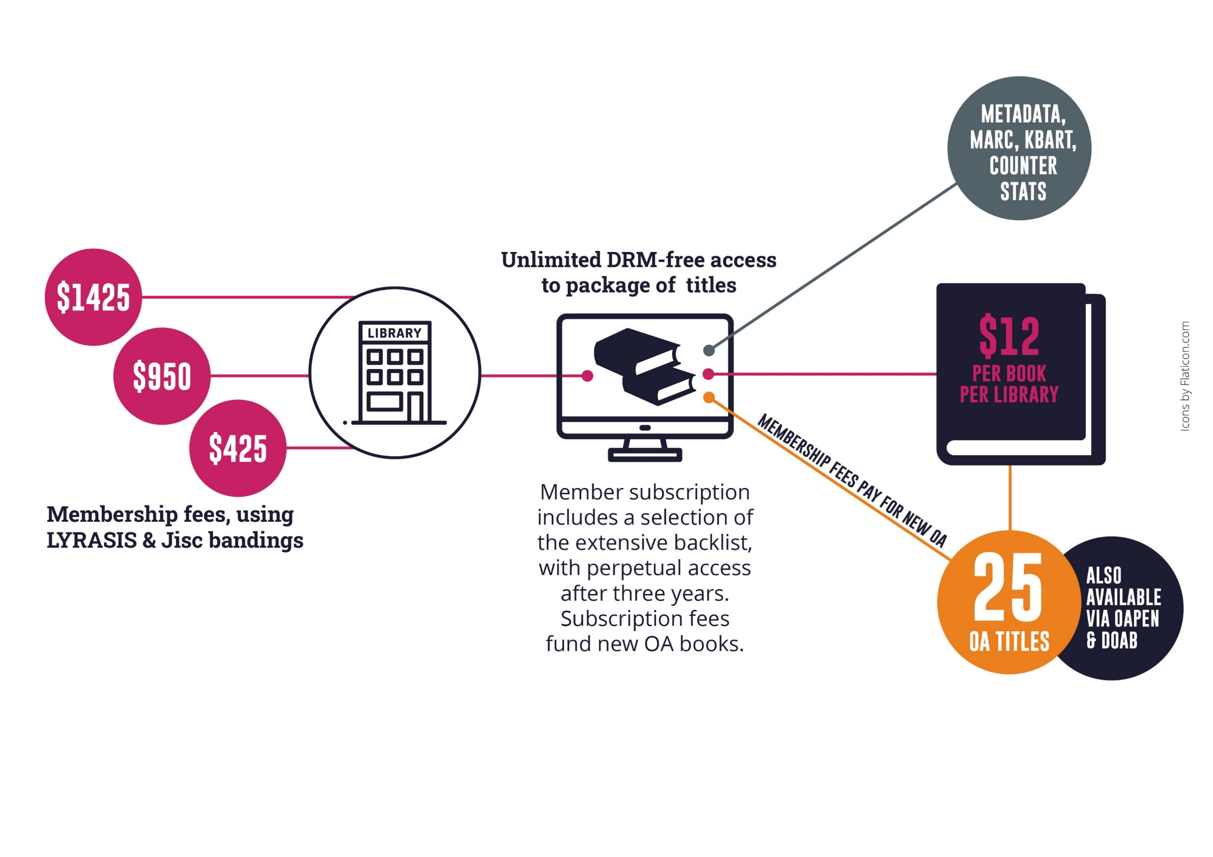
OtF subscriber member benefits
$2240
NZD/
$2030 AUD
$19 NZD
$17 AUD
$1495 NZD/
$1350 AUD
$670 NZD/
$605 AUD
Note: $19/17 per book is for indication only and is calculated on the basis of every library receiving 50 books as a subscription and gaining access to 25 new open access books per year. Cost modelling is based on an average membership of $1495/1350 per year (our medium-size band pricing) and assumes 250 library members. Appraising the cost per book/per library is only possible once we’ve had time to accrue members. This is a pilot project.

Slide 9
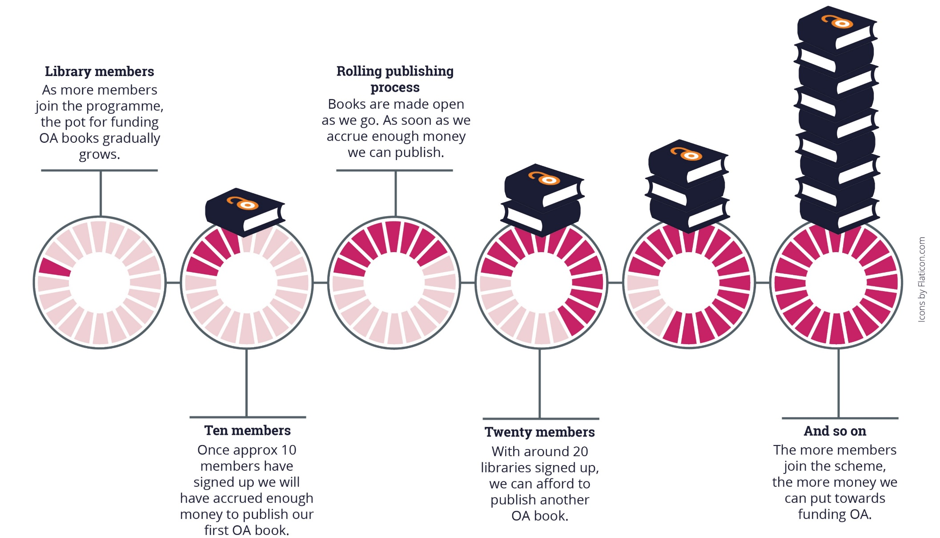
As we accrue enough membership funds we can publish the next OA book, a rolling process
Note: the OA modelling here is based on an average membership of $1495/1350 per year (our medium-size band pricing).
Appraising the cost per book/per library is only possible once we’ve had time to accrue members. This is a pilot project.

Slide 10
What this model is not
Opening the Future is not a ‘read and publish’ deal

Slide 11




For more information
martin.eve@bbk.ac.uk
openingthefuture.net
copim.ac.uk
copim.pubpub.org

