Slide 1




Making Open Access Book Funding Work Fairly
Opening the Future
Professor Martin Paul Eve
COPIM & Birkbeck, University of London
Dr Frances Pinter
Executive Chair, CEU Press
Emily Poznanski
Director, CEU Press

Slide 2

Why OA and why does it matter?
COVID 19 has exposed how vital OA is to the future of scholarly communications while also ripping out the heart of library budgets
The traditional publishing model is broken
Traditional sales of academic books have dropped but we’re still working the way we always have
OA offers increased readership, usage and citation
Funder mandates
Books are not as difficult as journals – only a handful of models

Slide 3

Large, well-funded academic presses
MIT’s D20 has a subscription threshold before OA titles can be released
Small to medium-sized academic presses
Low risk, no threshold models like Opening the Future
Three strata
Opening the Future,
MIT’s D20, and other
library subscription models
Scholar-led born-OA presses
Open collectives working together to provide combined offers

Slide 4
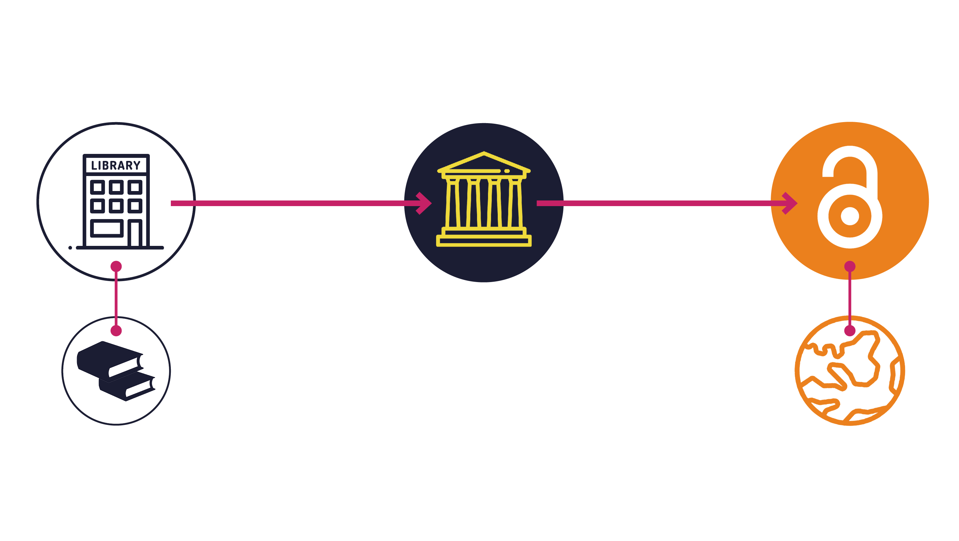
Opening the Future in a nutshell

Slide 5
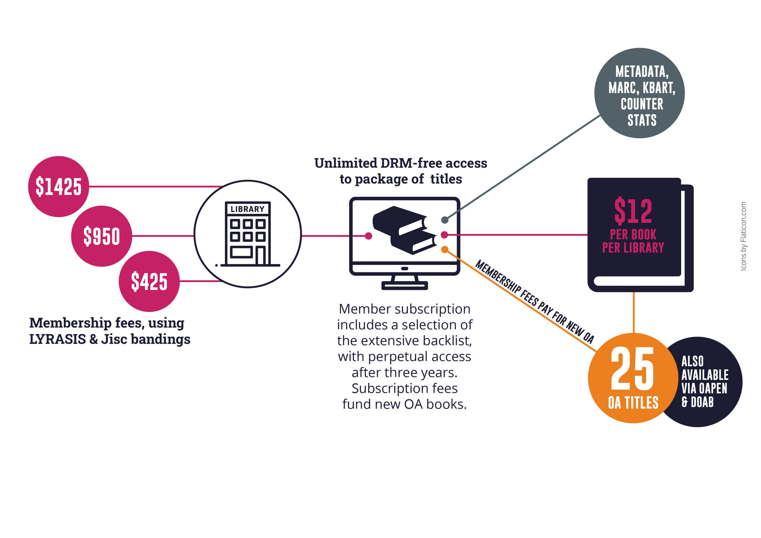
Subscriber member benefits
Note: $12 per book is for indication only and is calculated on the basis of every library receiving 50 books as a subscription and gaining access to 25 new open access books per year. Cost modelling is based on an average membership of $950 per year (our medium-size band pricing) and assumes 250 library members.
Appraising the cost per book/per library is only possible once we’ve had time to accrue members. This is a pilot project.

Slide 6
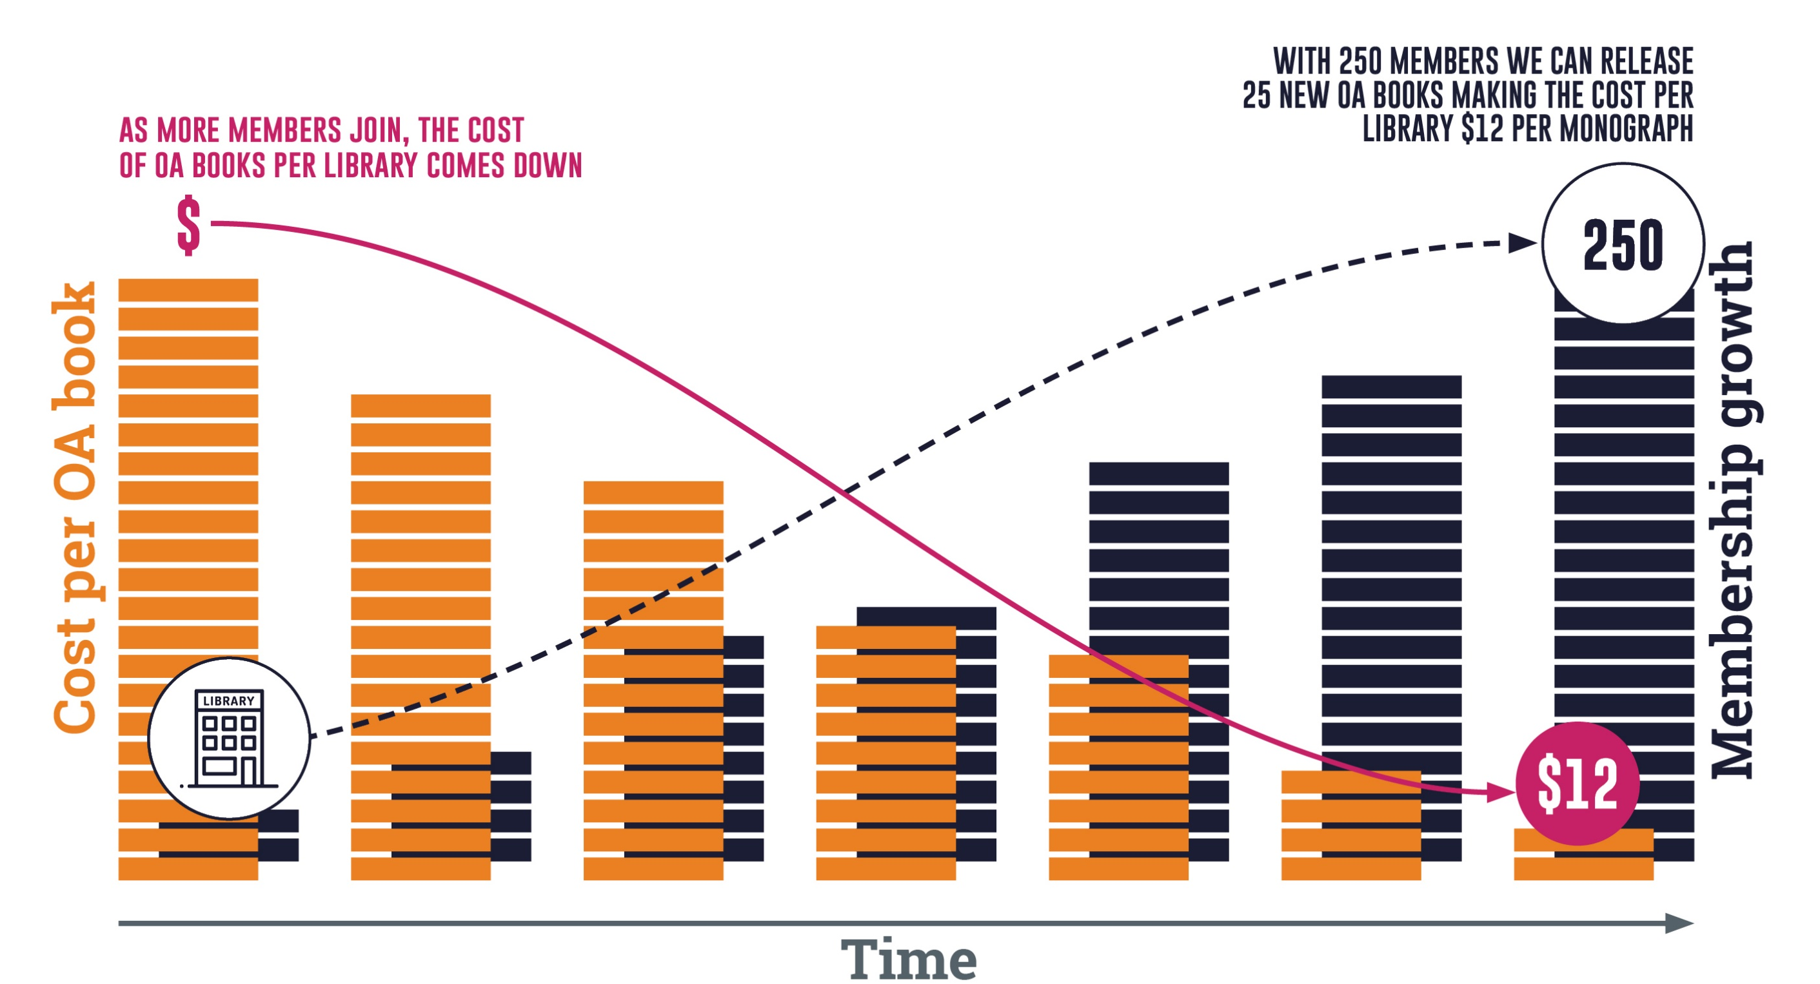
As members grow, costs can go down
Note: the OA modelling here is based on an average membership of $950 per year (our medium-size band pricing). Appraising the cost per book/per library is only possible once we’ve had time to accrue members. This is a pilot project. Icons by Flaticon.com

Slide 7



Piloting Opening the Future
Liverpool University Press & Central European University Press

Slide 8
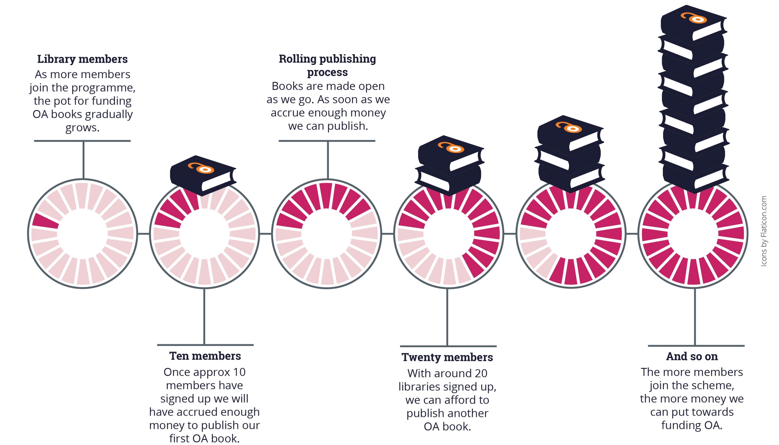
As we accrue enough membership funds we can publish the next OA book, a rolling process
Note: the OA modelling here is based on an average membership of $950 per year (our medium-size band pricing). Appraising the cost per book/per library is only possible once we’ve had time to accrue members. This is a pilot project.

Slide 9
What this model is not
Opening the Future is not a ‘read and publish’ deal

Slide 10
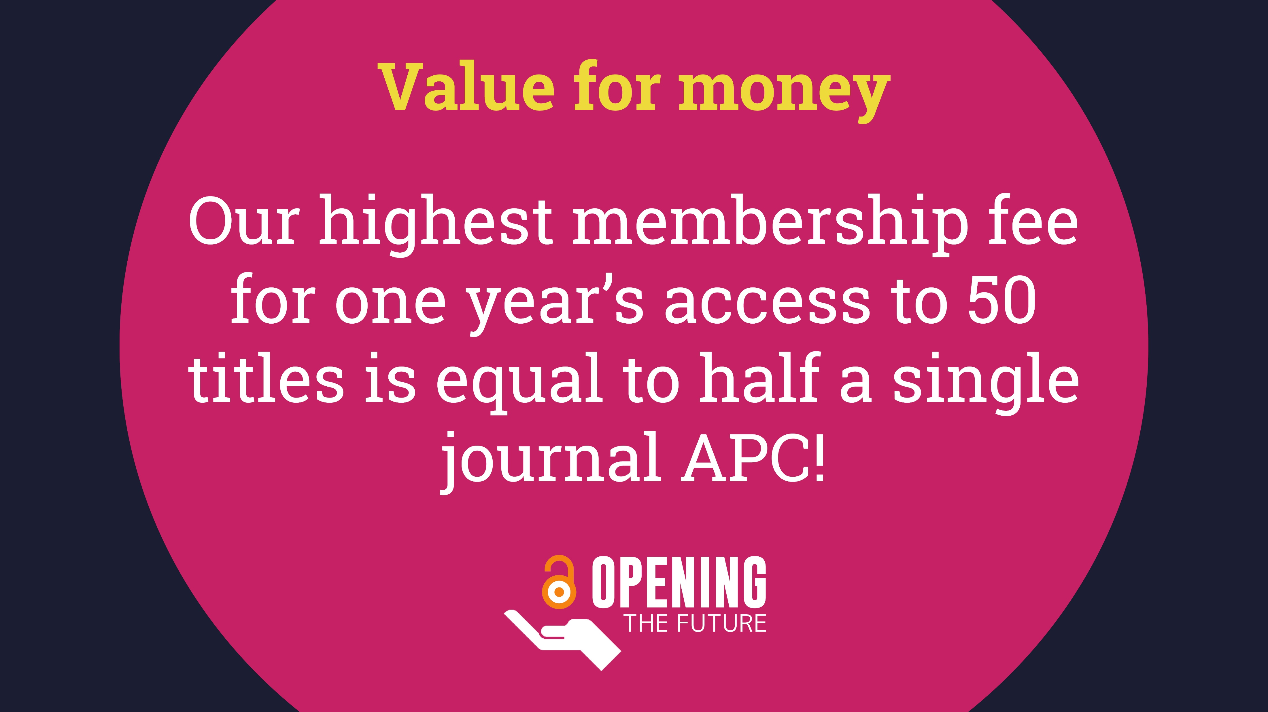

Slide 11
New funding models, pilots and experiments…
We need success stories to show an alternative to BPCs

Slide 12


How can libraries get on board?
1) There’s more info on eDesiderata
2) Sign up via LYRASIS @ tinyurl.com/LYRASISOpeningTheFuture
3) Tell your colleagues and come to an office hour
  Wednesday, June 1st, 10am - 11am (PST)
  Wednesday, June 8th, 10am - 11am (PST)

Slide 13





For more information
martin.eve@bbk.ac.uk
frances@pinter.org.uk
PoznanskiE@press.ceu.edu
ceup.openingthefuture.net
tinyurl.com/LYRASISOpeningTheFuture

