Slide 1

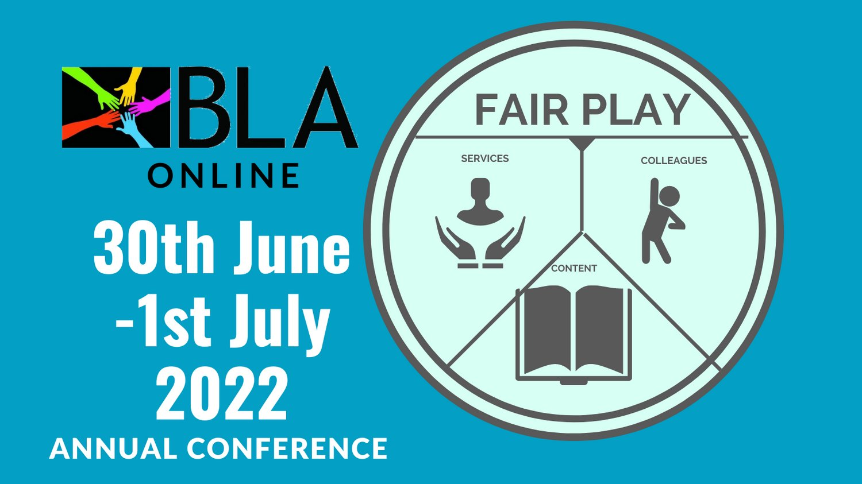
Fairness,
Openness,
Access,
& Evaluation
Martin Paul Eve
martin@eve.gd

Slide 2

Evaluation remains a core problem
Symbolic prestige economy
Translates into real-world economic problems for libraries
Financial flows have become locked into "acquisitions" vs. "scholarly communications" dichotomy

Slide 3

Two Decades of OA
What do we mean by "open access"?
Terminologies/jargon
Why does it matter?
What about in the business context? (SMEs)

Slide 4

Recent Policy Developments
Mandates
Who mandates? Who funds? E.g. UKRI
Books (vs Journals)
Green/gold, Licensing & Embargoes
Libraries
New models from publishers
Notes:
Mandates from reseach funder – public and private
Mandates are not free money

Slide 5



Plan S – a Change Driver
17 National Funders
5 Charitable and International Funders
EU and European Research Council
Developments at UKRI and REF
Notes:
Coalition S driving change through Plan S
Implementation is hard because all parts of the system need changing
And this all applies only to funded research – estimated at less than 20% of HSS output of UK publishers
UKRI -UKRI developments
Research funders set aside some money for OA, but often not enough
Conditions – different to journals
Green and gold – both allowed, but most authors don’t like green for books
Licensing – CC BY NC ND
Embargoes – up to 12 months
Plan S – driving the change

Slide 6

OA Policies
"The truth is that we must all go further" - Amanda Solloway, Minister for Science, Research and Innovation, August 2021
UKRI review published August 2021 (only for project funding):
  Zero-embargo green requirement
  OA extended to monographs from 2024
REF review will be next
  Ministerial steer is clear on direction of travel
  But not yet set in stone
  Unclear what funding would be provided for OA monographs
    See Eve, Martin Paul, Kitty Inglis, David Prosser, Lara Speicher, and Graham Stone. 2017. ‘Cost Estimates of an Open Access Mandate for Monographs in the UK’s Third Research Excellence Framework’. Insights: The UKSG Journal 30 (3). https://doi.org/10.1629/uksg.392.

Slide 7

New business models are problematic
100 people in a room
APCs, BPCs, Consortial models

Slide 8

Large, well-funded academic presses
MIT’s D20 has a subscription threshold before OA titles can be released
Small to medium-sized academic presses
Low risk, no threshold models like Opening the Future
Three strata
Opening the Future,
MIT’s D20, and other
library subscription models
Scholar-led born-OA presses
Open collectives working together to provide combined offers

Slide 9
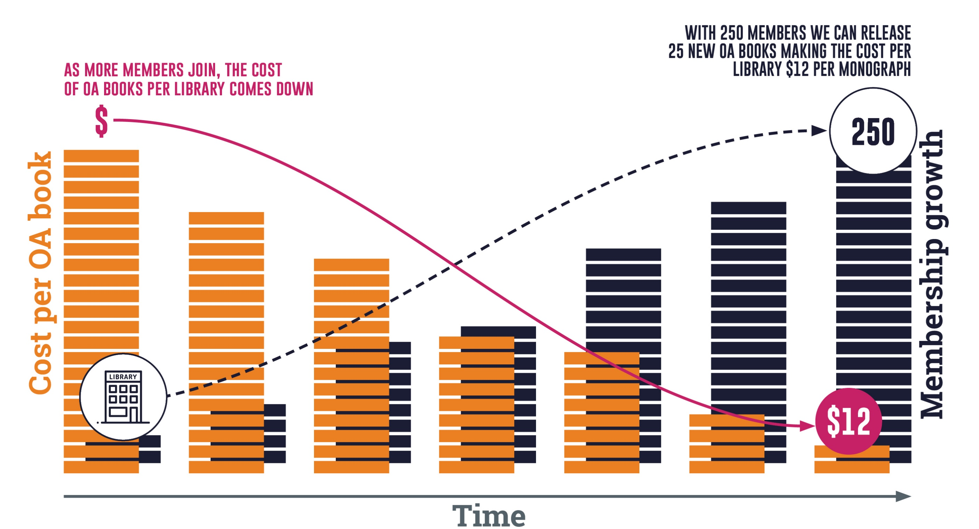
Note: the OA modelling here is based on an average membership of $950 per year (our medium-size band pricing). Appraising the cost per book/per library is only possible once we’ve had time to accrue members. This is a pilot project. Icons by Flaticon.com

Slide 10

These models ask us to evaluate differently
Getting away from "read and publish" deals
Global collections and local value
Values-aligned "acquisition"

