Slide 1



OA Monographs
Making Mandates Reality
Professor Martin Paul Eve
Birkbeck, University of London
a COPIM webinar in partnership with RLUK

Slide 2

£3.6m
COPIM is funded by the Research England Development Fund (REDFund) as a major development project in the Higher Education sector with significant public benefits, and by Arcadia, a charitable fund of Lisbet Rausing and Peter Baldwin.
International partnership
Libraries,
Universities,
OA book publishers, Researchers,
Infrastructure providers.
Notes:
Explain here that COPIM is working with a number of presses, and that this model has been adopted by CEUP and LUP, but here the case study will be CEUP

Slide 3

Awaiting the REF Review
Current allocated funding for projects
If REF follows suit: £19.2m to move to OA monographs
Transition from acquisition to ScholComms
BPC models are problematic
The money is not in the right places

Slide 4

Larger academic presses
MIT’s D20 with subscription threshold. CUP Pilot. Michigan's Fund to Mission.
Small to medium-sized academic presses
Low risk, no threshold models like Opening the Future
Three strata
Library subscription models
Scholar-led born-OA presses
Open collectives working together to provide combined offers

Slide 5



Piloting Opening the Future
Liverpool University Press & Central European University Press

Slide 6
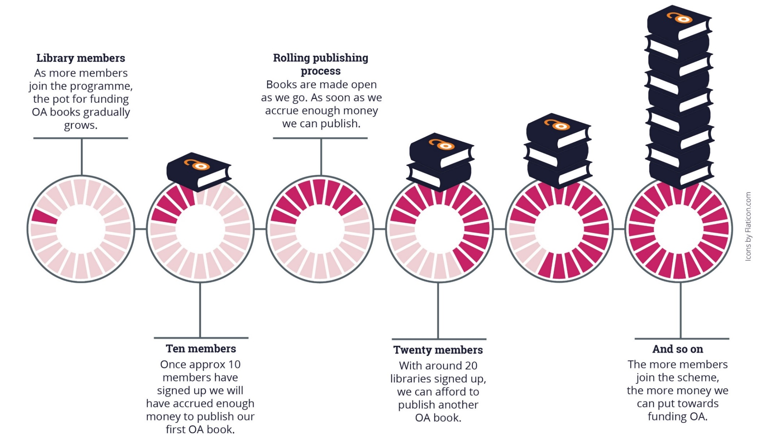
Opening the Future
as membership funds accrue, the next book can be published OA, a rolling process
Note: the OA modelling here is based on an average membership of £700 per year (our medium-size band pricing). Appraising the cost per book/per library is only possible once we’ve had time to accrue members. This is a pilot project.

Slide 7

"We Need Experiments"
OK, but we then need participation
If everyone just waits, experiments will fail
There are not that many models
Experiments are affordable...
... but we need long-term transition

Slide 8

How to Appraise Investment?
"Local Teaching Need"
"Local Research Environment (OA)"
"Researcher Output"
"Usage Metrics"
"Global Collection for Everyone"

Slide 9

Experiments to "Business as Usual"
The acquisitions budget must change
Models have acquisition components
Care around metrics
Library leadership is key

Slide 10




Stay in touch
martin.eve@bbk.ac.uk
copim.ac.uk
openingthefuture.net
thoth.pub
@OpenBookCollect

