Slide 1

Open Monographs: Next Steps
Northumbria University
Prof Martin Paul Eve
Birkbeck, University of London & COPIM

Slide 2

Why OA and why does it matter?
COVID 19 has exposed how vital OA is to the future of scholarly communications while also ripping out the heart of library budgets
The traditional publishing model isn't great
Traditional sales of academic books have dropped but we’re still working the way we always have
OA offers increased readership, usage and citation
Funder mandates

Slide 3

Recent Policy Developments
Mandates
Who mandates? Who funds? E.g. UKRI
Books (vs Journals)
Green/gold, Licensing & Embargoes
Libraries
New models from publishers
Notes:
Mandates from reseach funder – public and private
Mandates are not free money

Slide 4



Plan S – a Change Driver
17 National Funders
5 Charitable and International Funders
EU and European Research Council
Developments at UKRI and REF
Notes:
Coalition S driving change through Plan S
Implementation is hard because all parts of the system need changing
And this all applies only to funded research – estimated at less than 20% of HSS output of UK publishers
UKRI -UKRI developments
Research funders set aside some money for OA, but often not enough
Conditions – different to journals
Green and gold – both allowed, but most authors don’t like green for books
Licensing – CC BY NC ND
Embargoes – up to 12 months
Plan S – driving the change

Slide 5
Who pays for OA monographs now?
Research Funders (BPC)
Institutions/departments (BPC)
Libraries collectively (BPC and Non-BPC)
(largely through Scholarly Communications offices)
Notes:
Need to redirect OA fupport from Schol Comms to acquisitions/collection budgets – because oA has the potential to be both cheaper and better

Slide 6
Key policy for books – from UKRI
Green and Gold – either is fine (but authors less happy about books going green)
Licensing – Prefers CC BY, but accepts NC and ND
Embargoes – up to 12 months

Slide 7

£3.6m
COPIM is funded by the Research England Development Fund (REDFund) as a major development project in the Higher Education sector with significant public benefits, and by Arcadia, a charitable fund of Lisbet Rausing and Peter Baldwin.
International partnership
Libraries,
Universities,
OA book publishers, Researchers,
Infrastructure providers.
Notes:
Explain here that COPIM is working with a number of presses, and that this model has been adopted by CEUP and LUP, but here the case study will be CEUP

Slide 8
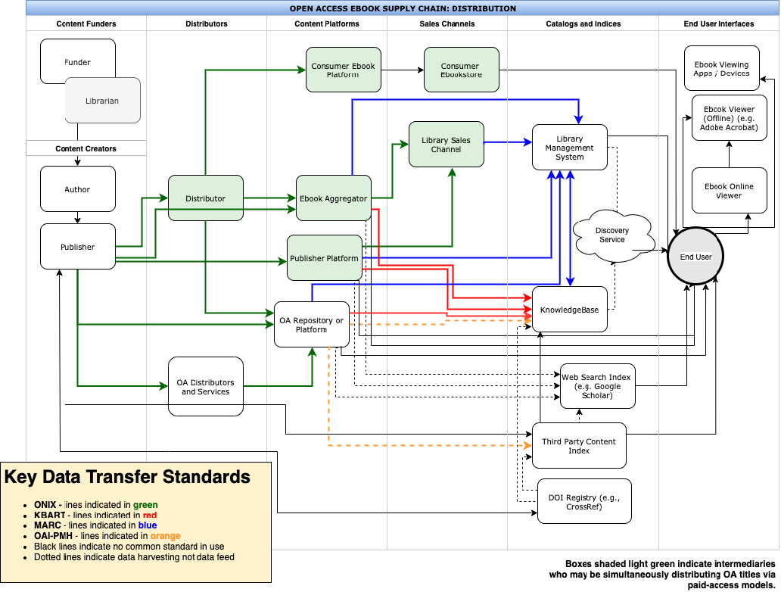
Libraries want OA books but….
Notes:
Difficulties in identifying, delivering and accessing OA through libraries
Library suppliers often do not indicate that there is an OA edition. This will change at EBSCO in months, others will have to follow
Metadata gets garbled en route to libraries – infrastructure projects working on fixing this
So now on to Martin

Slide 9

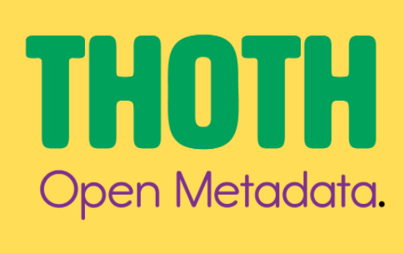
Scaling: infrastructure development at COPIM
Work Package 5
Metadata & dissemination: THOTH
Work Package 2
Open Book Collective
And collaborating with initiatives around the world

Slide 10
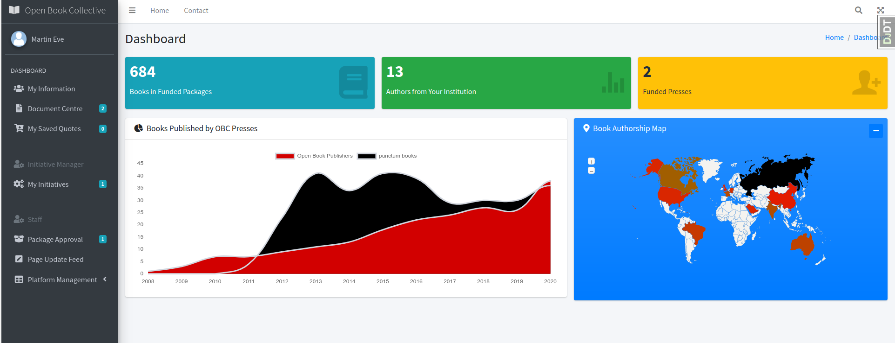
Open Book Collective

Slide 11
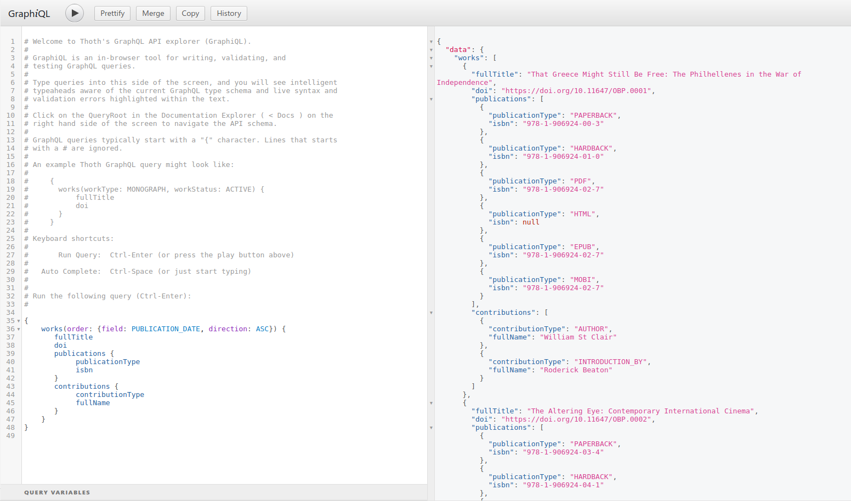
Thoth

Slide 12

Large, well-funded academic presses
MIT’s D20 has a subscription threshold before OA titles can be released
Small to medium-sized academic presses
Low risk, no threshold models like Opening the Future
Three strata
Opening the Future,
MIT’s D20, and other
library subscription models
Scholar-led born-OA presses
Open collectives working together to provide combined offers

Slide 13
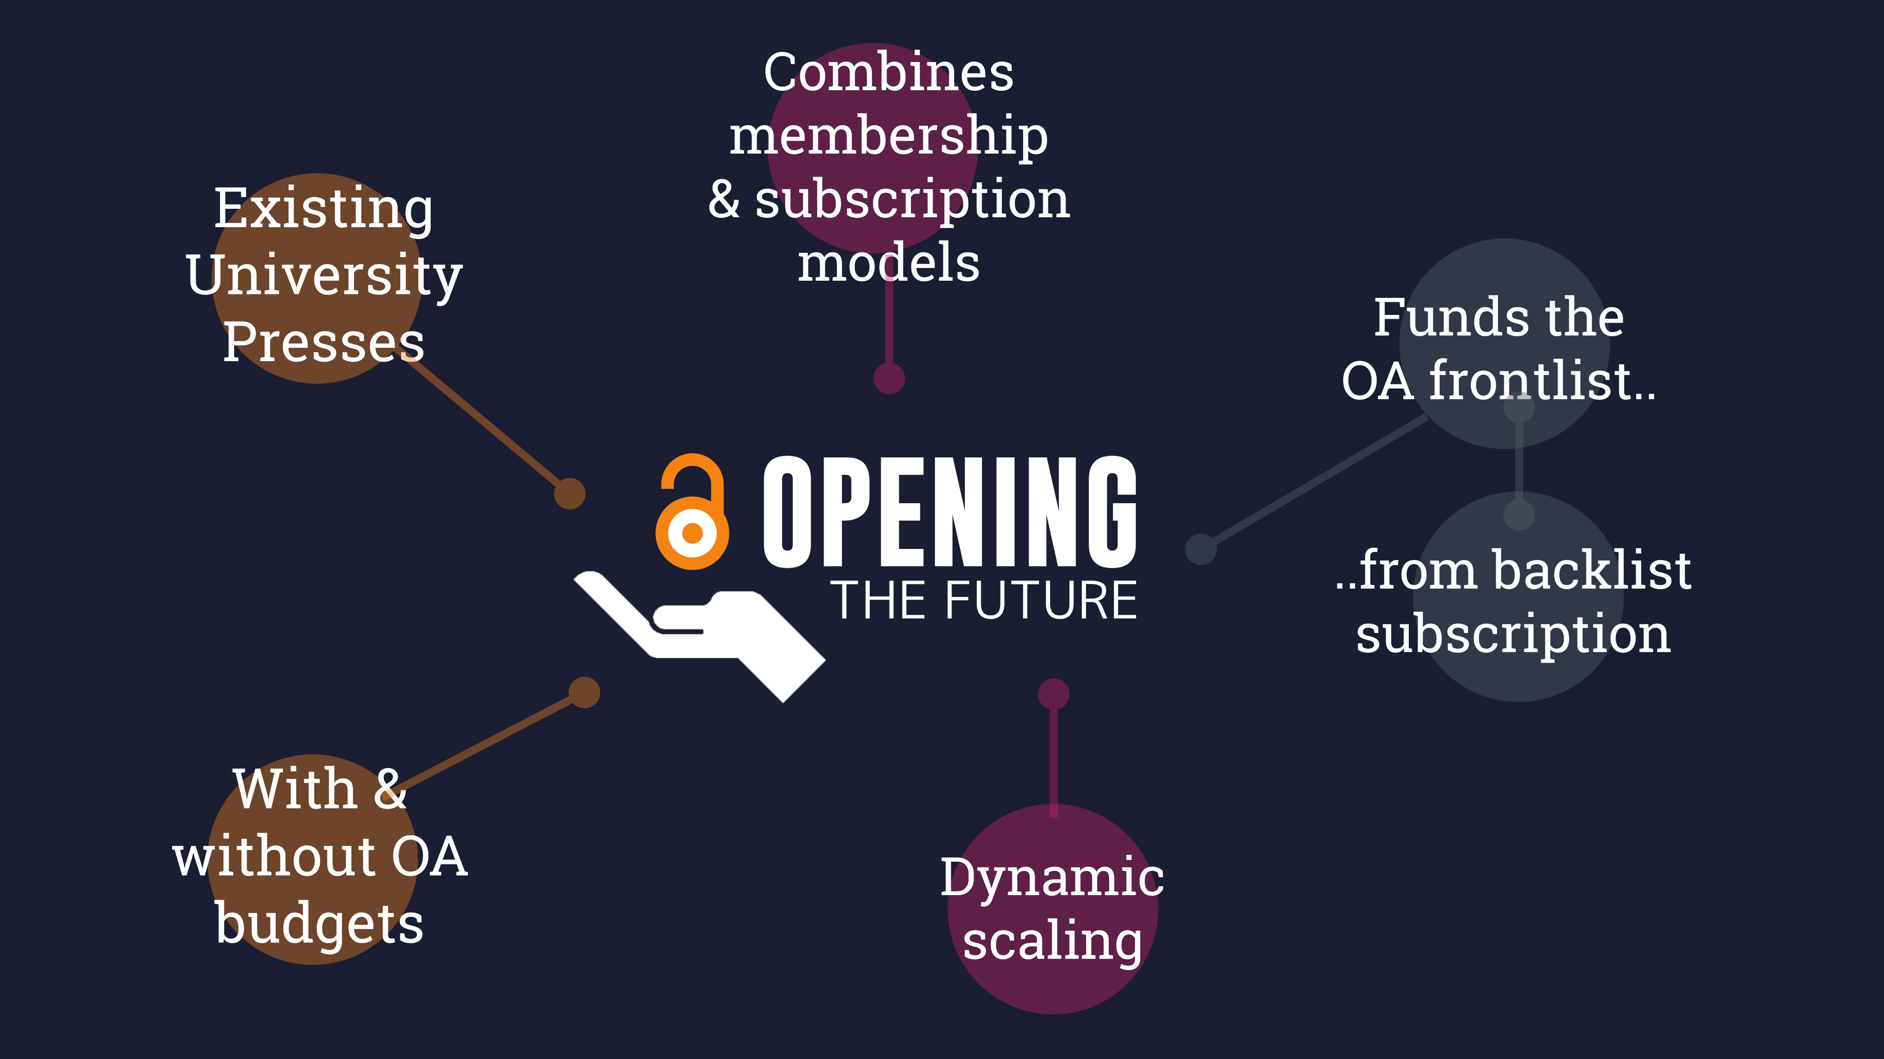

Slide 14
Central European University Press
279
7
they were downloaded
350,000
of the top 10 downloads were over
titles were made open on Project MUSE during
times, from
10
129
March to June 2020
countries
years old

Slide 15

Liverpool University Press
Established in 1899, they are the UK’s third oldest university press and an award-winning academic publisher.
publishing OA for more than
10
publishing approximately
and
150
39
years
books a year
journals & a number of digital collections

Slide 16
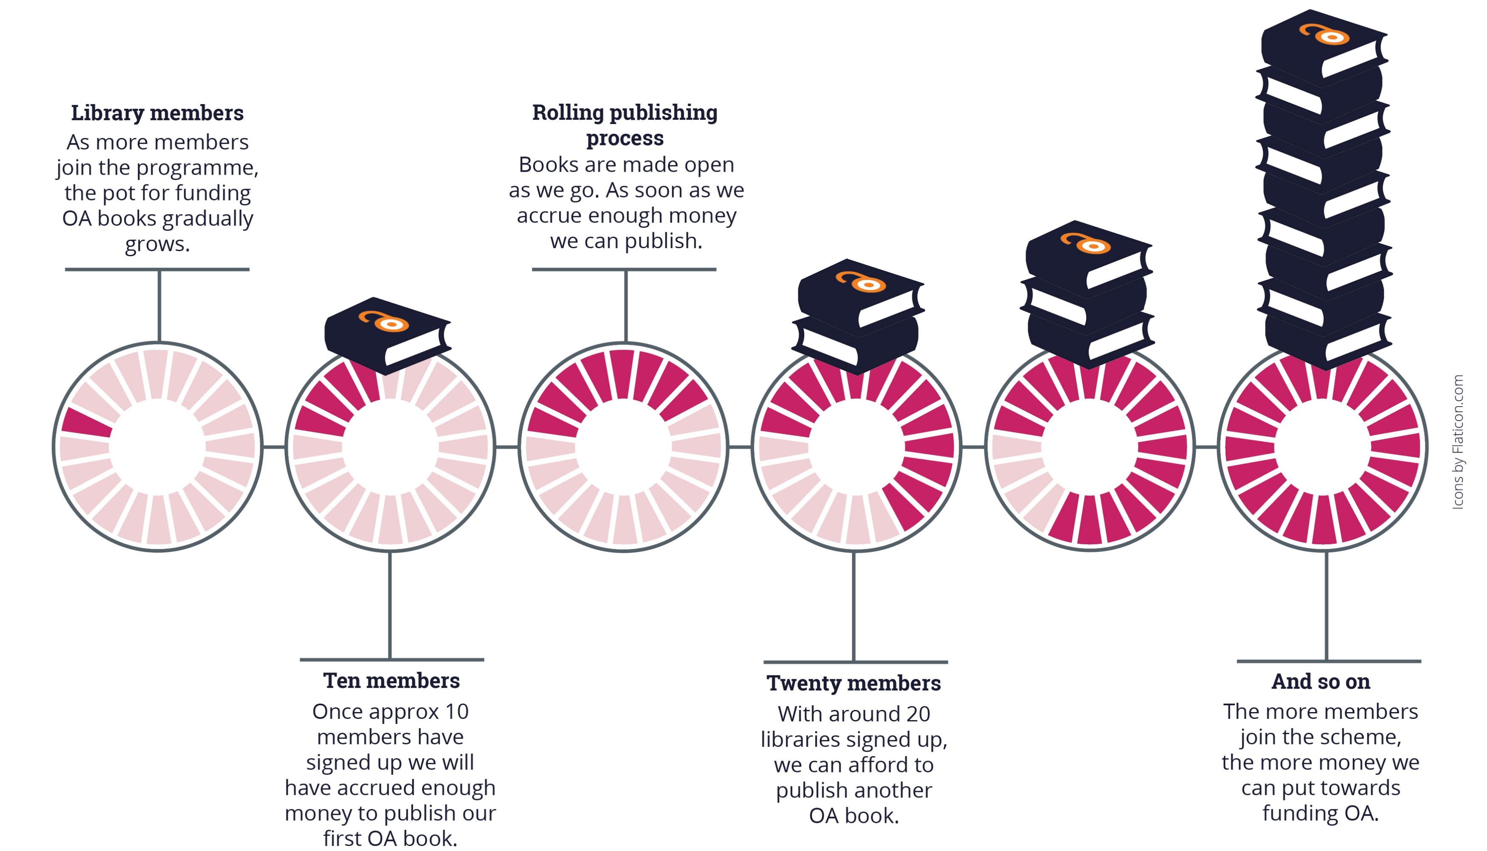
Note: the OA modelling here is based on an average membership of £700 per year (our medium-size band pricing). Appraising the cost per book/per library is only possible once we’ve had time to accrue members. This is a pilot project.

Slide 17
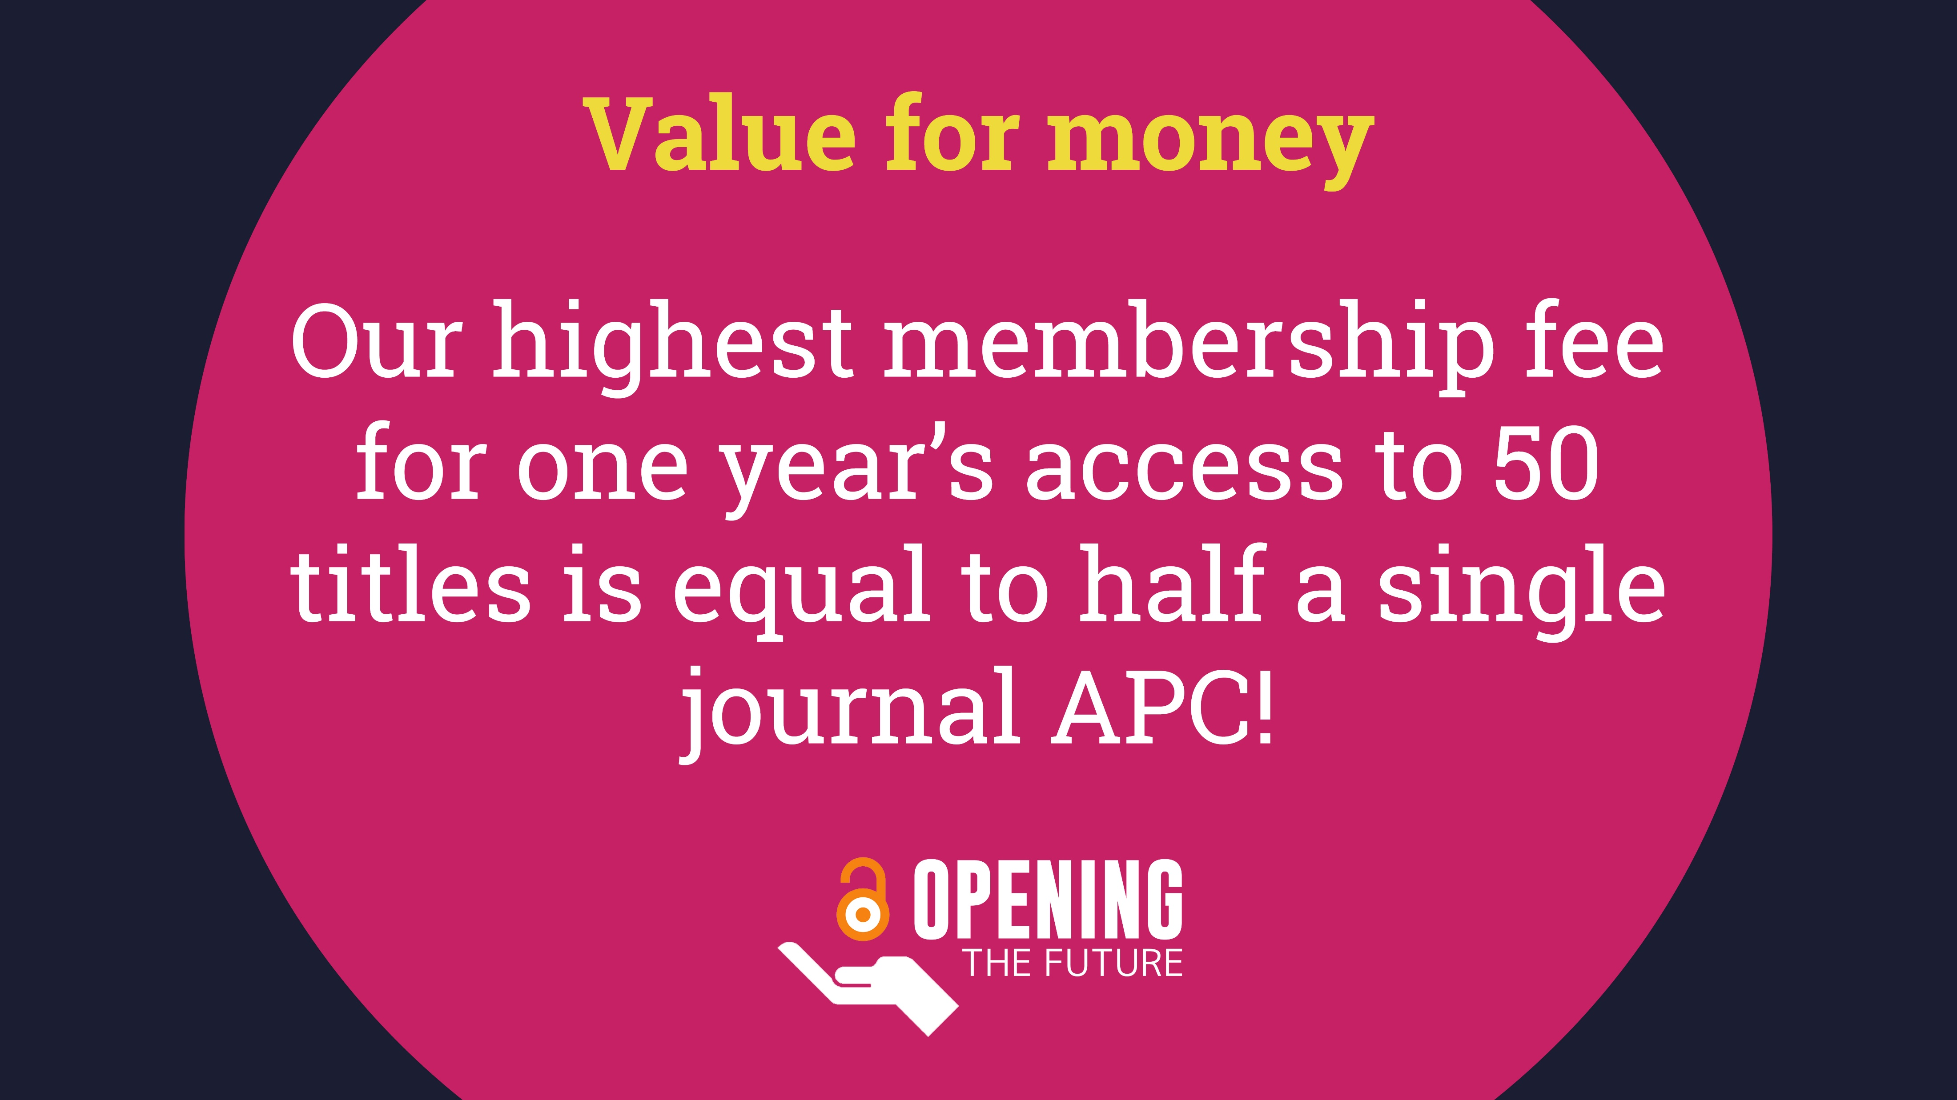

Slide 18
Get engaged
We need both BPC and Non-BPC models to work
Access to publishing for Global South is important for the world
Endorse non-BPC Opening the Future model
What happens if STEM is open and HSS stays mainly closed?
OA for all needed for global challenges
Notes:
1.Support both BPC and non-BPC where you can
3. And other non-BPC models
4. STEM – journals vs HSS - books

Slide 19



For more information
martin.eve@bbk.ac.uk
openingthefuture.net
copim.ac.uk

