Slide 1



Making Open Access Book Funding Work Fairly
Opening the Future library membership scheme
& publisher toolkit
Professor Martin Paul Eve
COPIM & Birkbeck, University of London

Slide 2

Why OA and why does it matter?
COVID 19 has exposed how vital OA is to the future of scholarly communications while also ripping out the heart of library budgets
The traditional publishing model is challenging
Traditional sales of academic books have dropped but we’re still working the way we always have
OA offers increased readership, usage and citation
Funder mandates in Europe & the recent White House memo

Slide 3

Large, well-funded academic presses
MIT’s D20 has a subscription threshold before OA titles can be released
Small to medium-sized academic presses
Low risk, no threshold models like Opening the Future
Three strata
Opening the Future,
MIT’s D20, and other
library subscription models
Scholar-led born-OA presses
Open collectives working together to provide combined offers

Slide 4
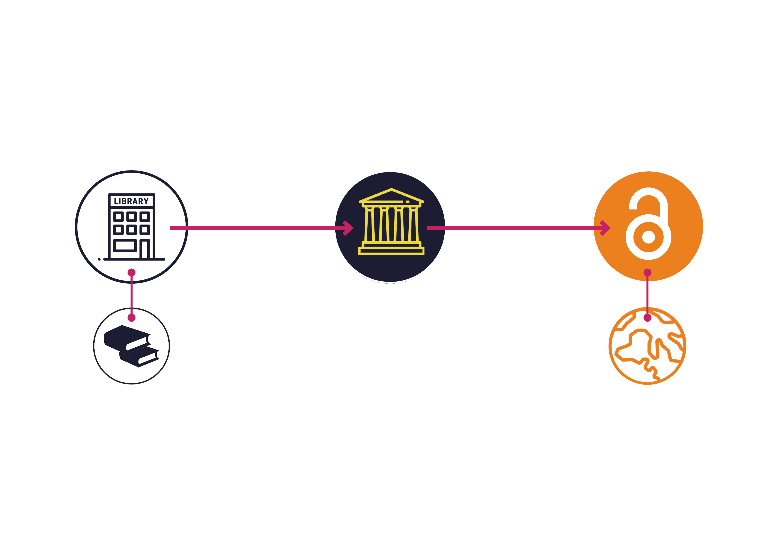
Opening the Future in a nutshell

Slide 5



Piloting Opening the Future
Central European University Press
& Liverpool University Press

Slide 6
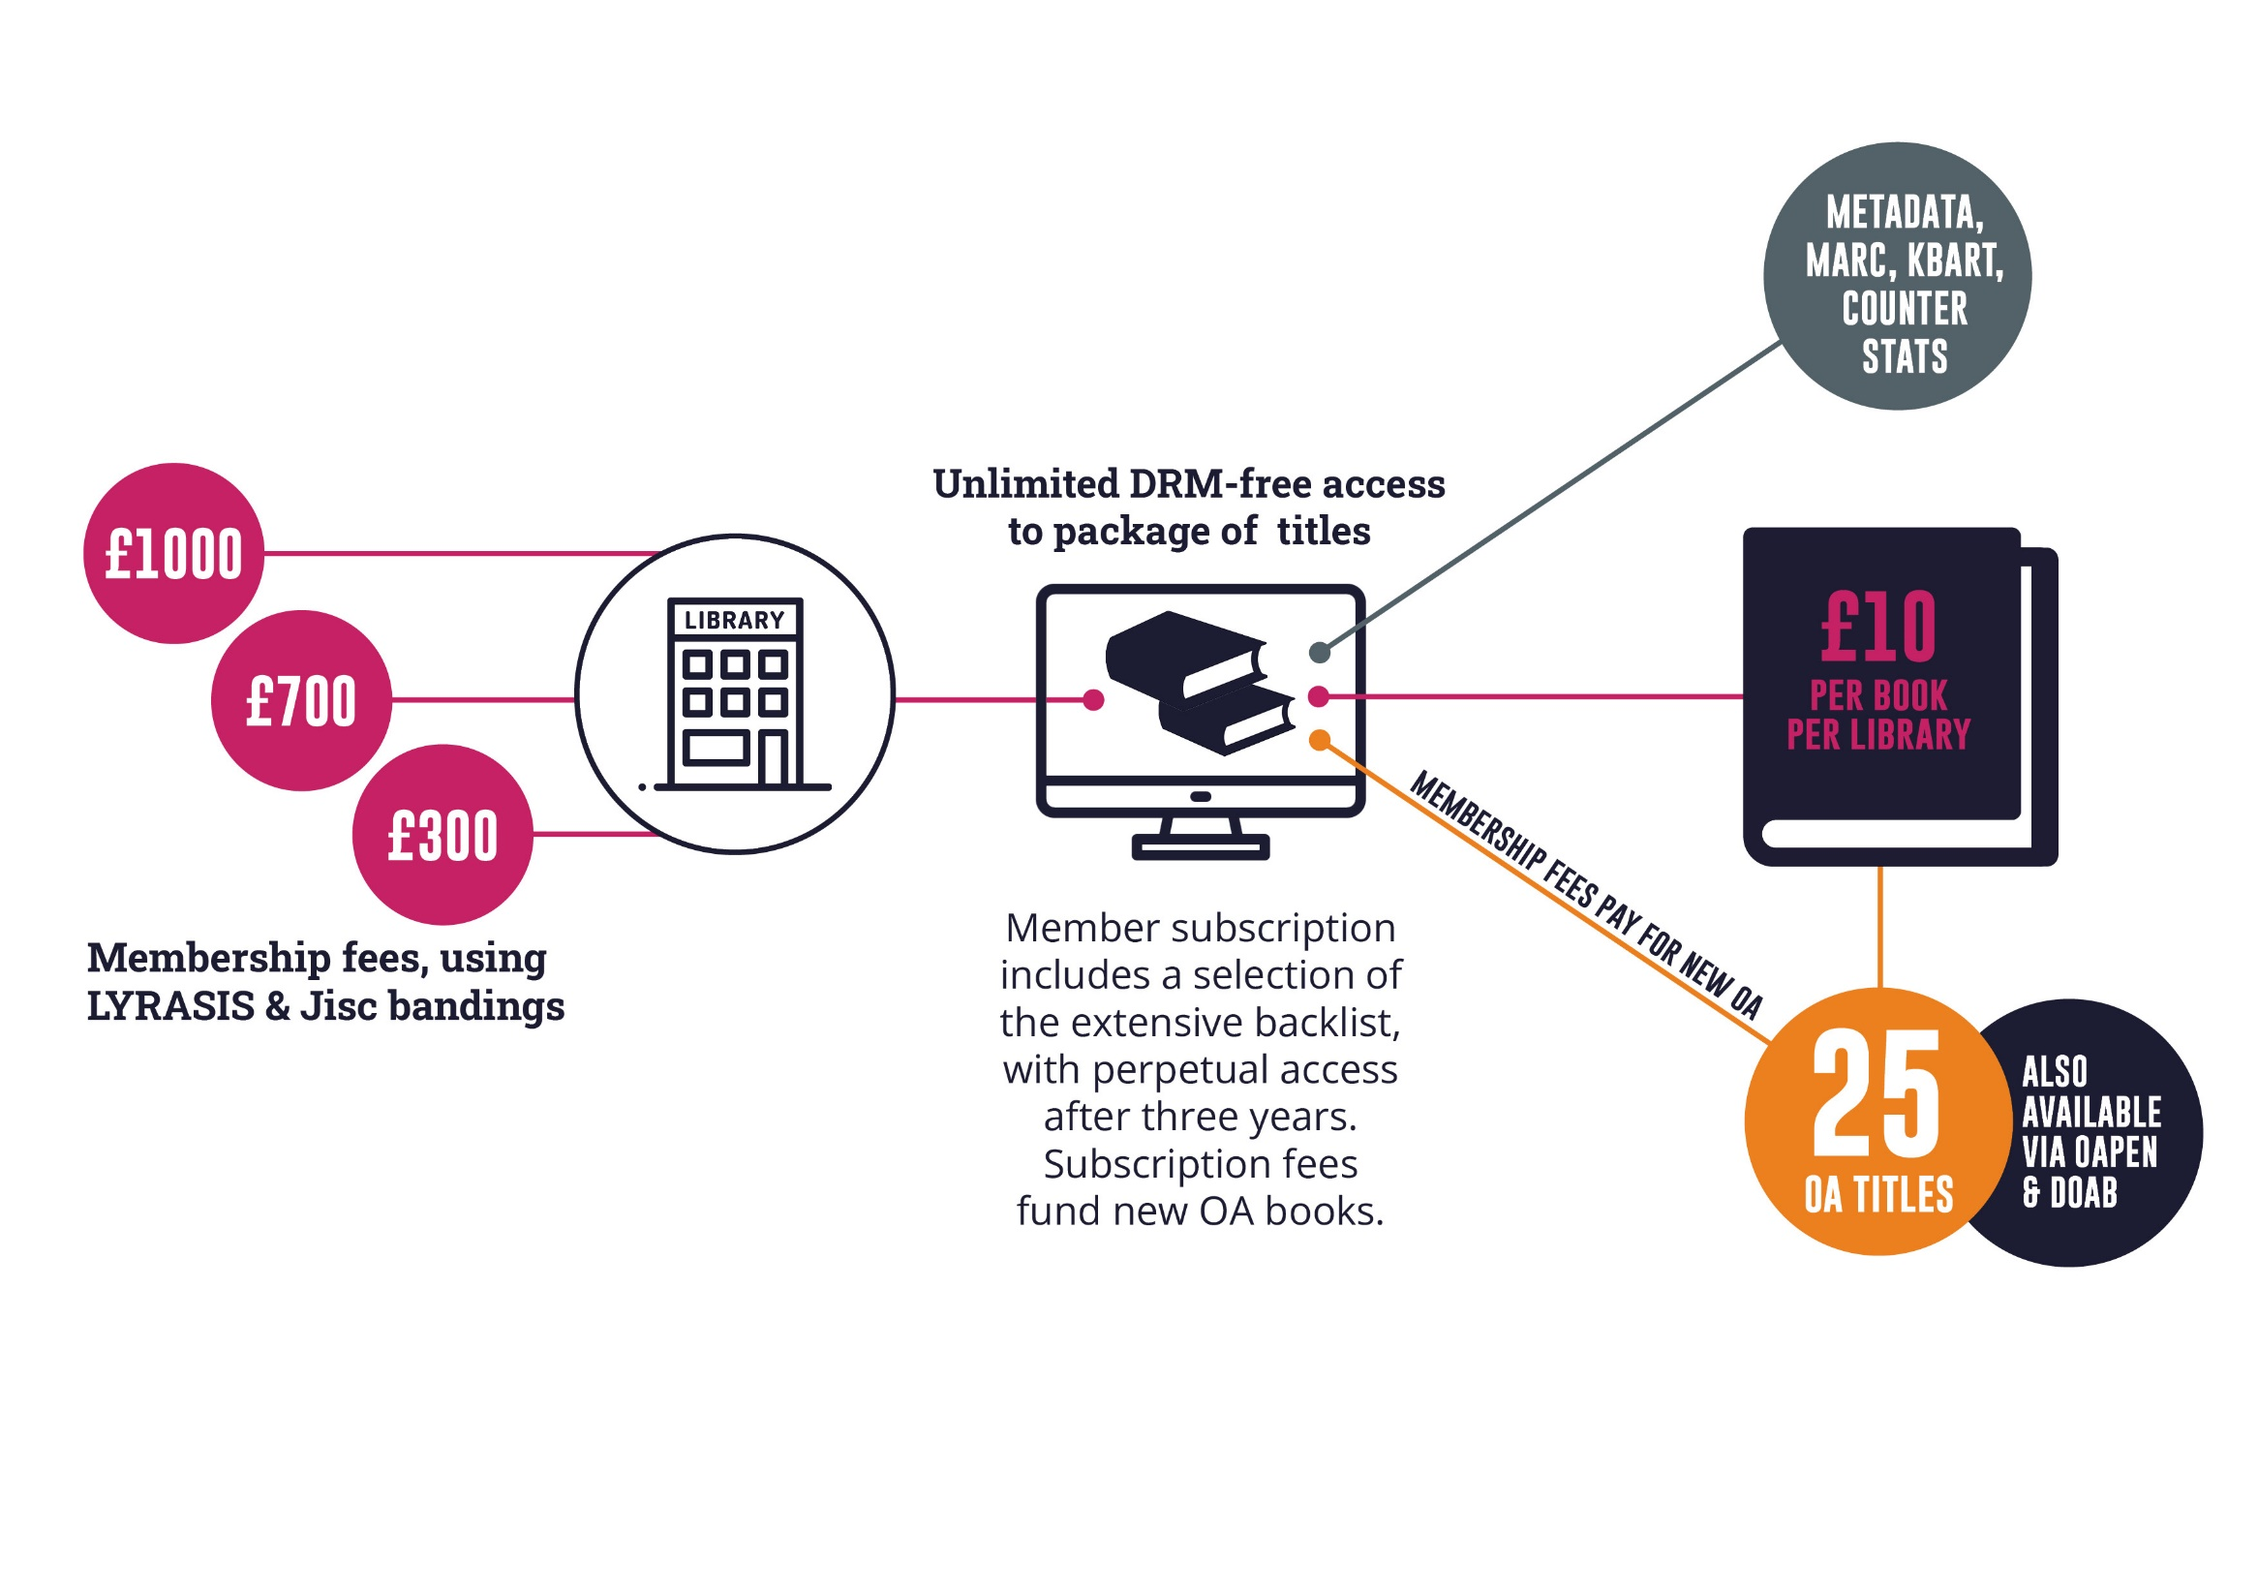
OtF subscriber member benefits
£
special access to backlist
$
Icons by Flaticon.com
€
OA TITLES

Slide 7
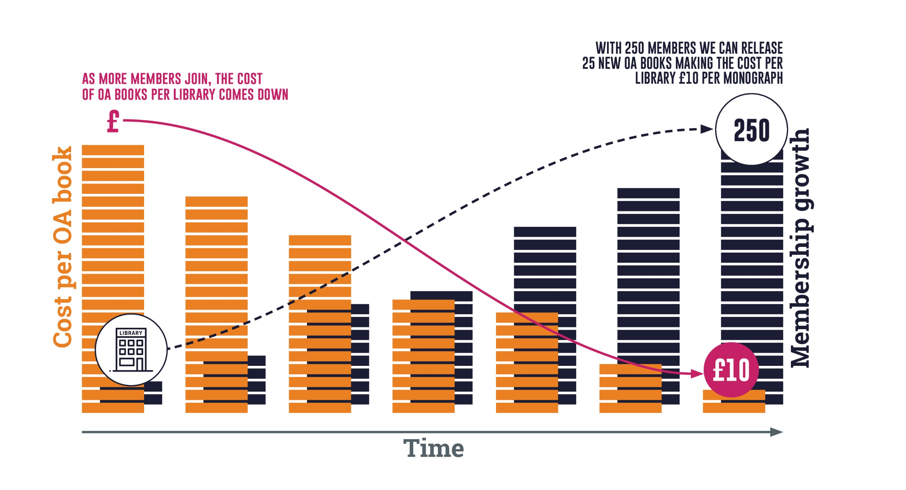



As members grow, costs can go down
€ $ £
Icons by Flaticon.com
€ $ £

Slide 8
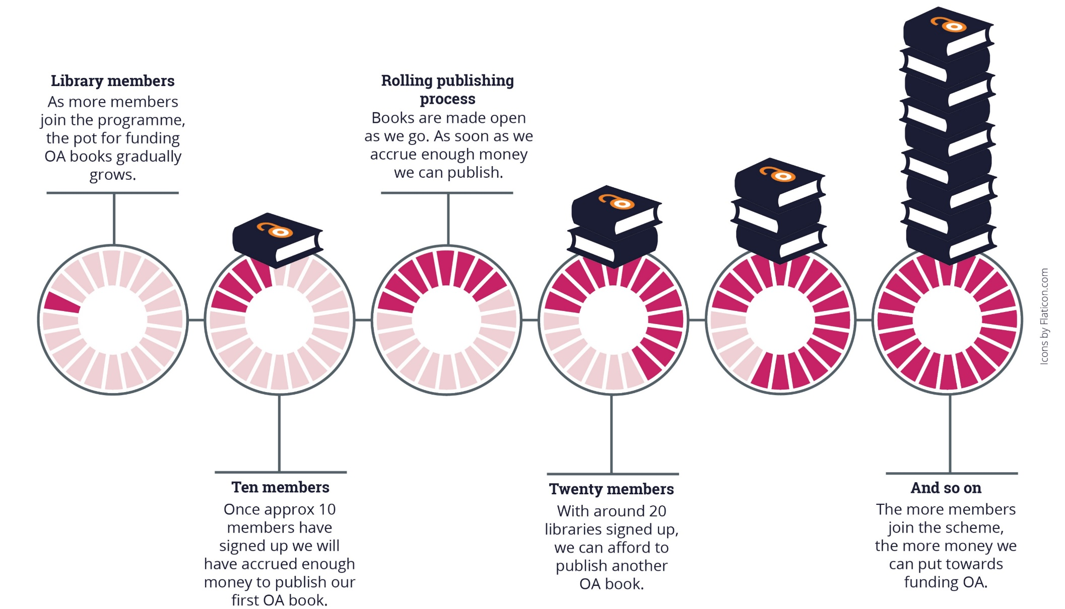
As we accrue enough membership funds we can publish the next OA book, a rolling process
Note: the OA modelling here is based on a membership of medium-size band pricing. Appraising the cost per book/per library is only possible once we’ve had time to accrue members. This is a pilot project.

Slide 9
What this model is not
Opening the Future is not a ‘read and publish’ deal

Slide 10

Why publishers should use this model
Relatively low risk
GitHub & toolkit
Avoids BPCs
Laying
the groundwork

Slide 11
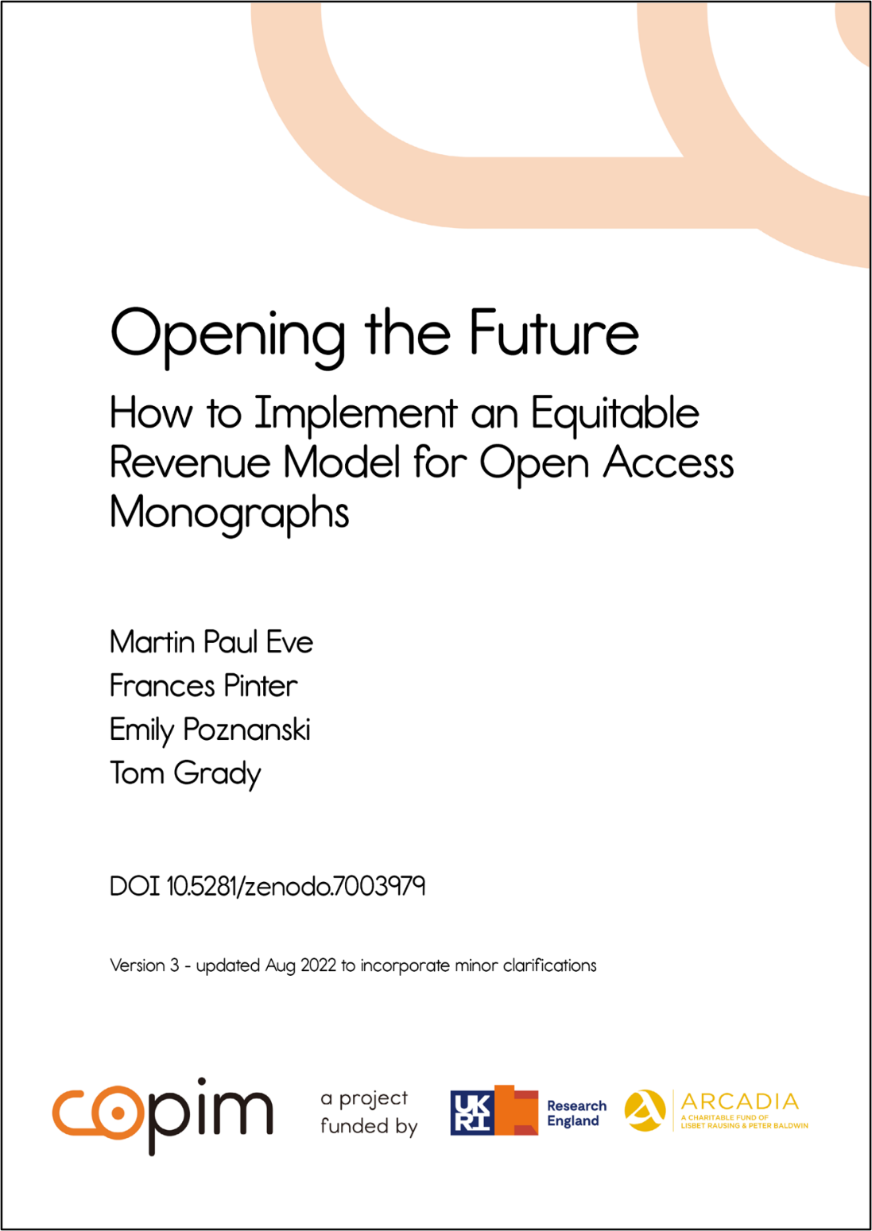
Toolkit contents
Challenges
Resources needed
Financial analysis & modelling spreadsheets
FAQs
Outreach & marketing activities, incl. templates
Key partners & providers

Slide 12



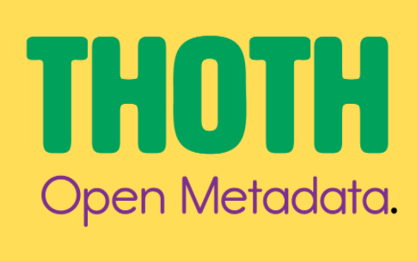
SCALING infrastructure development at COPIM
Opening the Future
Open Book Collective
THOTH – Open metadata & dissemination
And collaborating with initiatives around the world

Slide 13





For more information
martin.eve@bbk.ac.uk
t.grady@bbk.ac.uk
openingthefuture.net
Toolkit
zenodo.org/record/7003979
GitHub
github.com/BirkbeckCTP/otf-signup

