Slide 1
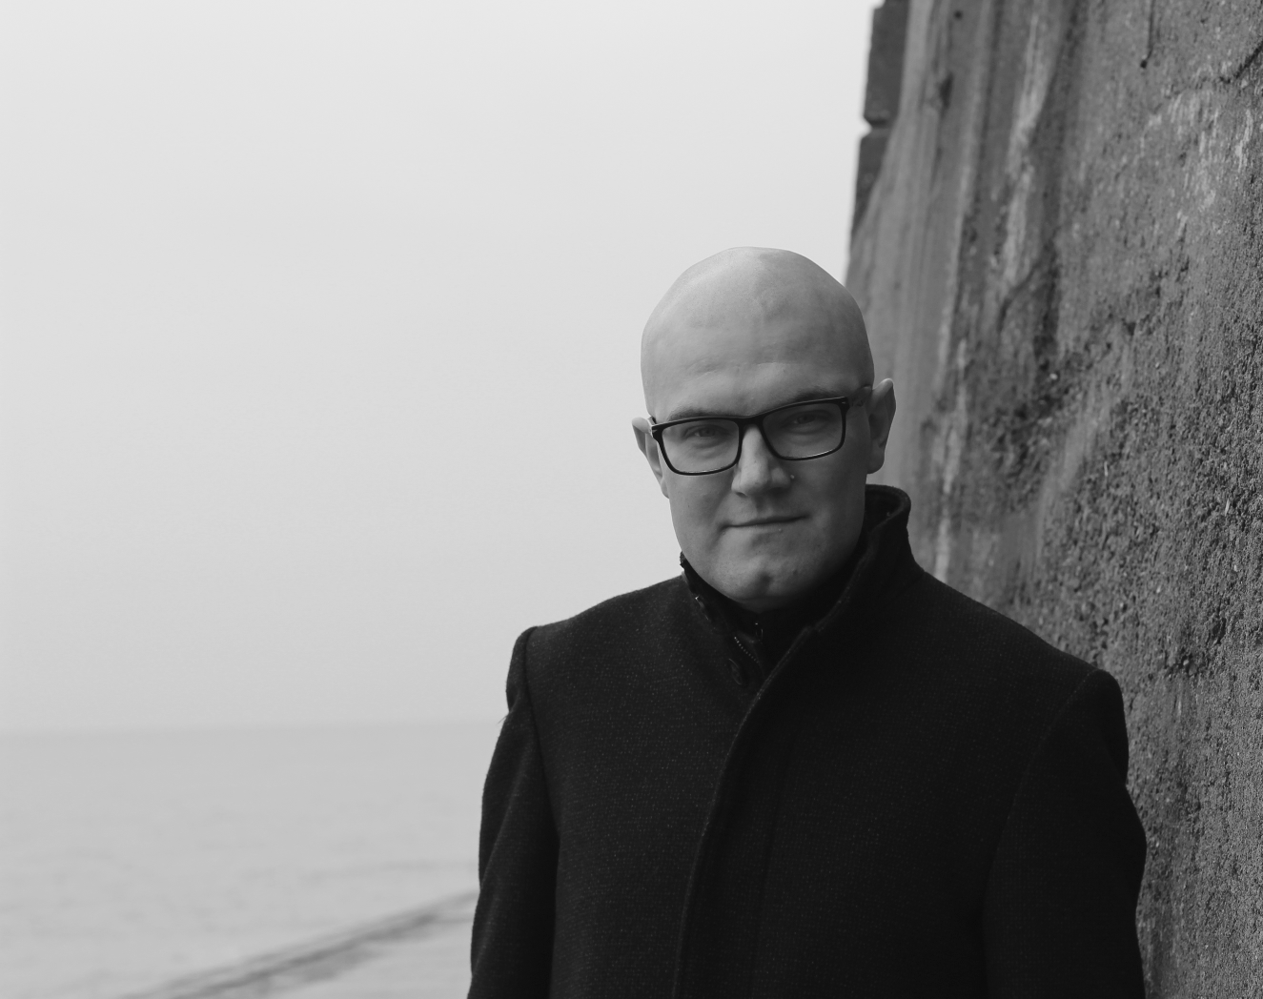
Persisting Persistent Identifiers
Or: how much is actually preserved?
Martin Paul Eve
Principal R&D Developer, Crossref
Professor of Literature, Technology and Publishing, Birkbeck, University of London
meve@crossref.org

Slide 2

Let us start with what we don't know
Why does Crossref care about this?
What proportion of scholarly objects assigned a DOI are adequately preserved in a recognised dark archive?
How stable are the preservation systems that underpin the persistence of persistent identifiers?
Which actors are behaving well on this theme?
Who should be doing this? Libraries? Publishers? Both?
Is it already too late?

Slide 3
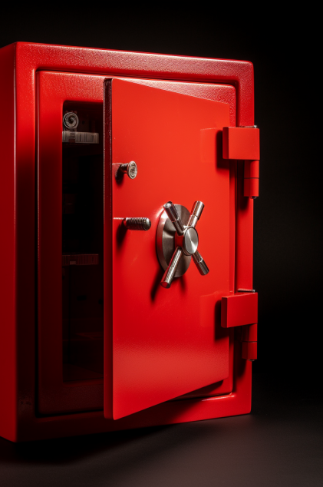

What have we got?
Laakso, Mikael, Lisa Matthias, and Najko Jahn, ‘Open Is Not Forever: A Study of Vanished Open Access Journals’, Journal of the Association for Information Science and Technology, 72.9 (2021), 1099–1112 <https://doi.org/10.1002/asi.24460>
The Keepers Registry
Infrastructural deficit: no item-level data

Slide 4
Building an item-level preservation database
Archive | File | Test Date
Cariniana | http://reports-lockss.ibict.br/keepers/pln/ibictpln/keepers-IBICTPLN-report.csv | 2023-02-17
CLOCKSS | https://reports.clockss.org/keepers/keepers-CLOCKSS-report.csv | 2023-02-16
HathiTrust | https://www.hathitrust.org/hathifiles | 2023-02-23
Internet Archive / FATCAT | https://archive.org/details/ia-keepers-registry-kbart | 2023-02
LOCKSS | https://reports.lockss.org/keepers/keepers-LOCKSS-report.csv | 2023-02-20
PKP PLN | https://pkp.sfu.ca/files/pkppn/onix.csv | 2023-02-20
Portico | https://api.portico.org/kbart/Portico_Holding_KBart.txt | 2023-02-21
Scholars Portal | Private data source. Please contact archive. | 2023-02-21

Slide 5
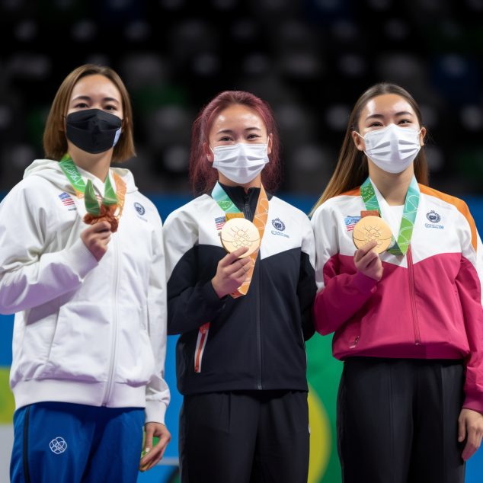
A grading system
Grade | Criteria
Gold | Gold members are those that have 75% of their content digitally preserved in three or more recognised archives.
Silver | Silver members are those that have 50% of their content digitally preserved in two or more recognised archives.
Bronze | Bronze members are those that have 25% of their content digitally preserved in one or more recognised archives.
Unclassified | Unclassified members are those that do not meet the above criteria.

Slide 6

The Sample
Tkaczyk, Dominika, Esha Datta, and Crossref, ‘Sampling Framework’, GitLab, 2023 <https://gitlab.com/crossref/sampling-framework> [accessed 12 April 2023]
Data public in AWS at s3://samples.crossref.org/members-works/2023-03-05/samples/
Labs API presents preservation findings at https://api.labs.crossref.org
7,438,037 DOIs in the sample

Slide 7
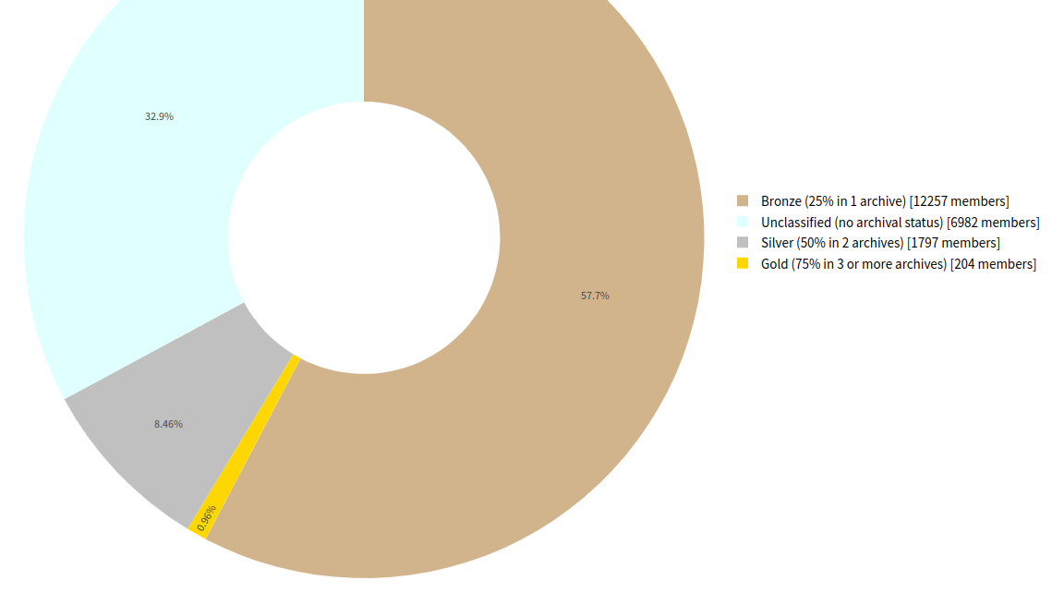
Overall Preservation Status

Slide 8
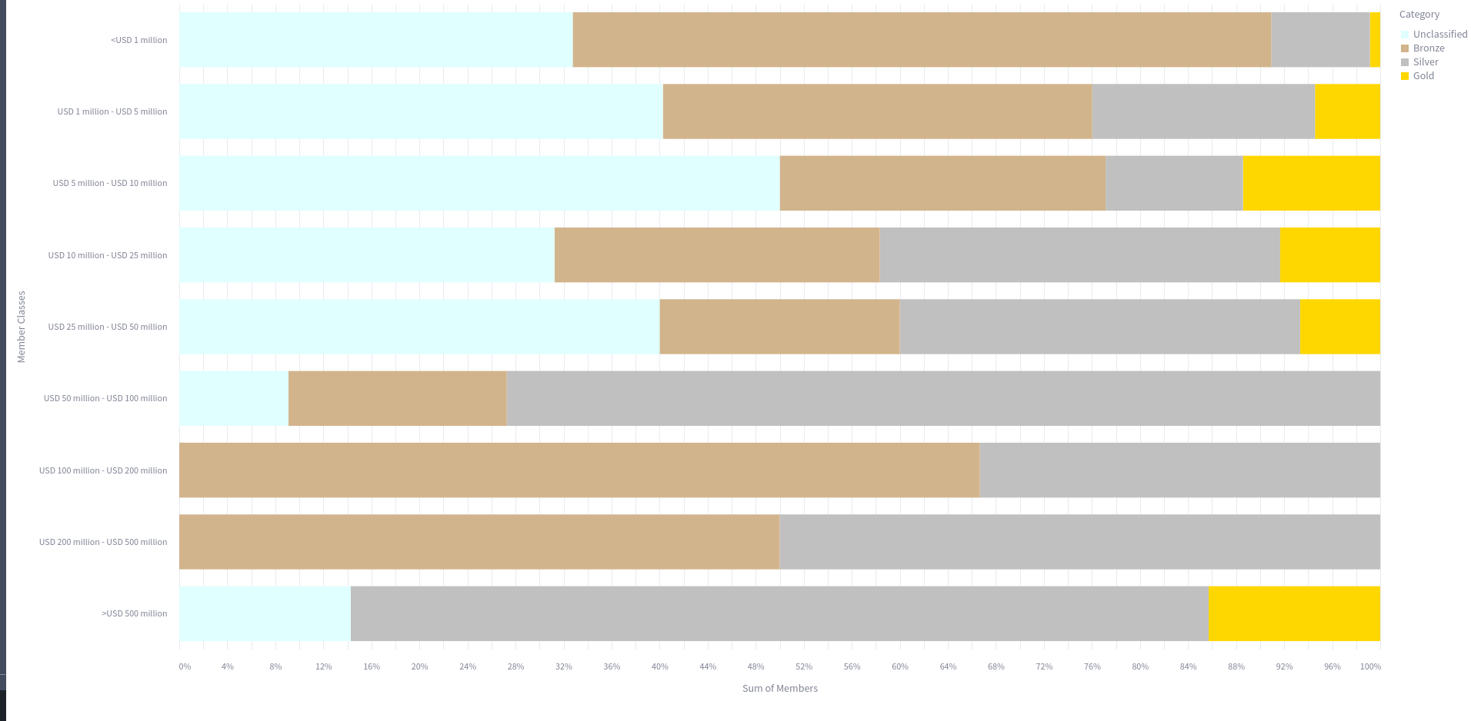
Preservation By Member Revenue

Slide 9
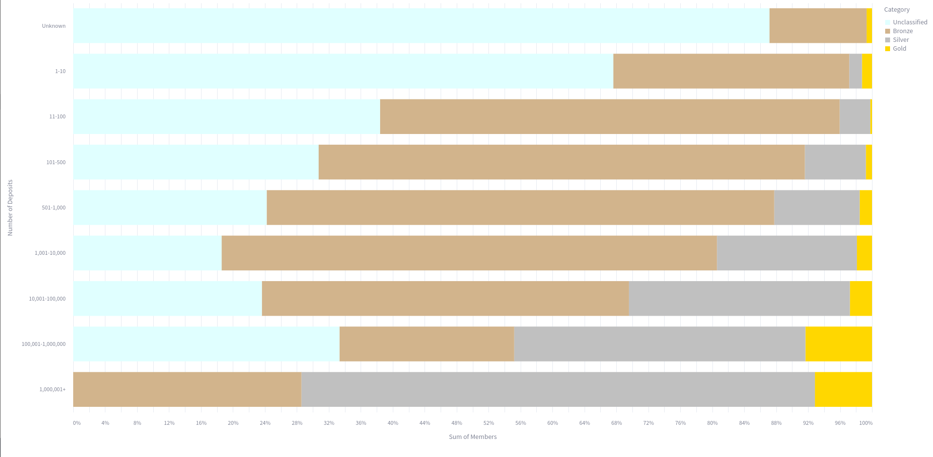
Preservation by Member Deposits

Slide 10
Works
4,342,368 of the works that we studied (58.38%) preserved at least once
2,056,492 works in our sample (27.64%) that seem unpreserved
13.98% of works in the sample were excluded either for being too recent (published in the current year), not being journal articles, or having insufficient date metadata for us to identify the source.

Slide 11

Next steps
Forthcoming peer-reviewed paper
Lay/easy read summary of preservation situation
Direct member outreach
Project "Op Cit"
Full charts and dataset: https://the-vault.fly.dev/

Slide 12
But what was missing?
Data infrastructure
Technical capacity at smaller publishers/members
Time/labour

