Slide 1
Skills not Silos!
Open Data as OER #oer16 #ODasOER OER16 edinburgh 19-20 april 2016
Leo Havemann
Birkbeck, University of London
@leohavemann
Javiera Atenas
University College London
@jatenas @okfnedu

Slide 2
Opening up in Education
In education we have seen the rise of parallel open or ‘opening’ movements around:
Learning and teaching: open educational resources and open delivery models (from OCW to OER, Open Textbooks, and lately, MOOCs)
Research: open access (OA) to research publications (shaking up traditional publishing models and also driving emergence of open peer review models)
Data: open access to government and research data (OD)
Which has brought us to a brave new world….

Slide 3
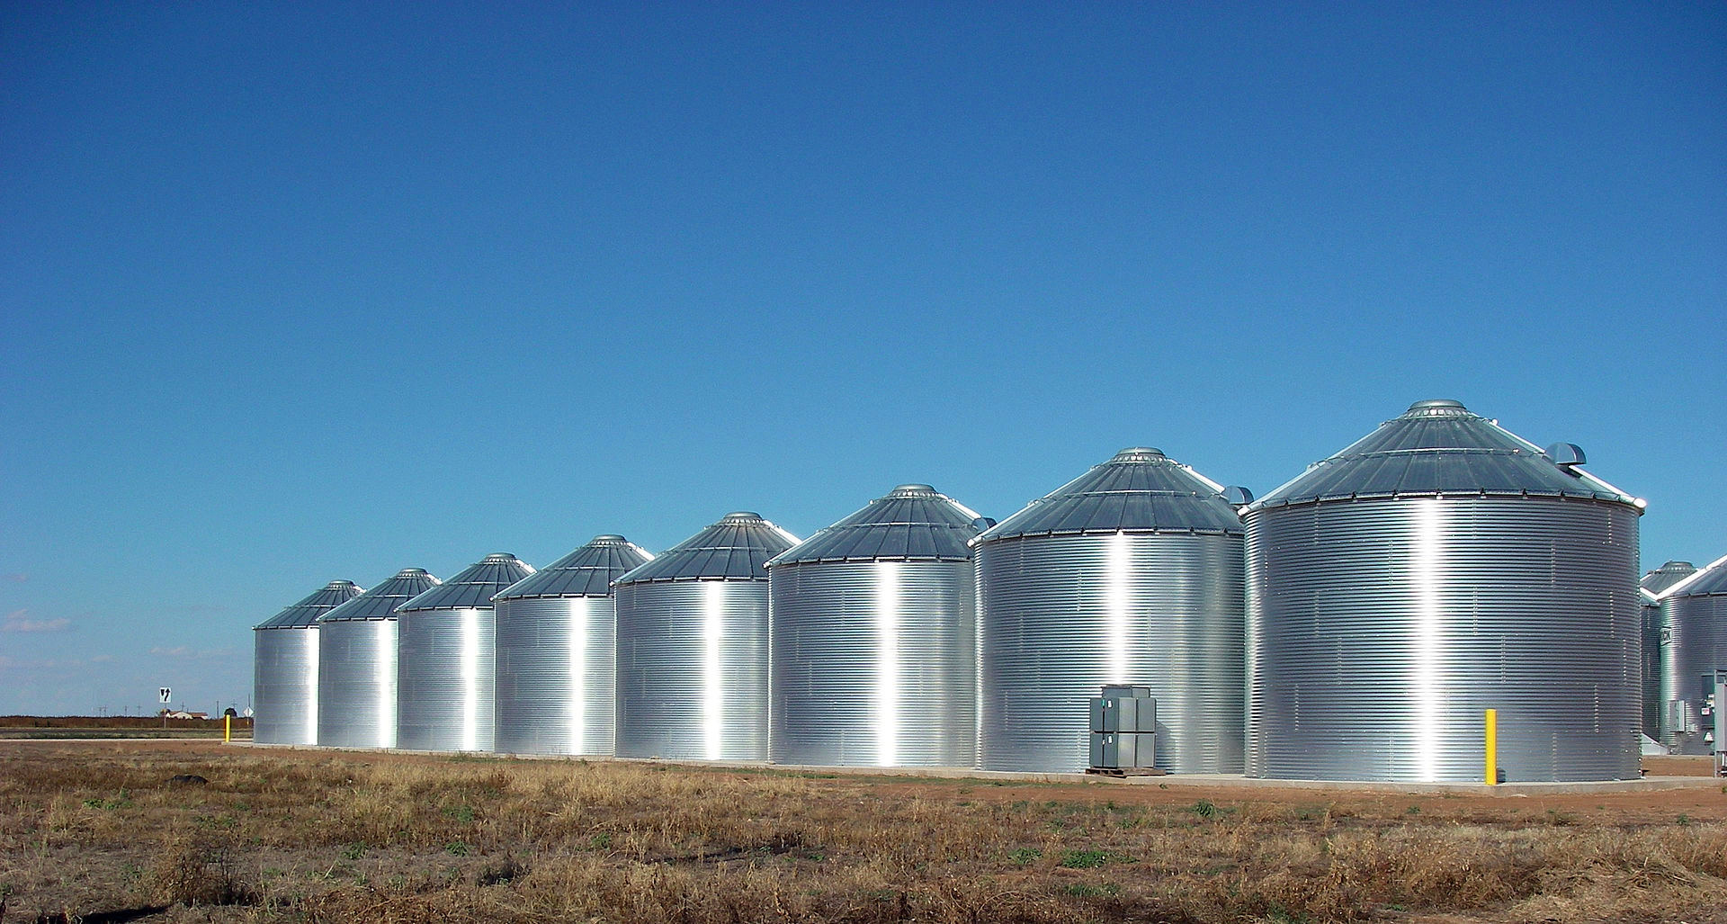
of the ‘Open Silos’
By Leaflet (Own work) [CC BY-SA 3.0 (http://creativecommons.org/licenses/by-sa/3.0)], via Wikimedia Commons

Slide 4
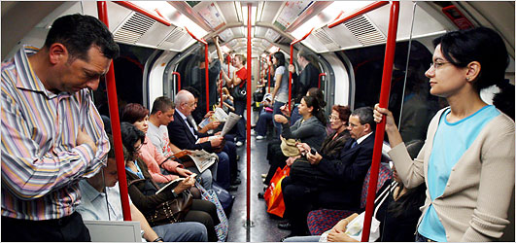
No Interaction!

Slide 5
Parallel Open Movements
Research
Education
Data
Open Silos

Slide 6
OER
ROERs
Education
Open Textbooks
MOOCs
OCW

Slide 7
Open Science
Open Data
Research
Open Access
Open Peer-Review
Open Trials

Slide 8
Open Gov Data
Open Research Data
Data
Civil Society
Transparency and corruption
Big Data (not open)

Slide 9
OEP
Open Courses
Open Licenses
Open Data
Open Textbooks
Open Education
ROER
OER
Open Access Papers
Open Source

Slide 10
Thinking about Open Data - through an Open Education Lens
The illusion of access promoted by computers provokes a confusion between the presentation of information and the capacity to use, sort and interpret it. (Brabazon, 2001)

Slide 11
Thinking about Open Data - through an Open Education Lens
...as with the earlier discussion concerning the “digital divide” there would, in this context, appear to be some confusion between movements to enhance citizen “access” to data and the related issues concerning enhancing citizen “use” of this data as part, for example, of interventions concerning public policies and programs. (Gurstein, 2011)

Slide 12
Open Data: the Open Definition
Availability and Access: the data must be available as a whole and at no more than a reasonable reproduction cost
Re-use and Redistribution: the data must be provided under terms that permit re-use and redistribution including the intermixing with other datasets.
Universal Participation: everyone must be able to use, re-use and redistribute - there should be no discrimination against fields of endeavour or against persons or groups.

Slide 13
Where does OD come from?
International agencies and organisations
Word Bank ; United Nations ; EU
National Governments and their agencies
UKOD; GermanyOD; USA
Local governments
Sardinia ; London; Barcelona
Non-governmental organisations
ODI; Monithon
Academic institutions and research centres

Slide 14
Open Data for developing ‘transversal skills’
Students construct knowledge by critically analysing information from various sources and formats, including data.
Being capable of analysing and interpreting raw data can be key to the development of transversal skills, which are defined by UNESCO as “critical and innovative thinking, inter-personal skills; intra-personal skills, and global citizenship”.

Slide 15
Skills and social participation
If one of our goals as educators is to develop transversal skills in students, towards enabling them to function as citizens and to actively participate in the discourse and debates of society, then we propose that Open Data can play a key role.

Slide 16
Open Education for social participation
Open Education
OER
Open Science
Open Textbooks
Open Data
Relationship with society
Open Courses
Open Access Papers
Critical Thinking
Social Engagement
Open Repositories

Slide 17
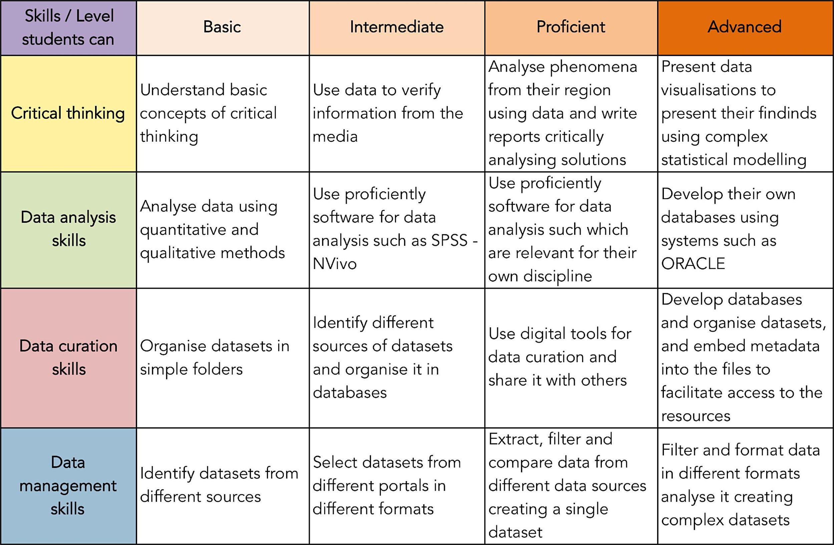

Slide 18
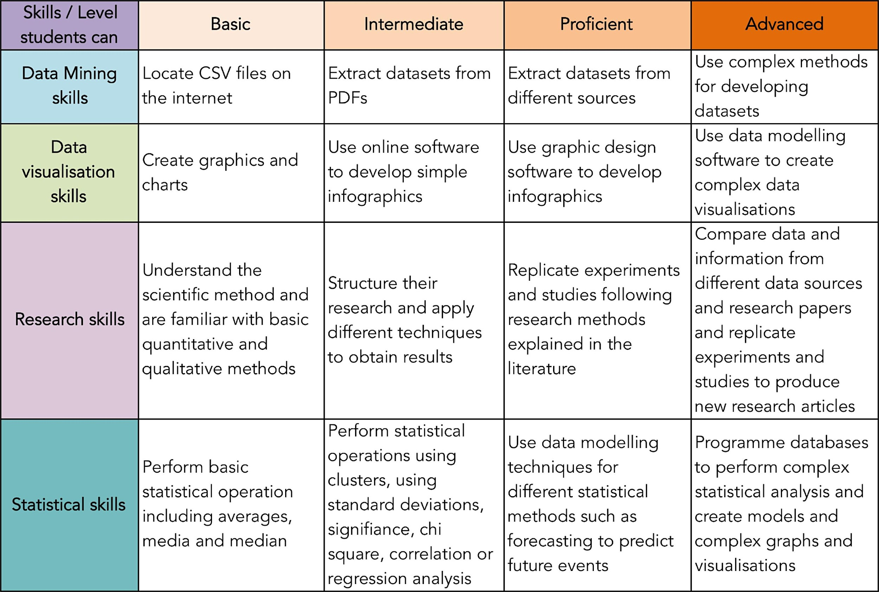

Slide 19
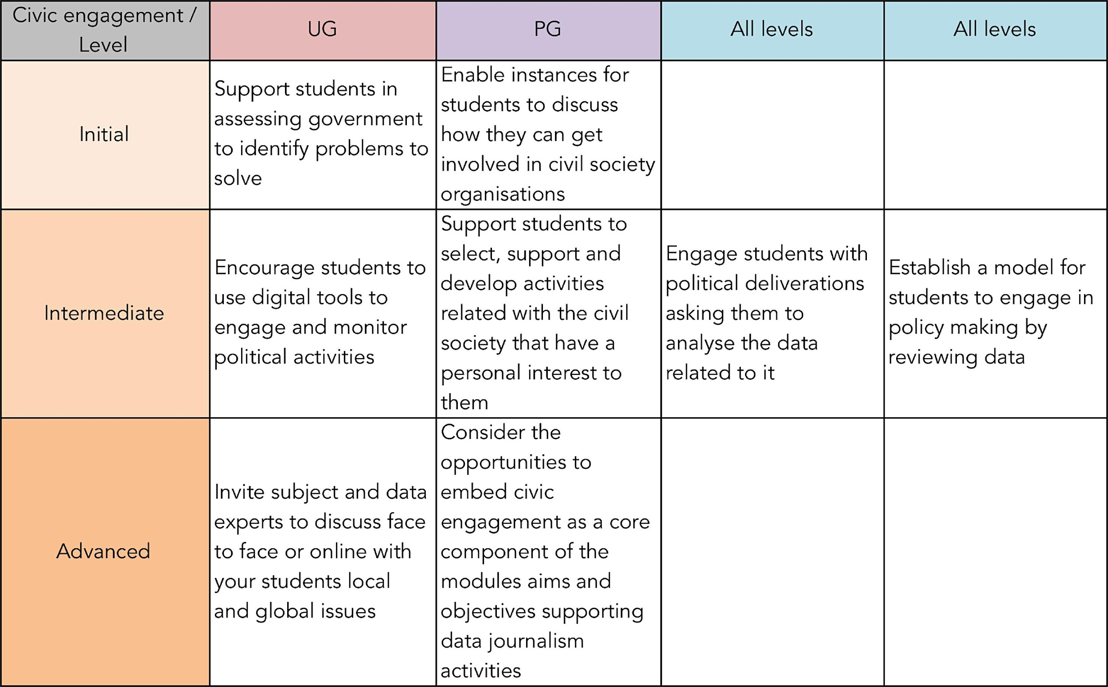

Slide 20
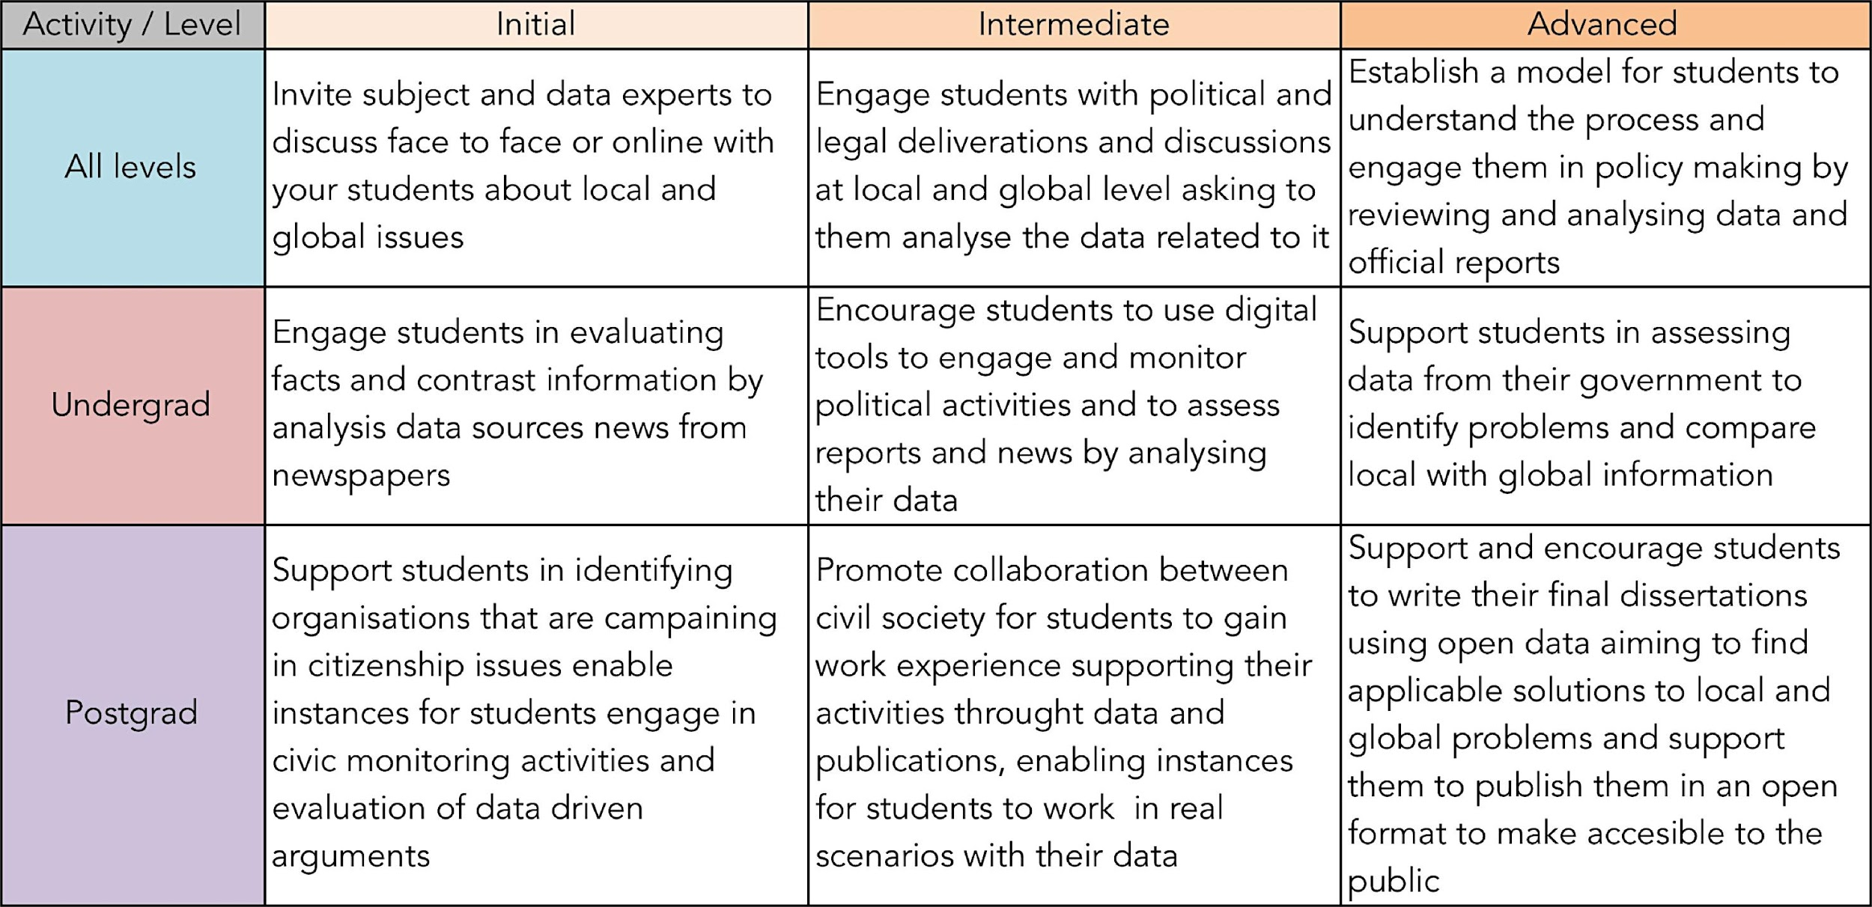
Using Open Data as OER

Slide 21
Embedding OD in T&L activities
Identify and describe the learning outcomes for the intended activities;
Identify the portals which will source the data;
Clearly identify and describe the challenges students might face;
Provide training materials for the software students will need to analyse the data;
Support students in communicating their findings to local or wider communities.

Slide 22
Open Data activities in T&L
Focus: define the research problems and its relation to the environment students.
Practicality: match technical applications and practices to expected solutions.
Expectations: set realistic expectations for data analysis.

Slide 23
Open Data activities in T&L
Direction: support in finding data portals which contain appropriate information.
Training: provide training materials for the software students will need to analyse the data.
Location: use global, local and scientific data which is as granular as possible.

Slide 24
Open Data activities in T&L
Modelling: develop model solutions to guide students on the challenges and activities.
Collaboration: support students to work collaboratively and at multidisciplinary level.
Communication: support students in communicating their findings to local or wider communities

Slide 25
All citizens should have equal opportunities and multiple channels to access information, be consulted and participate. Every reasonable effort should be made to engage with as wide a variety of people as possible (OECD, 2009, p.17).

Slide 26
To learn more about OD and Open Education
Open Definition: http://opendefinition.org
Open Data Handbook: http://opendatahandbook.org
Open Education Handbook:http://education.okfn.org/handbook/
A Scuola di OpenCoesione: http://www.ascuoladiopencoesione.it/
School of Data: http://schoolofdata.org/
Data Literacies Research:http://schoolofdata.org/2016/01/08/our-data-literacy-research-findings/

Slide 27
To learn more about OD and Open Education
Open Data as OER post:http://education.okfn.org/the-21st-centurys-raw-material-using-open-data-as-open-educational-resources/
OD as OER – case studies:http://education.okfn.org/open-data-as-open-educational-resources-case-studies-of-emerging-practice/
Open Data as OER paper:http://www.openpraxis.org/index.php/OpenPraxis/article/view/233

