Slide 1
A multitude of modes
considering ‘blended learning’ in context
Leo Havemann, Elizabeth Charles, Sarah Sherman, Scott Rodgers, and Joana Barros
@leohavemann #RIDE2019
CDE RIDE conference, Senate House, University of London, 15 March 2019
Notes:
goo.gl/bKPvpm
Presentation at University of London Centre for Distance Education RIDE 2019 (15 March), by Leo Havemann (UCL, formerly at Birkbeck), co-authored with Sarah Sherman (Bloomsbury Learning Environment), Elizabeth Charles, Scott Rodgers, and Joana Barros (Birkbeck).
This is a story of a review - an unfinished tale, and a trip down memory lane! In the context of an institution-wide Student Experience Review, various findings were pointing to the need to increase support for digital approaches to learning and teaching.

Slide 2
Abstract
Discussions of mode in higher education tend to contrast face-to-face teaching with distance education, while acknowledging that somewhere in between these poles, some students are engaged in a somewhat mysterious practice of ‘blended learning’. Blended learning is generally taken to indicate that a combination of face-to-face time in the classroom with the use of digital/online platforms is in use. While the question of whether blended learning is well understood or well-defined remains unanswered, it can nonetheless be described as the ‘new normal’. This session considers transformation in educational delivery mode in the context of the results of an institutional review of technology-enhanced learning, undertaken at Birkbeck, University of London in 2018. An overview of the method and results of the review will be discussed, alongside consideration of the extent to which these findings are more widely applicable. Birkbeck’s mission has been to create opportunities to study for groups who are usually excluded by conventional modes of provision. However, where ‘distance’ mode teaching acts to take location out of the equation, Birkbeck has historically opened access through its timetable. Birkbeck students give up the semblance of a normal life to dedicate many of their evenings to the classroom. But perhaps this has obscured the extent to which student life is increasingly the life of the computer, as well as of the mind. Evening, face-to-face mode teaching, while seen to a great extent as the college’s ‘USP’, is only one element of the ‘student experience’ and digital practices have quietly gone mainstream. These results have thrown into question whether ‘face-to-face’ mode truly exists at Birkbeck any more. Furthermore, if blended learning has become an umbrella term that covers a multitude of modes, it seems that much closer attention is now due to the nature and diversity of ‘blends’.

Slide 3
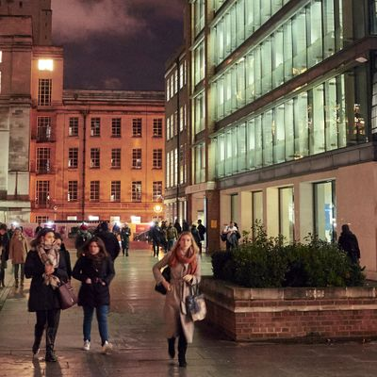
Context
is king.
BIRKBECK: “LONDON'S EVENING UNIVERSITY”
Notes:
But first a bit of context.

Slide 4
...established 1823 then as the London Mechanics Institute, for the purpose of enabling working people to study in the evening.
...this was also referred to at the time as ‘spreading the seeds of evil’.
...the mission continues.
Notes:
Established by Dr George Birkbeck in 1823 as the London Mechanics Institute, for the purpose of enabling working people to study in the evening ...this was also referred to at the time as ‘spreading the seeds of evil’.
The college was renamed Birkbeck College and later joined the University of London, and has rebranded again more recently as “Birkbeck, University of London”. The same mission continues.

Slide 5
There is no typical Birkbeck student...
Overwhelmingly ‘evening-taught’ - between 6 and 9 pm, studying across all levels and varied disciplines.
Traditionally: majority part time, enter via direct application, average age mid 30s. But, increasingly: more full time, more UCAS entry, average age getting younger.
Many ‘non-traditional’ students (mature, working, first in family).
Higher than average: EU, those with disabilities and SpLDs, taught postgraduates.
Notes:
Overwhelmingly ‘evening-taught’, between 6 and 9 pm.
Traditionally: majority part time, enter via direct application, average age mid 30s.
Increasingly: more full time, more UCAS entry, average age getting younger.
Many ‘non-traditional’ students (mature, working, first degree).
Higher than average: proportions of students from throughout the EU, of students with disabilities and specific learning difficulties , and of taught postgraduates.
Studying across 5 schools, from CertHE level through bachelor’s and master’s degree and postgraduate research.
So as you can see there are quite a few contrasts here - widening participation is core to the mission, but also a lot of postgraduate study, for example. There is a lot of diversity. What the students perhaps do have in common is by and large they want to come to a face to face class in the evening.

Slide 6
TEL support in a small(-to-medium), ‘face-to-face university’
The TEL team in 2008 was one Learning Technologist, & one IT Trainer.
Joined by one more LT for 2008/09 to support WebCT to Blackboard migration.
IT trainer role then not replaced when staff member left, but lecture capture project role created 2014/15.
Notes:
Why small-to-medium? Birkbeck’s traditional student body has been majority part time so while the college’s FTE at peak rose to around 10,000, the actual numbers of people had risen to 20,000. This total number has fallen off more significantly in recent years than the FTE number has as we have seen an increase in full time enrolment - but in any case we are talking about quite substantial student numbers to support with a TEL team of this kind of size...
The TEL team in 2008 … One Learning Technologist, one IT Trainer.
Also, some support for data integration, and VLE externally hosted. Joined by one more LT for 2008/09 to support WebCT to Blackboard migration (me/Leo), fixed term, later made permanent. IT trainer role not replaced when staff member left, but lecture capture project role created 2014/15, fixed term, later made permanent.
Roughly speaking there have been two LTs (plus another separate role) over this 10 year period, in an college which has had a peak of around 20K students enrolled just prior to the introduction of the 9K fee regime, with total person numbers now lower but a relatively similar level of FTE enrolment due to increasing fulltime.

Slide 7
Much was achieved, considering....
Migration from WebCT > Blackboard 2008/09.
Rapid growth from 500 live modules to 1500.
Migration from Blackboard > Moodle 2011/12.
Growth of online submission and marking.
Improvements to data integration.
Introduction of lecture capture.
Lynda.com.
Notes:
With a team of this size it has been quite a lot of work over the years to keep the home fires burning - to keep the platforms running, the plugins integrated, the suppliers managed, the queries answered, and colleagues trained.
This is not to claim that all of these have been optimal - just to point out that there is a lot of work to do just to keep platforms ticking over and assist people in doing ‘the basics’. Business as usual is happening.

Slide 8
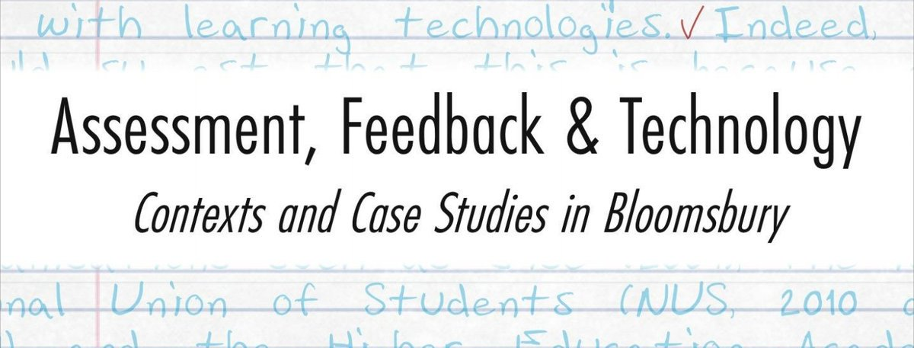
And even some surprising things...
2013-18
2016
2017
Notes:
On the fringes of all the stuff that has to be done, it’s been possible intermittently to do some really worthwhile work in terms of...
Blended learning design to support academic skills development.
See: Havemann, Leo and Drew, Liz and Barros, Joana and Leal, Joanne (2013) Special blend: developing a model for technology-enhanced, flexible learning. In: Can We Do It? Yes We Can: HEA/SEEC Conference 2013, 22-23 Jul 2013, London, UK. (Unpublished);
Leal, Joanne and Havemann, Leo and Barros, Joana and Drew, Elizabeth (2016) Transitions: recruit, support, retain. In: Learning and Teaching Seminars, 27 Oct;
Havemann, Leo (2017) Formative assessment for postgraduate academic skills development in arts. In: Havemann, Leo and Sherman, S. (eds.) Assessment, Feedback and Technology: Contexts and Case Studies in Bloomsbury. London, UK: Bloomsbury Learning Environment, pp. 49-51.
Developing resources to support inclusive practices.
See : Peake, Sarah-jane and Rushworth, Lee and Havemann, Leo (2016) Birkbeck for all: joined-up thinking on accessibility. Birkbeck, University of London.
And through working across the BLE, investigating the ‘state of the actual’ and the possibilities of using digital tools and environments to support diversity of assessment and feedback practices.
See: Havemann, Leo and Sherman, S. (eds.) Assessment, Feedback and Technology: Contexts and Case Studies in Bloomsbury.London, UK: Bloomsbury Learning Environment. www.ble.ac.uk/ebook
All of which would seem important to do more of…

Slide 9
Birkbeck TEL myths persisted …
We’re not the Open University
The academics don’t want to do TEL (*except enthusiasts)
Our students are not ‘digital natives’
Notes:
Various TEL myths also tend to circulate and cloud the issue… suggesting that we are the wrong institution, or we have the wrong staff, or the wrong students. ‘We do face-to-face’. TEL usage thought of as something done by enthusiasts.
A tendency to ‘Birkbeck exceptionalism’ perhaps extends to the idea that the digital has not yet permeated and transformed the everyday life of our staff and students.

Slide 10
Debunking was needed...
We’re not the Open University but we are ‘an open university’
The academics don’t want to do TEL but they are actually already doing it
Our students are not ‘digital natives’ ...but it’s actually digital natives that are mythical
Notes:
Thinking about Birkbeck as an open university is something that I’ve discussed in a previous conference presentation (and forthcoming book chapter).
See: Havemann, Leo (2017) Stepping up as opening up: aspects of openness in everyday pedagogic practice. In: OER17: The Politics of Open, 5-6 Apr 2017

Slide 11
Don’t ask,
don’t TEL?
Notes:
But somehow the idea that such projects were only starting points, providing proof of concept rather than finished programmes of institutional and pedagogic transformation, did not seem to be getting through. It appeared clear that to do more, more resources would be needed.
Was it simply a case of don’t ask, dont TEL?

Slide 12
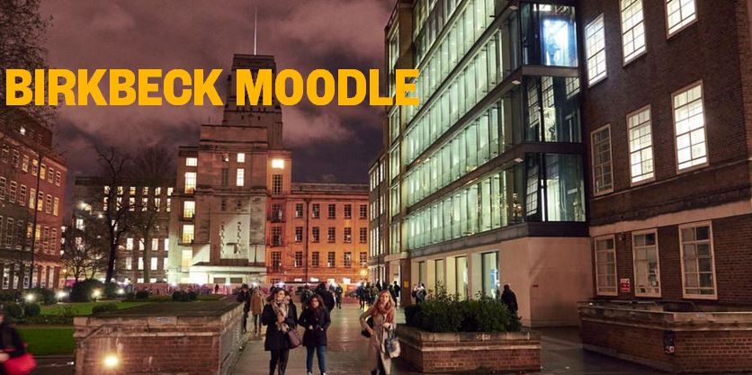
2018 TEL Review:
Getting beyond ‘business as usual’?
Notes:
So finally, with the advent of the TEL review we had an opportunity to look beyond ‘business as usual’, beyond where we are now, and consider where we would like to be. So an initial group worked out what kinds of things the review would seek to cover and decided to split it into two strands, which would respectively ask internal and external questions.
This proposal for the review went away to be considered. And remained away. And then, after quite some time the review was greenlighted, with the proviso that all would be done within seven weeks. Panic ensued. Well not really - but it was clear that everything originally planned (as written in the session abstract) could not be done during the time available.

Slide 13
External strand
Pull together aggregated data from known surveys (UCISA, HeLF)
and reach out to contacts at other HEIs (City, UCL, Sussex)
Notes:
For the external strand, reach out to contacts at other HEIs became “talk to Julie”. Well no, actually for this strand we did stick to the plan but it became more reliant on the pre-existing information sources, and interviews with quite a select group of heads of TEL at other institutions. Including Julie (aka Julie Voce, head of TEL at City). We had also identofied UCL as another candidate. Julie recommended for a third case we speak to the university of Sussex, which proved very useful.

Slide 14
Internal strand
Interviews with key academic staff Online surveys for (i) staff and (ii) students User testing for (i) staff and (ii) students Focus groups Usage data
Notes:
Some elements were cut from the internal strand due to the tight schedule.

Slide 15
External strand
Through looking at HELF and UCISA survey data we confirmed suspicions that ….
we already use the standard/most popular platforms, therefore unlikely there is a fundamental technology lack / fix. And
availability of TEL support staff is the largest driver of adoption of learning technologies.
Notes:
Through looking at the HELF and UCISA survey data we were able to confirm our suspicions that we already use standard/most popular platforms, therefore there is no technology problem here or technological fix to our problems. And that availability of TEL support staff is the largest driver of adoption of learning technologies.
The UCISA TEL Survey and Case Studies helped us to devise a list of questions we wanted to ask reference institutions about.

Slide 16
External strand
Our interview questions considered...
1. TEL Vision, Strategy, Policy
2. Governance
3. Development and Innovation
4. Team Structure and Roles
5. The Good the Bad and the Ugly
Notes:
From our reference institutions, we wanted to know about:
1. TEL Vision, Strategy, Policy o What is the institutional vision for TEL – where are you going, big picture and/or short/medium term? o What is the strategy for TEL and is this standalone or subsumed under one or more other strategies, e.g. Learning and Teaching / Student Experience / Digital? o Does the strategy translate into institutional policies e.g. baseline/minimum level of VLE usage, or assessment-related? o Would it be possible to share with us any vision, strategy, policies, or any evaluation you have done?
2. Governance o How are strategic decisions about TEL made? How do stakeholders feed in to these? What is the structure? How does the process work?
3. Development and Innovation o How is pedagogic and/or technical innovation promoted, fostered, or supported? Is this top-down or bottom-up driven? o Where do you see the innovation?
4. Team Structure and Roles o How is/are the TEL-related support teams structured? o What roles are there are where are they based e.g. technical development/maintenance, end-user technical support, pedagogic development and innovation, and any other roles? o Do those who directly support staff also support students? o Who provides support for adoption of inclusive practices?
5. The Good the Bad and the Ugly o What works well? Is anything not working? Are changes planned?

Slide 17
Findings of external strand
Across most of the campus-based HE sector, education is now seen as inherently blended, and this understanding forms part of institutional strategy and key processes.
Digital education is a fast-moving field, in which usage, provision and policy need to be routinely reviewed and updated. Institutions often have a governance structure which oversees the links between TEL strategy and implementation.

Slide 18
Findings of external strand
There is no magic formula - structures have evolved organically and responded to local priorities
But, there is a tendency to separate staff from student support, pedagogic from technical support, and have dedicated support for distance learning.

Slide 19
Findings of internal strand
Learning technologies are used across all departments of the college and the top 20 most visited Moodle modules were spread across 9 departments.
Students appreciate online resources and study materials such as digitised readings, handouts and slides, and video (high production values not required, but rather content that is relevant, timely, and authentic).
Notes:
Learning technologies are used across all departments of the college and the top 20 most visited Moodle modules were spread across 9 departments.
Students appreciate online resources and study materials such as digitised readings, handouts and slides, and video (high production values not required, but rather content that is relevant, timely, and authentic).

Slide 20
Findings of internal strand
Staff noted that a lack of support in making small, modest improvements is a significant brake on enhancement and innovation.
Staff felt Birkbeck needs a culture shift around TEL, expressed through academically-led strategy and governance.
Most staff would accept some degree of standardisation based on clearly-evidenced guidance, implemented locally.

Slide 21
Findings of internal strand
Staff and students across the college, as elsewhere, now regard our typical so-called ‘face-to-face’ mode as in fact ‘blended’ (to varying degrees of intensity).
Notes:
The key finding?

Slide 22
Recommendations arising from the review
Four main areas:
(a) developing a digital education strategy;
(b) establishing a digital education governance structure;
(c) building a digital education service; and
(d) other key actions arising.

Slide 23
Thinking about mode
Tendency to talk about face-to-face and distance (or ‘fully online’) as opposite poles on a continuum...
and everything in between as blended.
< face-to-face blended online >
Notes:
Also I think it is worth drawing on a digital ethnographic perspective here: even when we are ‘online’ we remain ‘here’, in the world, embodied.
So, there is no fully face-to-face or fully online mode?

Slide 24
Face-to-face teaching, blended learning
Perhaps face-to-face is a better description of a context in which teaching is done rather than a ‘mode’ of study...implying that the ‘mode’ of modules which involve face-to-face teaching is actually by default blended.
But in this case what does blended even mean?

Slide 25
Blended: time for a more nuanced understanding?
UCISA TEL Survey 2018: “Blended learning delivery focusing on the provision of lecture notes and supplementary resources to students still represents the most commonly supported activity”
Dziuban et al, 2018, Blended learning: the new normal and emerging technologies: “U.S. Department of Education... defined BL as ‘a combination of online and in-class instruction with reduced in-class seat time for students’.”
Notes:
https://www.ucisa.ac.uk/bestpractice/surveys/tel/TEL_survey_report_2018/Execsummary
https://educationaltechnologyjournal.springeropen.com/articles/10.1186/s41239-017-0087-5

Slide 26
Discussion
What does blended mean to you?
How can we meaningfully break down ‘blended’ into more useful categories?

Slide 27
Thank you!

