Slide 1
Funding Open Access Books
Opening the Future
Professor Martin Paul Eve

Slide 2
More about the model
Context: Radically changing environment. OA mandates for books emerging but Book Processing Charges are not viable.
Shares cost savings with libraries.
In step with discoverability & accessibility direction. Access for everyone with findable research.
Incremental steps towards OA. Not all or nothing.
Re-purposable. Working on the OA Book Hub.

Slide 3
nearly
30
years old
Traditional publishing model, changing rapidly post-pandemic: aiming to be mostly OA for monographs.
450
backlist titles

Slide 4
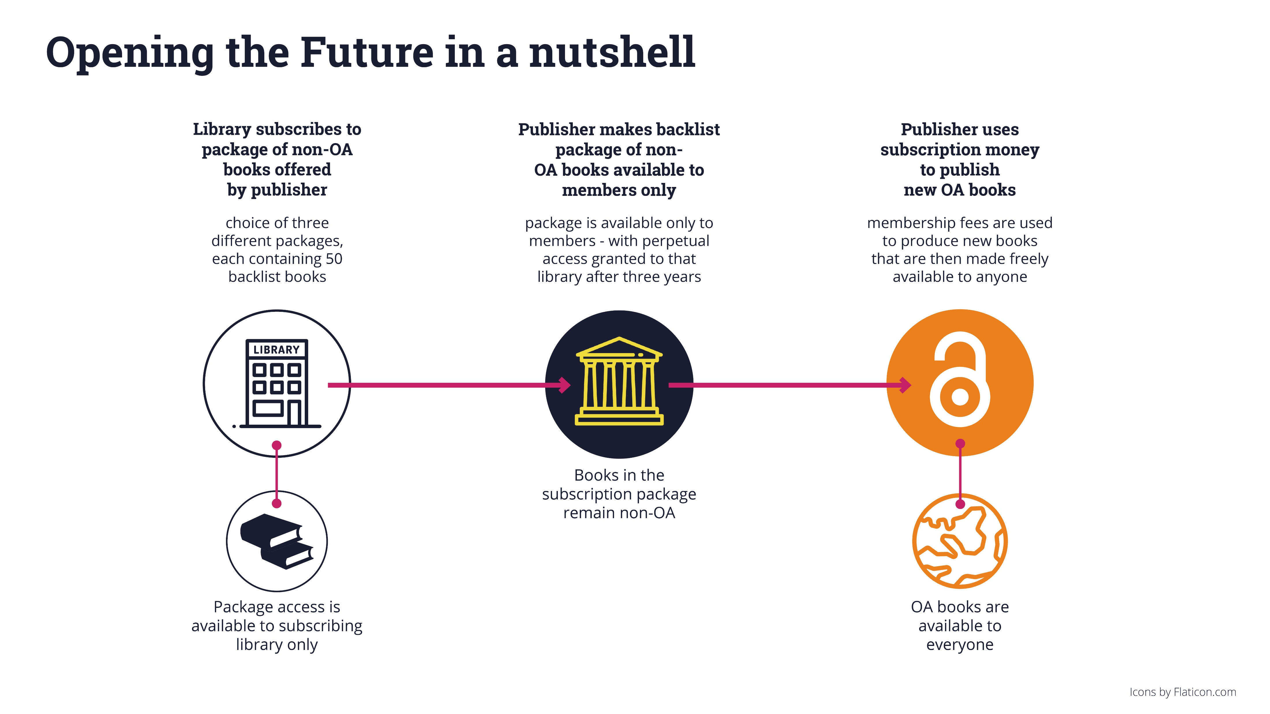

Slide 5
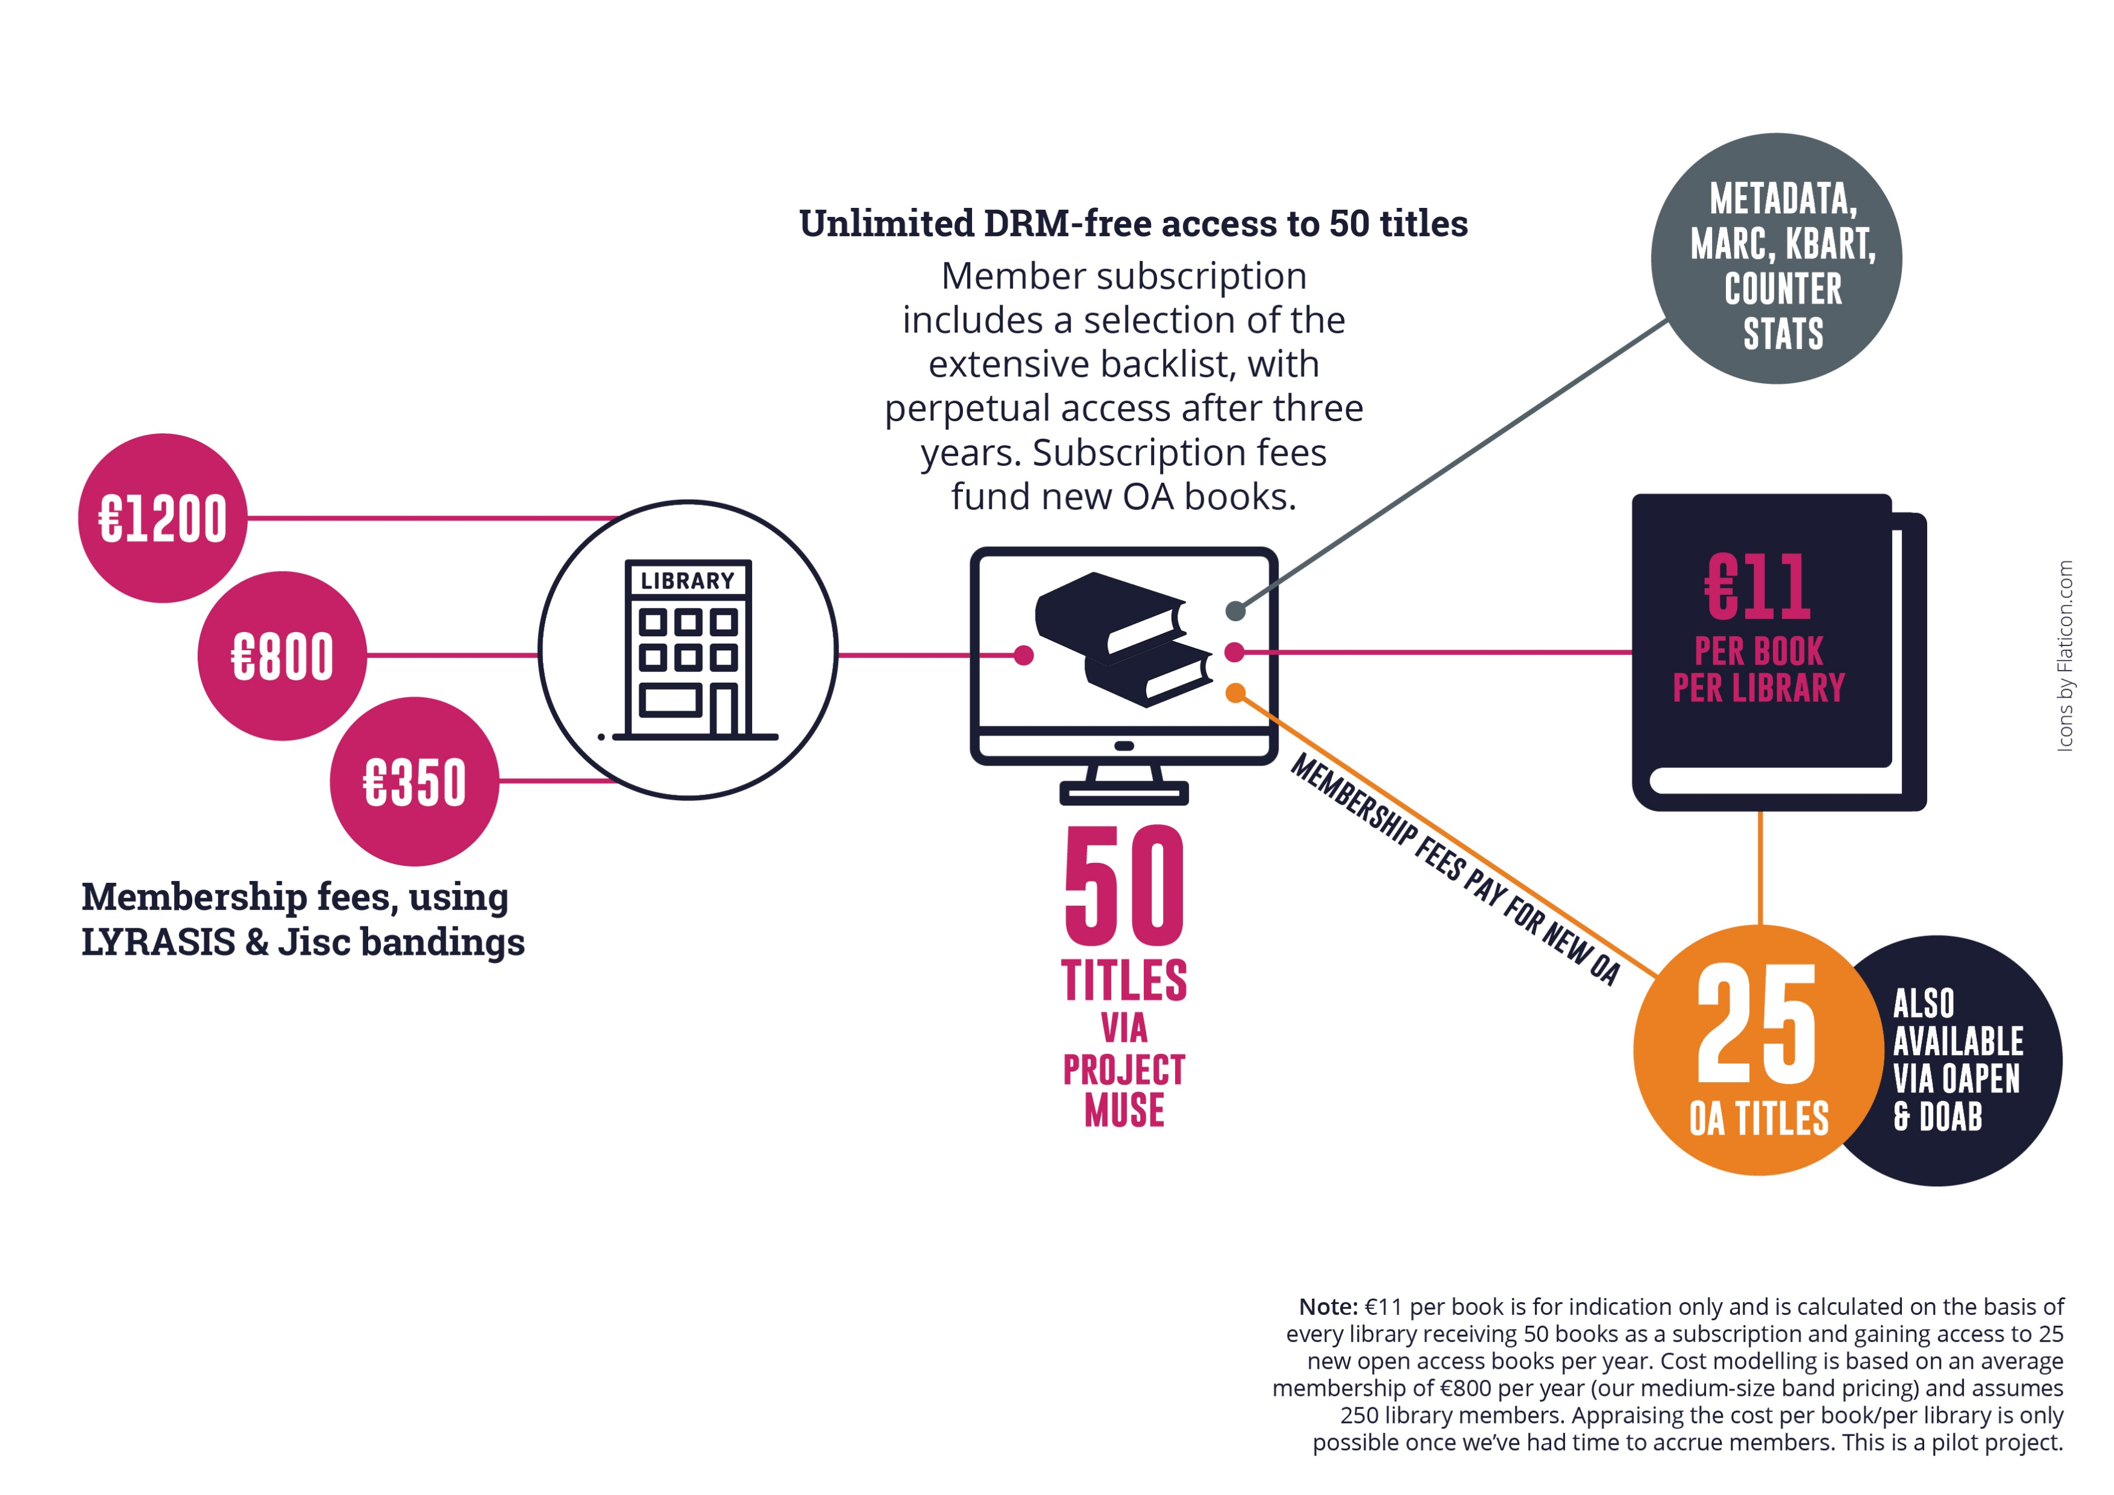

Slide 6
Liverpool University Press
Established in 1899, they are the UK’s third oldest university press and an award-winning academic publisher.
publishing OA for more than
10
publishing approximately
and
150
39
years
books a year
journals & a number of digital collections

Slide 7
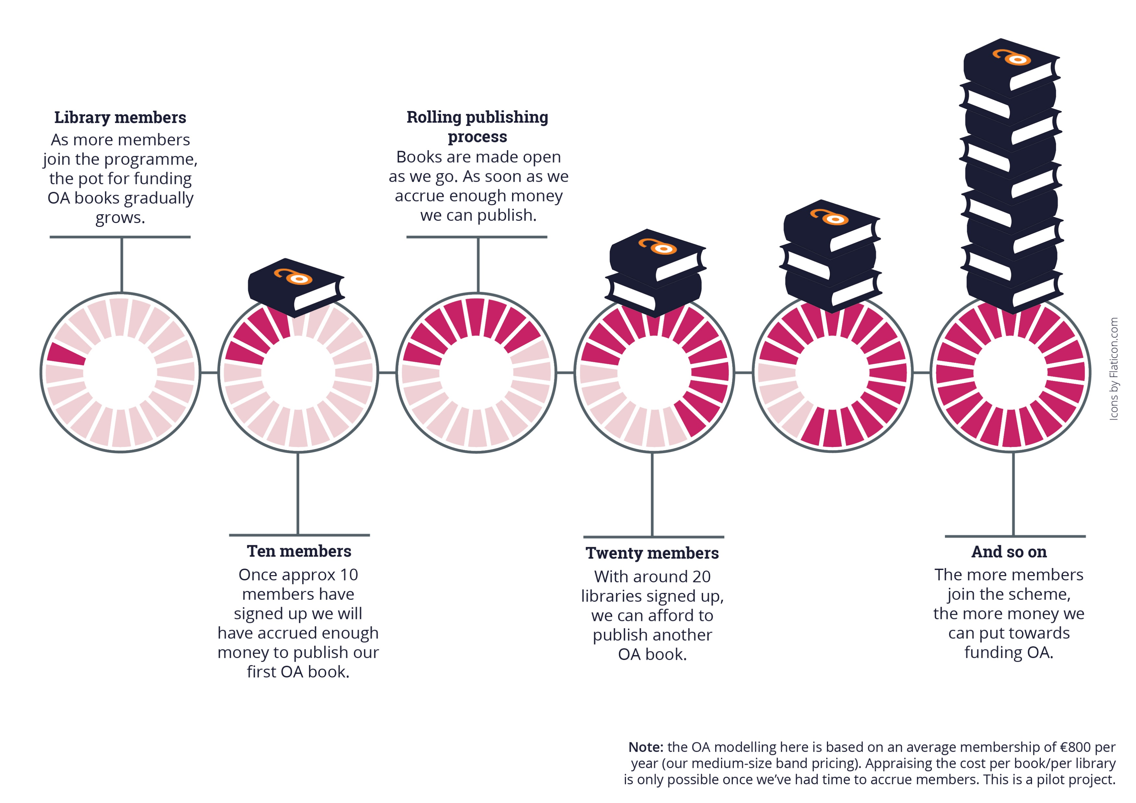

Slide 8
Objections
Isn’t this just writing a blank cheque for the Press?
We already have all the books
Why THIS publisher?
Is this too expensive?

Slide 9
Why publishers should use this model
Relatively low risk
COPIM toolkit
Avoids BPCs
Laying the groundwork

Slide 10
Contact us for more information
martin.eve@bbk.ac.uk
https://openingthefuture.net
for FAQs, downloadable brochure, lists of available titles & ISBNs
Slides CC BY. Press logos excluded from license.

