Slide 1
COPIM and Open Access Monographs
Professor Martin Paul Eve
COPIM & Birkbeck, University of London

Slide 2
Why OA and why does it matter?
COVID 19 has exposed how vital OA is to the future of scholarly communications while also ripping out the heart of library budgets
The traditional publishing model is broken
Traditional sales of academic books have dropped but we’re still working the way we always have
OA offers increased readership, usage and citation
Funder mandates

Slide 3
OA Policies
"The truth is that we must all go further" - Amanda Solloway, Minister for Science, Research and Innovation, August 2021
UKRI review published August 2021 (only for project funding):
Zero-embargo green requirement
OA extended to monographs from 2024
REF review will be next
Ministerial steer is clear on direction of travel
But not yet set in stone
Unclear what funding would be provided for OA monographs
See Eve, Martin Paul, Kitty Inglis, David Prosser, Lara Speicher, and Graham Stone. 2017. ‘Cost Estimates of an Open Access Mandate for Monographs in the UK’s Third Research Excellence Framework’. Insights: The UKSG Journal 30 (3). https://doi.org/10.1629/uksg.392.

Slide 4
Benefits of OA: CEU Press
279
7
they were downloaded
350,000
of the top 10 downloads were over
titles were made open on Project MUSE during
times, from
10
129
March to June 2020
countries
years old

Slide 5
Snapshot of OA book world
602 publishers
36,947 books
100 publishers
16,172 journals, 5,890,831 articles
OA books market has many smaller players with publications in multiple languages, across a broad spectrum of subject areas

Slide 6
Large, well-funded academic presses
MIT’s D20 has a subscription threshold before OA titles can be released
Small to medium-sized academic presses
Low risk, no threshold models like Opening the Future
Three strata
Opening the Future,
MIT’s D20, and other
library subscription models
Scholar-led born-OA presses
Open collectives working together to provide combined offers

Slide 7
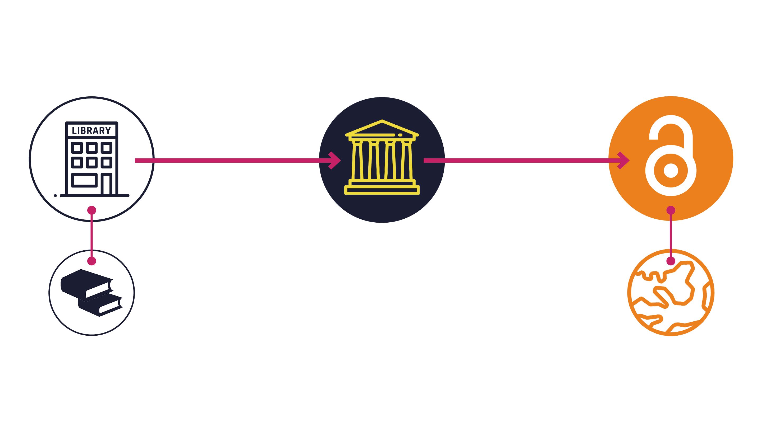
Opening the Future in a nutshell

Slide 8
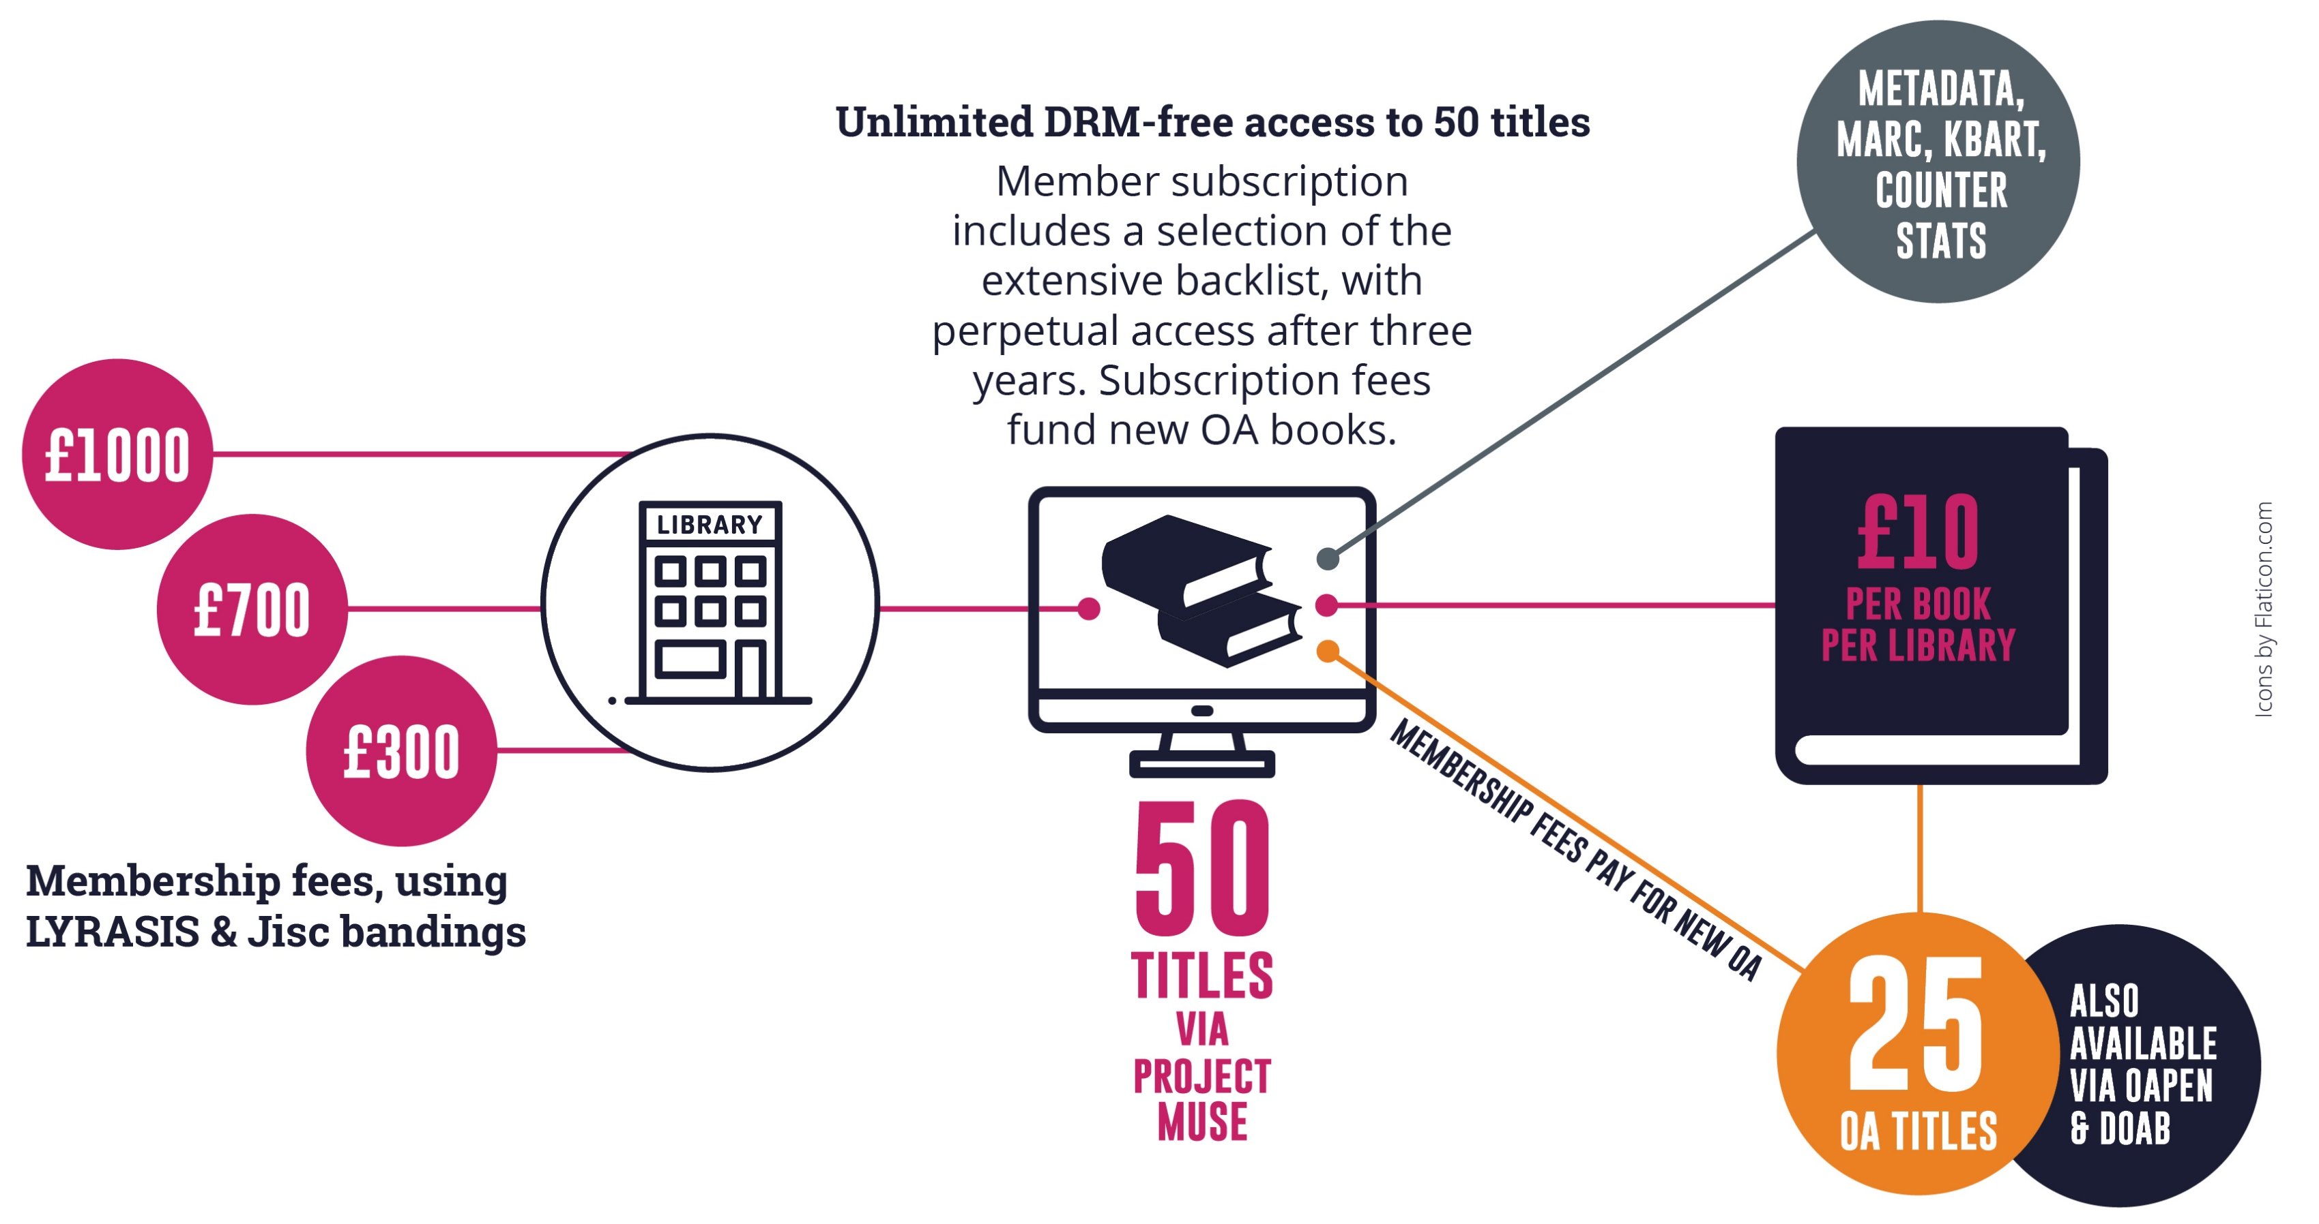
Note: £10 per book is for indication only and is calculated on the basis of every library receiving 50 books as a subscription and gaining access to 25 new open access books per year. Cost modelling is based on an average membership of £700 per year (our medium-size band pricing) and assumes 250 library members. Appraising the cost per book/per library is only possible once we’ve had time to accrue members. This is a pilot project.

Slide 9
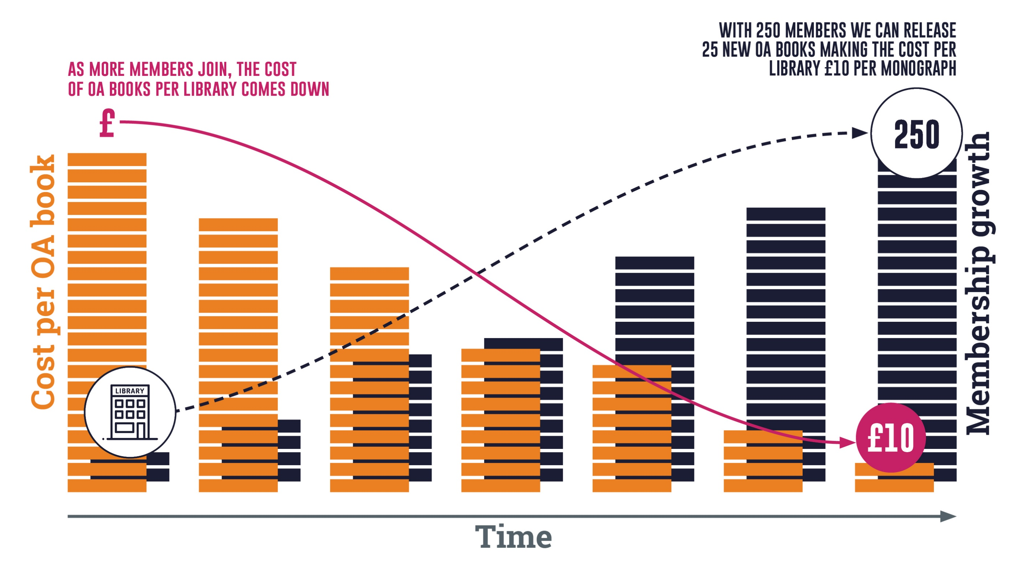
Note: the OA modelling here is based on an average membership of £700 per year (our medium-size band pricing). Appraising the cost per book/per library is only possible once we’ve had time to accrue members. This is a pilot project. Icons by Flaticon.com

Slide 10
Piloting Opening the Future
Liverpool University Press & Central European University Press

Slide 11
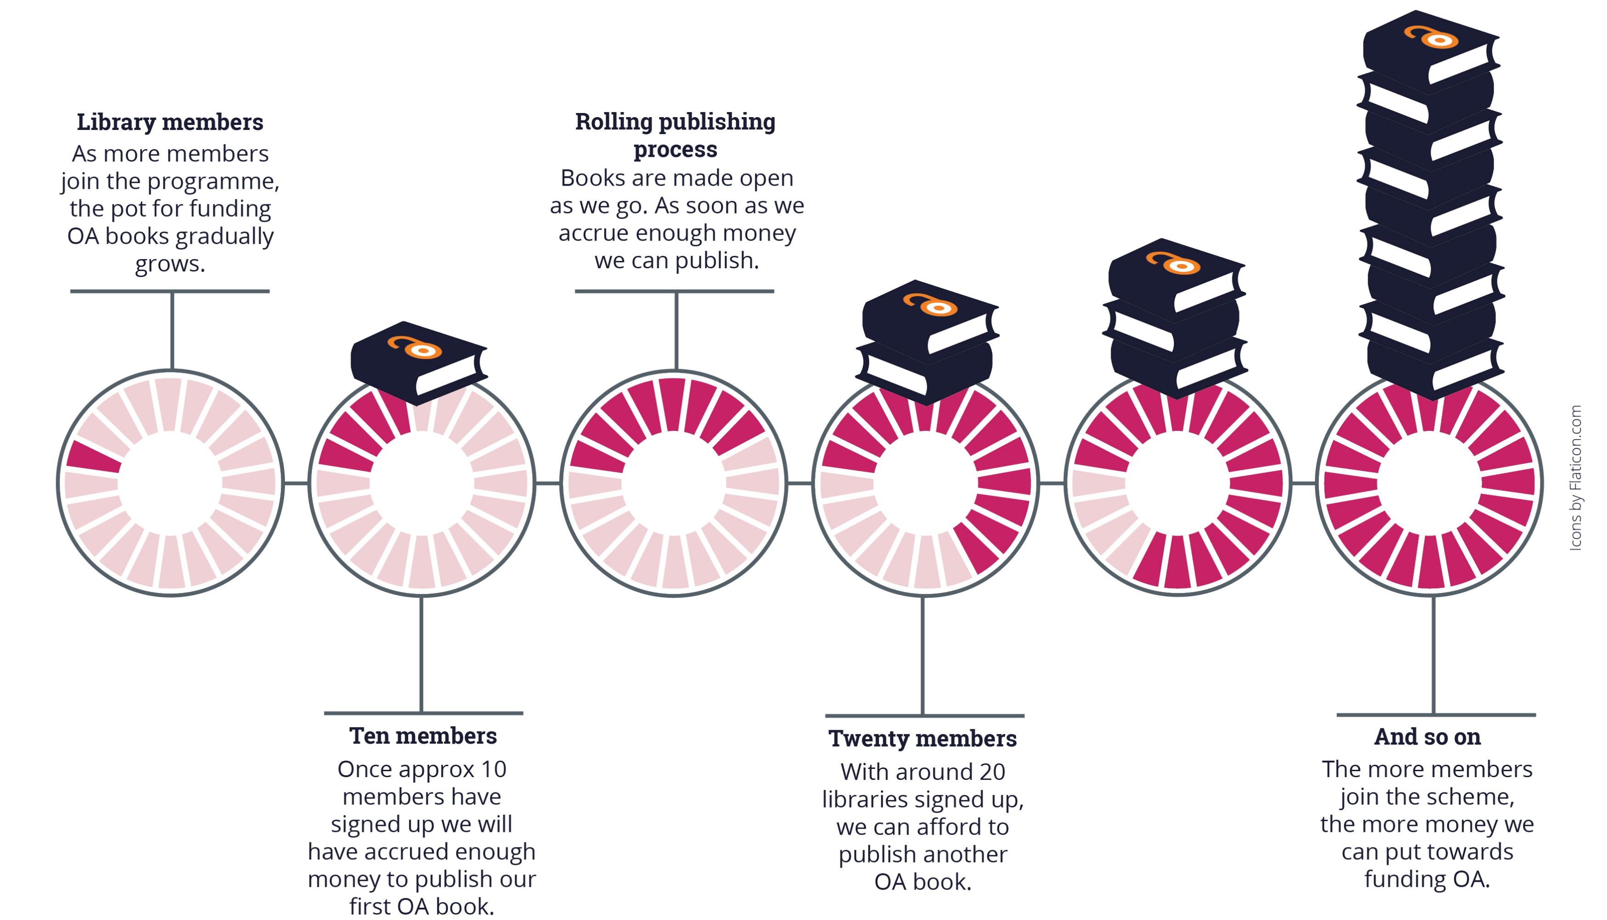
Note: the OA modelling here is based on an average membership of $950 per year (our medium-size band pricing). Appraising the cost per book/per library is only possible once we’ve had time to accrue members. This is a pilot project.

Slide 12
What this model is not
Opening the Future is not a ‘read and publish’ deal

Slide 13
For more information
martin.eve@bbk.ac.uk
PoznanskiE@press.ceu.edu
openingthefuture.net
for FAQs, downloadable brochure, lists of available titles & ISBNs

