Slide 1
‘Begin at the beginning, the King said, very gravely’: Serious Openings and Subversive Epigraphs in the Novels of Thomas Pynchon
Martin Paul Eve
Birkbeck, University of London

Slide 2
Sprockets and Film

Slide 3
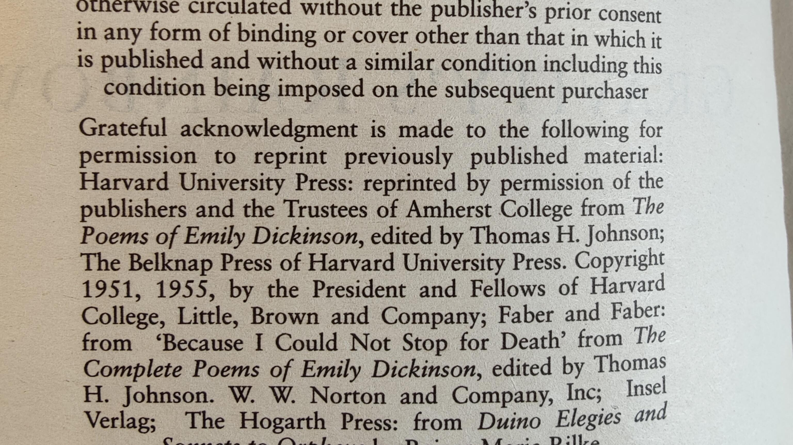
Copyright Normativity

Slide 4
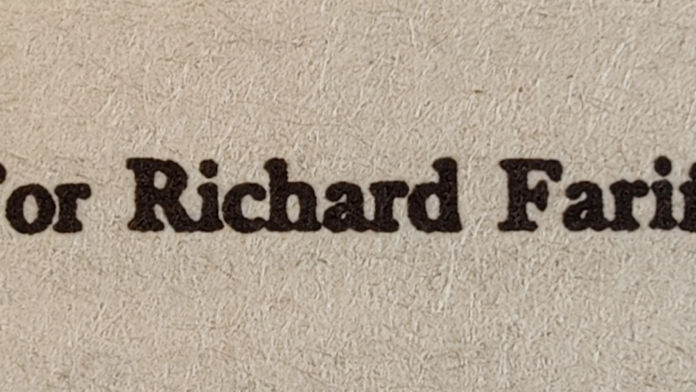
Dedications

Slide 5
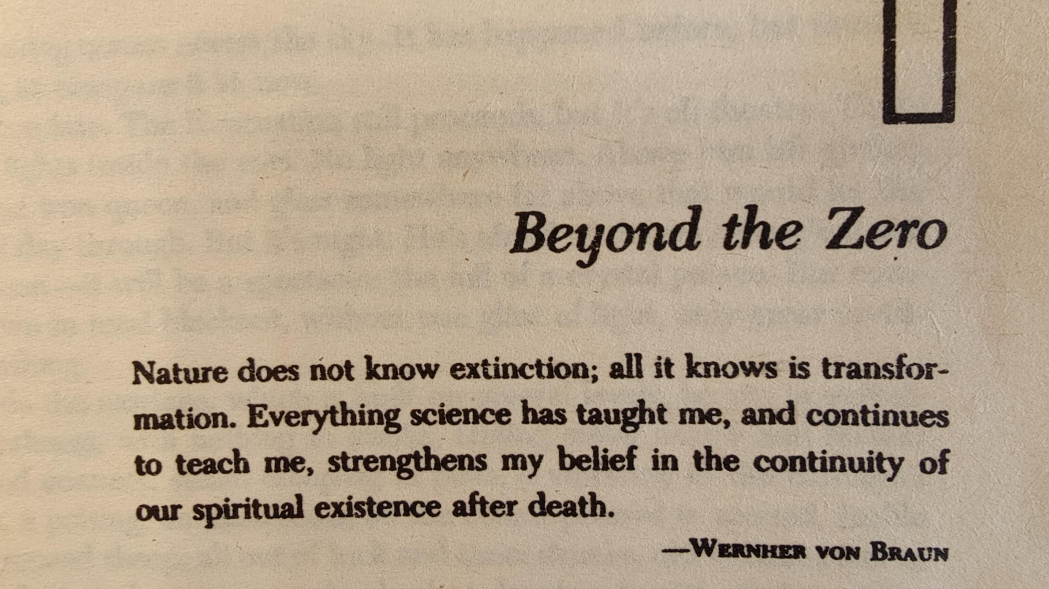
Epigraph

Slide 6
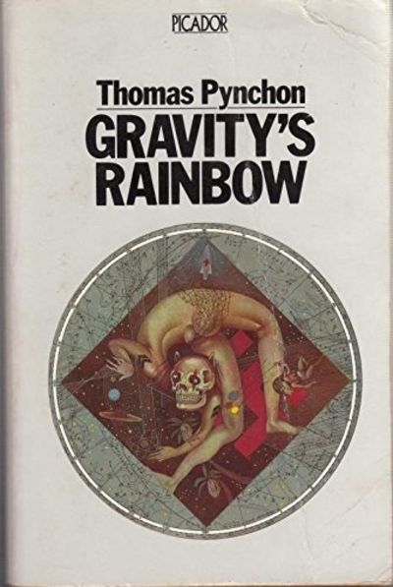
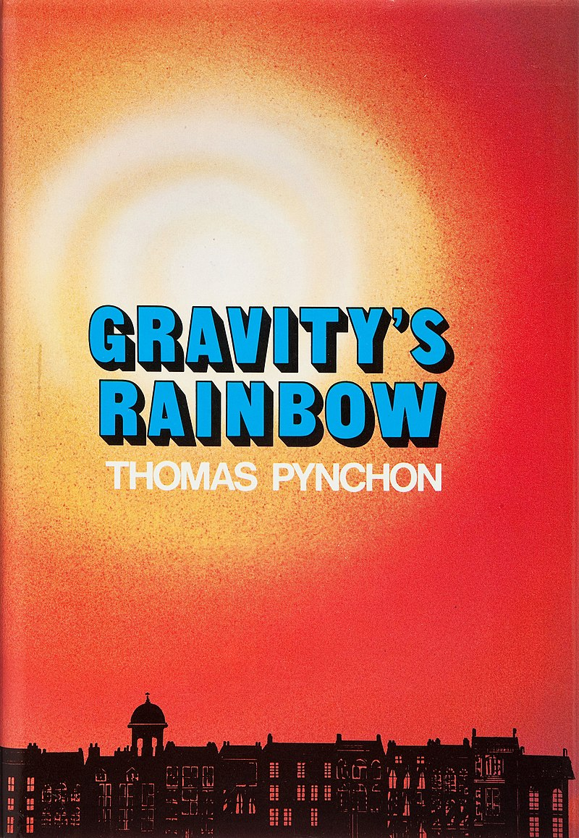
Covers

Slide 7
Gravity's Car Crash of a Cover

Slide 8
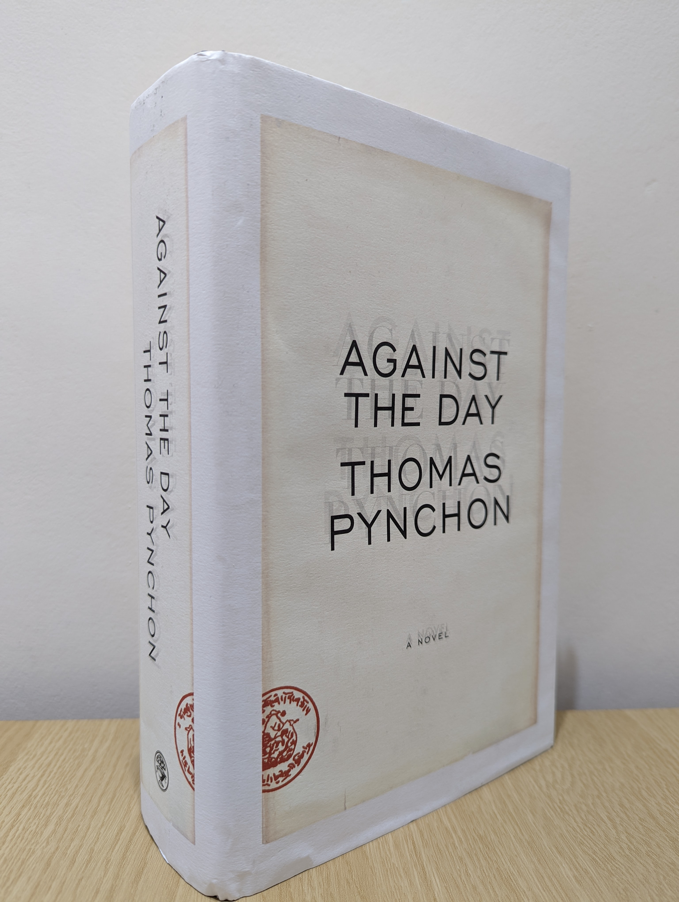
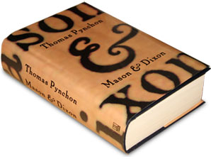
Mason & Dixon and Against the Day

