Slide 1


On Collective Funding Models for Open Access
Professor Martin Paul Eve PhD
Technical Lead, Knowledge Commons, MESH Research, Michigan State University
Professor of Literature, Technology, and Publishing, Birkbeck, University of London
evemarti@msu.edu | martin.eve@bbk.ac.uk

Slide 2
Open Access: What Is It? Who Am I? Why Am I Talking About It?
"The removal of price and permission barriers to academic research and scholarship"
Using the internet to disseminate scholarship and research for free with a license that means it can be re-used

Slide 3
Lots of technical terms
Gold: the publisher makes it OA (sometimes using an author-facing charge)
Green: a repository makes a version OA
Diamond/platinum: the publisher makes it OA without an author-facing charge
APC: an article-processing charge
Creative Commons licenses: licenses that allow for re-use with attribution

Slide 4
What is it that makes OA possible?
The underlying economics
A freedom from the market
A freedom to disseminate

Slide 5
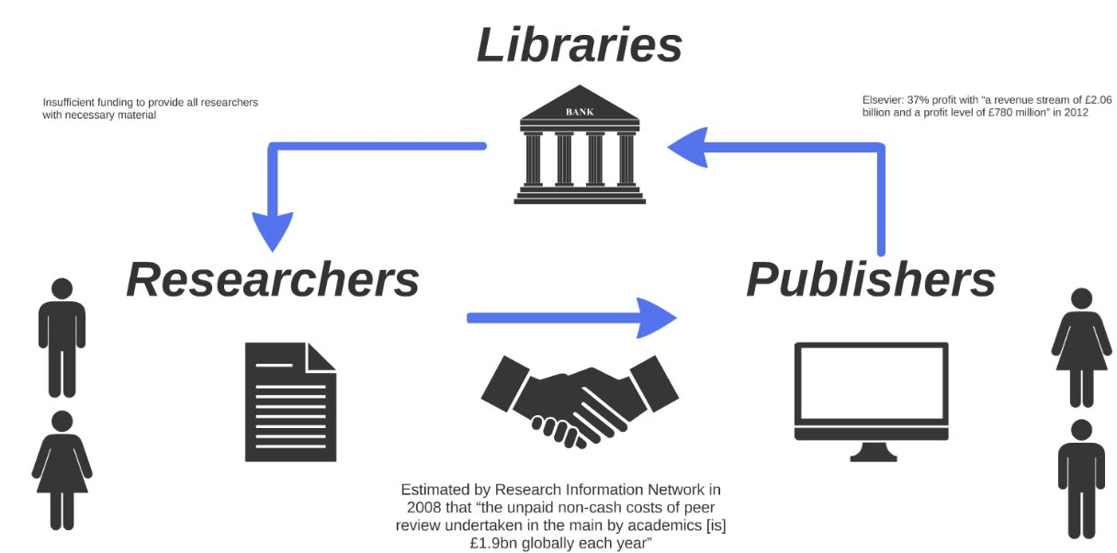
Constrained by prestige system

Slide 6
Historical Axes of the Open Access Movement
Right financial
Right access
Left financial
Left access

Slide 7

OA for Books: Why? Worth thinking about as an extreme case
Many scholarly monographs are unaffordable for individuals
The humanities disciplines, where these are a common format, need visibility
Sharing knowledge to all should be in line with the epistemology of disciplines that study human cultures
Re-use (CC licenses) facilitates translations and other scholarly activities

Slide 8



OA for Books:
Why Not?
Costs/BPCs
Third-party re-use issues (CC objections)
Fear of loss of print/digital-only
Ongoing misconceptions about peer review
Trade crossover titles

Slide 9
Why don't BPCs work for OA books? (Or APCs work for journals)
Distribution: imagine 100 people in a room
Funding situation in book-heavy disciplines
Third-party content re-use different in some disciplines
Trade markets

Slide 10

What other options are there?
Collective funding mechanisms
State funding councils (in the UK: £100m over the course of a REF cycle)
Private philanthropy (per title?)
Print sales subsidy
Institutional subsidy
Green OA for books

Slide 11

Why is there so little green OA for books?
Authors want final typeset and copyedited version seen and read
Unknown economic consequences for publishers
  With higher initial costs and therefore financial risk
  Market dynamics of individual sales units
Complex rights management questions
Royalties
Publisher policies not in place

Slide 12
Seeding Change: Membership Models Drive New Thinking
Journal and Preprint Schemes (OLH; arXiv; Subscribe2Open)
Scholar-Led Memberships (OBP, punctum books, Mattering Press)
University Press Fronlist Flips (MIT Press, Cambridge UP)
Opening the Future (CEU Press and Liverpool University Press)

Slide 13

Knowledge Unlatched
Now owned by Wiley

Slide 14

The Model We Developed
Libraries subscribe to backlist (not OA) titles
Revenue is used to fund new frontlist titles (OA) without BPCs
Balances need for unique local benefit with altruistic collective funding
Email: t.grady@bbk.ac.uk for more

Slide 15

Collective Models for Journals
The opportunity of having research published openly is that it will always improve the speed, efficiency and efficacy of research, its reproducibility and the potential for collaboration. Open access also increases the visibility, usage and impact of research, allowing everyone to benefit from it.
In the OLH in 2019:
  We published 532 articles.
  These articles were viewed 870,324 times.
  These articles were uniquely downloaded 120,435
  Average time between submission and publication: 238 days
The challenges of open access have much to do with business models.
  One of the main goals of the Open Library of Humanities has been to ‘flip’ subscription journals to open access using a business model that does not require authors to pay.

Slide 16

Making it "Works": Community-Owned Green OA https://join.hcommons.org

Slide 17
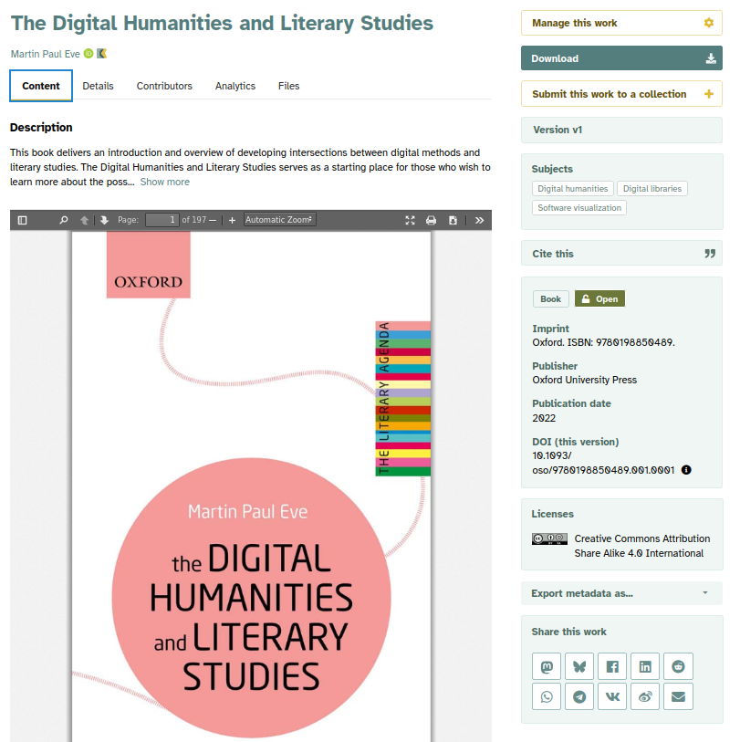
Works for Institutions
A robust, enterprise-grade institutional repository connected to a broader knowledge commons
Institutional branding
Fair pricing that beats all current commercial offerings

Slide 18
The End
Martin Paul Eve
Technical Lead, Knowledge Commons, MESH Research, Michigan State University
Professor of Literature, Technology, and Publishing, Birkbeck, University of London
evemarti@msu.edu | martin.eve@bbk.ac.uk

