Slide 1
Special Blend: Developing a Model for Technology-Enhanced, Flexible Learning HEA/SEEC Conference 2013
Leo Havemann and Liz Johnston Drew
Birkbeck, University of London

Slide 2
Context
Birkbeck is a medium sized HEI, part of the University of London, based in Bloomsbury
Birkbeck’s traditional “USP” is a wide ranging offer of research-led teaching in Central London in the evening
The majority of our students are mature, part time and taught F2F
Attendance in person, in Bloomsbury often seen as a key feature of the Birkbeck experience
Pockets of distance learning exist but TEL use is mainly to support our traditional approach - widespread but not innovative
Recruitment and retention, transition to postgraduate study are ‘hot topics’

Slide 3
Consultancy via “Changing the Learning Landscape”
Leadership Foundation
NUS
The Higher Education Academy (HEA)
Association for Learning Technology (ALT)
JISC
Consultants:
Alison LeCornu, HEA
Amanda Jefferies, University of Hertfordshire

Slide 4
The Team
Joana Barros, TEL Champion and Lecturer in GIS, School of Social Sciences, History and Philosophy
Leo Havemann, Learning Technologist, IT Services
Joanne Leal, Assistant Dean for Learning and Teaching and Senior Lecturer in German, School of Arts
Vincent Tong, TEL Champion and Senior Lecturer in Geophysics, School of Science
Liz Johnston Drew, Research and Development Manager and Tutor, History of Art and Screen Media, School of Arts
Fleur Rothschild, Learning Support Adviser, School of Arts

Slide 5
Overarching aim of consultancy project
The development and use of learning technologies to expand the College’s concept of flexible learning in ways which will allow Birkbeck to offer more support to its existing student body and attract new students.

Slide 6
What we proposed to do
Develop a new model for flexible teaching and learning which
will encompass flexible delivery, combining face-to-face, self-managed and distance learning elements;
should have the potential to impact on teaching across departments in the College at all programme levels, allowing Birkbeck to reach and support students who require more flexible teaching patterns than those we currently offer.

Slide 7
Specific aim (pilot project)
To pilot this model by developing a module which will help Birkbeck both to deal with recruitment and retention challenges and to meet its commitment to life long learning.

Slide 8
The pilot module
A pre-entry module to bridge the transition from undergraduate to postgraduate studies, using flexible delivery to address the recruitment and retention of students at Masters level.
Directed at potential postgraduate students who require skills training before starting a programme, for instance because they come from a non-standard educational background or lack the confidence to start postgraduate studies.
Disciplinary based in a broad sense, i.e. there should/could be one for each School.

Slide 9
Phases of the project
Phase One: development of a generic teaching plan using flexible delivery
Determine choice of ratio between different kinds of pedagogic elements (distance learning, self-managed study, face-to-face), taking into account their distribution over time, interrelationship and appeal to different audiences.
Set out the appropriate combination of technology and traditional pedagogic elements which will make up the ‘special blend’ of teaching elements to sustain Birkbeck’s teaching identity.

Slide 10
Phases of the Project
Phase Two: creating the content to fill the generic plan
This phase will allow us to test the effectiveness of the model for delivering flexible learning in different disciplinary contexts.
Results from the second stage will serve as feedback for the initial model, which might need to be modified to encompass results from the testing phase.

Slide 11
Feasibility of the Project
Factors to bear in mind:
The project needs to be aligned to Birkbeck’s learning and teaching and retention strategies
The choice and ratio of blended pedagogic elements needs to take into account how the flexible delivery mode might appeal to existing and new students
The final module needs to be cost effective both in terms of cost to the student and in terms of running costs.

Slide 12
Thinking flexibly
Although we perceive technology as a key element in making the module flexible, the use of TEL does not in itself constitute ‘flexible learning’.
According to the HEA, flexible learning is
about providing learners with choices
helps to attract and meet the needs of an increasingly diverse range of students and includes making appropriate use of technology
is about enabling choice and responsiveness in the pace, place and mode of learning.
Source: http://www.heacademy.ac.uk/flexible-learning

Slide 13
The Challenge
Assuming you are working in the same context we have described, your ‘team’ is now working on developing a model for technology-enhanced, flexible learning…
What aspect(s) of flexibility are you going to implement, and how do you plan to apply it?
Which issue(s) is your flexible approach going to address?
What issues might adoption of flexibility potentially cause?
Please discuss and report back.

Slide 14
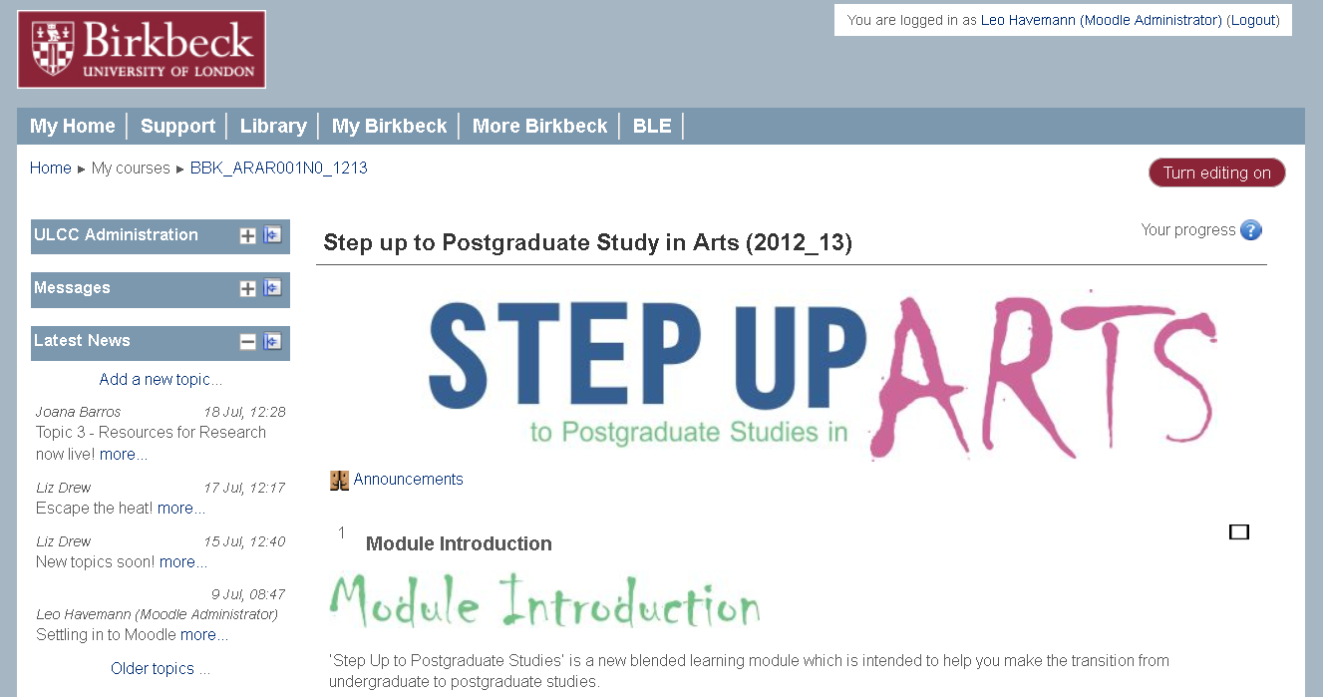
The result...

Slide 15
The generic template (pilot version)
Each module contains:
6 weeks worth of content
6 different topics
01 synchronous event
01 marking point
02 face-to-face events
Each topic = learning materials containing:
self-evaluation exercise,
video lectures,
text-based materials,
tasks and tests,
a piece of assessment, and
tips for further learning.

Slide 16
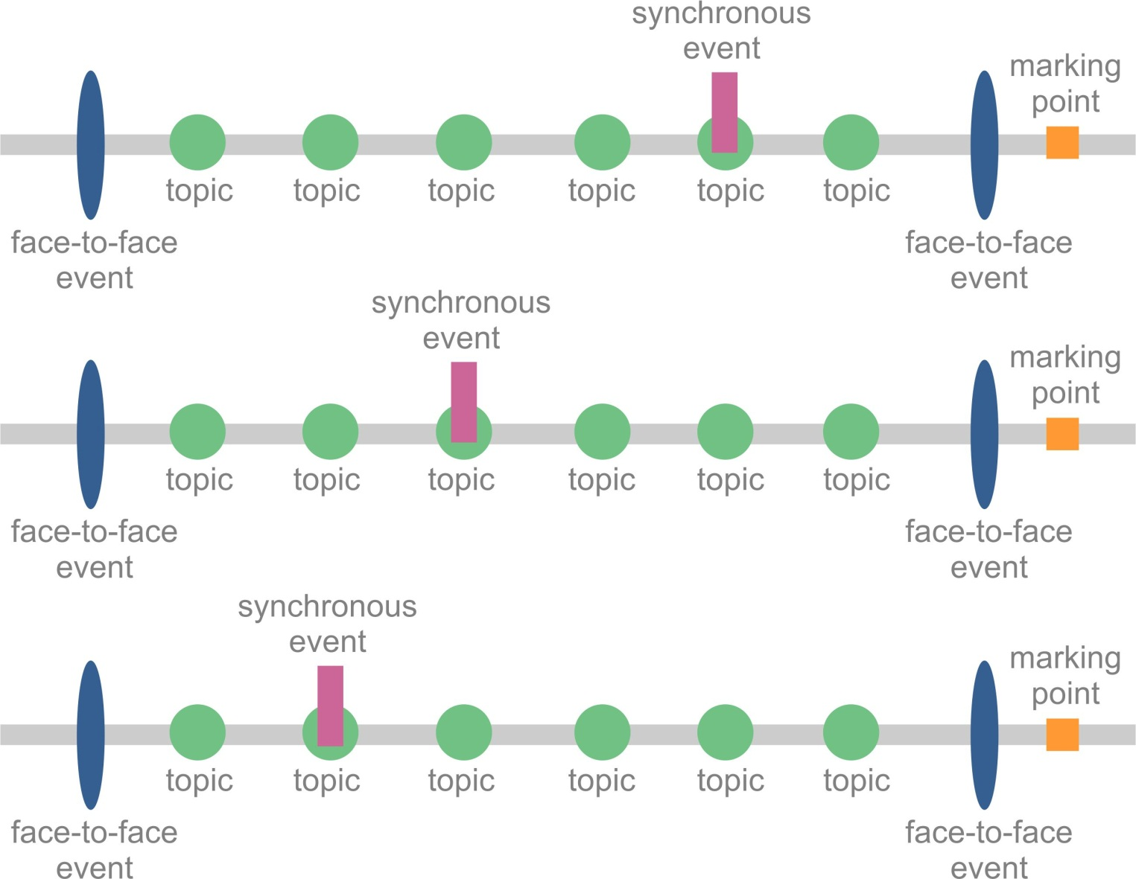
The generic template (‘fully flexible’)
January
March
April
June
July
September

Slide 17
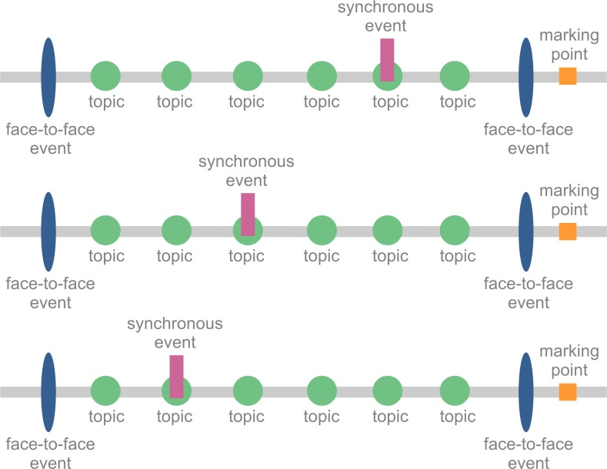
The Generic Template
Flexible delivery
Choice of start and end date (Jan – Sept)
Choice of order of topics
Choice of time spent per topic (self-assessment for informed choice)
Choice of dates for face-to-face events
Choice for synchronous or recorded events (including F2F events)
Choice for deadlines for assignment submission (marking points)

Slide 18
Our questions
What do you think is good or bad about this model?
How can it be improved?
What should we include that we haven’t included?

Slide 19
Your questions?
Ask us now - or send us an email later
Leo: l.havemann@bbk.ac.uk
Liz: e.drew@bbk.ac.uk
Thank you for listening and participating.

